Slide 1
Spot that rock: rock identification – online
Earth Science for science and geography
– online workshop
Developed from the Earth Science Education Unit ‘Spot that rock’ workshop, with permission
© Copyright is waived for original material contained in this workshop if it is required for use within the laboratory or classroom. Copyright material contained herein from other publishers rests with them. Any organisation wishing to use this material should contact the Earthlearningidea team.
Notes:
1

Slide 2
Spot that rock
Early warning The online version of this workshop works best if it is carried out by three people working together, with the following materials and apparatus:
pieces around 3-5 cm across of: porous sandstone (the grainy rock); granite (the speckled rock) and gneiss (the striped rock)
a hand lens or magnifier
glass(es) or beaker(s) big enough for the rock specimens, half full of water
a cloth/paper towel to dry the rocks
a teaspoon
the printed off sorting cards or paper/sticky notes and a pen/pencil
Gather these things together and enjoy the workshop
Notes:
2

Slide 3
Spot that rock
Early warning You do not need these for the online workshop, but if you want to complete all the activities, you will also need:
an electronic balance
magnetic or sticky shapes (circles or rectangles/squares)
a glass or beaker (e.g. 250 ml) full of marbles
a measuring jug/cylinder of water
an interlocking model (wooden or Lego™)
specimens of a range of additional rocks including:
the sedimentary rocks: limestone, mudstone, conglomerate
the igneous rocks: basalt, gabbro
the metamorphic rocks: slate, schist, marble, metaquartzite
Notes:
3

Slide 4
Earthlearningidea online video workshops
Purpose – ESEU background
Most Earthlearningidea online video workshops are based, with permission, on workshops originally developed by the Earth Science Education Unit (ESEU)
These were designed as interactive workshops for teachers and trainees, involving interaction, discussion and presentations by participants to others
Global research into professional development workshops shows that these aspects are critical to success
ESEU research shows that this workshop approach is highly successful in changing teaching in schools; evaluation feedback has also been very strong

Slide 5
Earthlearningidea online video workshops
Purpose – Earthlearningidea development
The Earthlearningidea Team has developed the ESEU workshops into online video workshops for those unable to take part in face to face interactive workshops
Each workshop is led by a PowerPoint presentation and has an accompanying booklet that contains all the activity background details, resource lists, risk assessments, etc.
The individual workshop activities have been published for open access online at the website: https://www.earthlearningidea.com/
Each workshop activity has a question script and a video keyed into CASE principles, that can be accessed through the PowerPoint hyperlinks
The aim is to facilitate online Earth science learning

Slide 6
Earthlearningidea online video workshops
Teaching Earth science using the Cognitive Acceleration through Science (CASE) approach
The activities in this workshop are keyed into the CASE approach – to develop thinking skills while teaching key Earth science material
If you are unfamiliar with the case approach, you can access a video introduction at: https://www.earthlearningidea.com/Video/CASE.html
An exemplar Earth science teaching activity with a question script using the CASE approach is at: https://www.earthlearningidea.com/Video/Atmosphere_ocean.html
Notes:
6

Slide 7
Earthlearningidea online video workshops
Running Earthlearningidea online video workshops
Each workshop is led by a PowerPoint presentation
Launch the PowerPoint
Some slides contain hyperlinks to MP4 video files
Run the hyperlinked files and then return to the PowerPoint, flick through any slides you have already seen, and continue
The workshop is presented in this way so that the workshop itself, or individual videos, can be used in classroom teaching

Slide 8
Spot that rock
Workshop run times |  | m | s | m | s
Spot that rock |  |  |  | 24 | 00
Activity 1. Rock clues |  |  |  | 1 | 46
Activity 2. Grain clues |  |  |  | 1 | 32
Activity 3. Predicting properties |  |  |  | 2 | 39
Activity 4. Rocky modelling | 2D model | 2 | 00 | 5 | 18
 | adding water | 1 | 07
 | options | 1 | 09
 | tipping container/ rock | 1 | 02
Activity 5. Weak or strong? |  |  |  | 0 | 36
Activity 6. Rock sort 1 – two great groups |  |  |  | 1 | 43
Activity 7. Rock sort 2 – striped rock |  |  |  | 3 | 34
Activity 8. Rock sort 3 – all rocks |  |  |  | 0 | 48
Activity 9. Sedimentary to metamorphic |  |  |  | 1 | 28
Activity 10. Naming rocks |  |  |  | 4 | 36
Notes:
8

Slide 9
Spot that rock
Earth science for geography and science
The workshop is based on this pdf booklet originally prepared by the Earth Science Education Unit and now available on the Earthlearningidea website. It contains a workshop summary, the outcomes, teacher guidance, risk assessments and resources lists – as in the following slides
Notes:
9

Slide 10
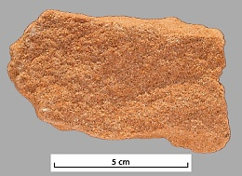
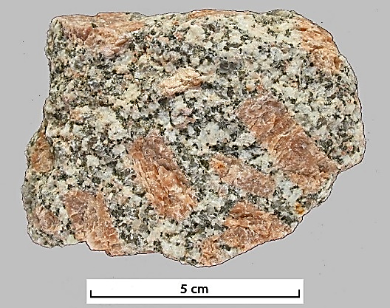
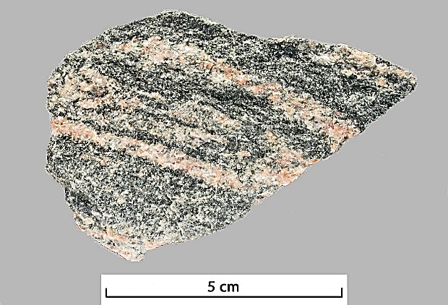
Spot that rock
‘Spot that rock’ leads you step by step through a series of investigative practical activities that will allow you to teach pupils to investigate and sort most rocks from first principles (and distinguish them yourself). The techniques are then applied in describing and classifying a series of unknown rocks.
The approach of using reliable characteristics to group and name rocks is based on the work of Duncan Hawley
Notes:
10

Slide 11
Spot that rock
Workshop outcomes
The workshop and its activities provide the following outcomes:
an introduction to a structured scheme of rock description and identification based upon the reliable characteristics of rocks, involving:
identifying key terms in describing rocks;
identifying key terms in describing the grains in rocks, using a magnifier/ hand lens;
testing for permeability;
modelling rock structures;
testing the strength of rocks;
classifying and naming rock groups;
practical activities giving opportunity for investigation and discussion.
Notes:
11

Slide 12
Spot that rock
The workshop uses the following sequence of activities:
Activity 1 Rock clues |  | Activity 2 Grain clues |  | Activity 3 Predicting properties |  | Activity 4 Rocky modelling
Recognise rock properties |  | Recognise grain properties |  | Testing porosity/ permeability |  | Making 2D and 3D rock models
Activity 5 Weak or strong? |  | Activity 6 Rock sort 1 |  | Activity 7 Rock sort 2 |  | Activity 8 Rock sort 3
Testing strength: finding how easy it is to remove grains |  | Sorting a sedimentary from a crystalline rock |  | Sorting igneous from metamorphic rock |  | Sorting a range of rocks
Activity 9 Sedimentary to metamorphic |  | Activity 10 Naming rocks
Sedimentary linked to metamorphic rocks |  | Using sorting cards to name rocks
Notes:
12

Slide 13
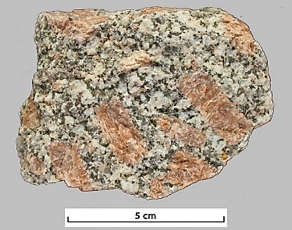
The speckled rock
The grainy rock
Spot that rock
1. Rock clues
Go to: https://www.earthlearningidea.com/Video/V15_Spotrock1.html hyperlink
Notes:
13

Slide 14
The speckled rock
The grainy rock
Spot that rock
1. Rock clues
In a group of three, look at the two rocks you have been given, the speckled rock and the grainy rock. The person on the left of the group should pick up the speckled rock and describe it (what it looks like, feels like, etc.) to the person on the right. The person in the middle should note down key words that are used. When this is done, swap over, one describes the grainy rock to the second person and the third person makes notes.
Then think:
‘Which key words were used in both descriptions?’
Notes:
14

Slide 15
Spot that rock
1. Rock clues
In a group of three, look at the two rocks you have been given, the speckled rock and the grainy rock. The person on the left of the group should pick up the speckled rock and describe it (what it looks like, feels like, etc.) to the person on the right. The person in the middle should note down key words that are used. When this is done, swap over, one describes the grainy rock to the second person and the third person makes notes.
Then think:
‘Which key words were used in both descriptions?’
Possible answer
The words bits, colour, heavy and rough/smooth are often used.
We will now use a scientific word for the ‘bits’ in rocks – grains.
Notes:
15

Slide 16
Spot that rock
2. Grain clues
Go to: https://www.earthlearningidea.com/Video/V15_Spotrock2.html hyperlink
Notes:
16

Slide 17
Spot that rock
2. Grain clues
Now repeat the activity, but using a magnifier or hand lens to describe the grains of the two rocks to one another whilst the third person makes notes.
Note: The correct way to use a magnifier or hand lens, is to hold the magnifier/hand lens up to your eye, and then move the object you’re viewing closer and closer until it comes into focus.
Possible answer
The words, shape, size, colour and shininess are often used.
We are going to investigate the importance of the shape of the grains further now.
Looking closely at a rock using a magnifier
(Hazel Benson)
Notes:
17

Slide 18
Spot that rock
3. Predicting properties
Go to: https://www.earthlearningidea.com/Video/V15_Spotrock3.html hyperlink
Notes:
18

Slide 19
Spot that rock
3. Predicting properties
Discuss and predict what will happen to the masses of the rocks when they are placed in water. There are only three possible options - the rocks could:
stay the same weight;
get heavier;
become lighter.
Be ready to discuss and explain your predictions.
Notes:
19

Slide 20
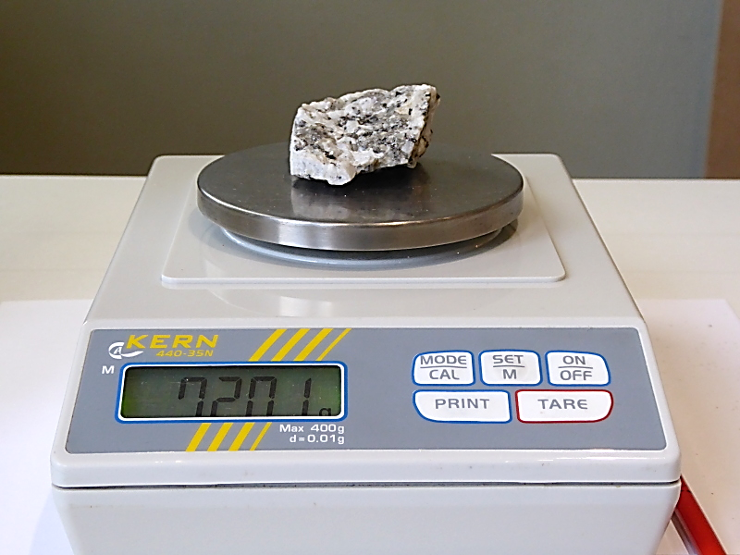
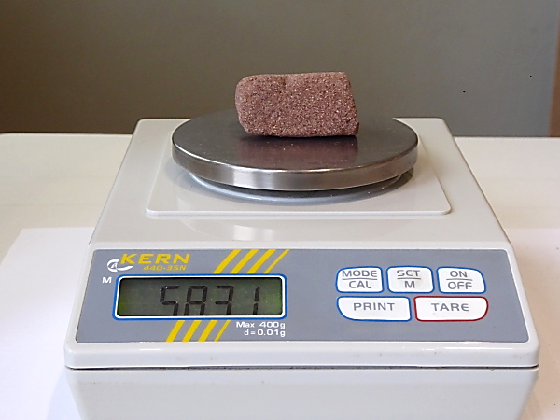
Optional extra
Spot that rock
3. Predicting properties
If you have time – ask each group to find the mass of each of the dry rocks using an electronic balance, and record the masses
Notes:
20

Slide 21
Spot that rock
3. Predicting properties
Now each group should put the samples, at the same time, into a clear plastic container of water and watch carefully to see what happens. Then they should take them out again after about 30 seconds and dry them with towels (paper or cloth).
Notes:
21

Slide 22
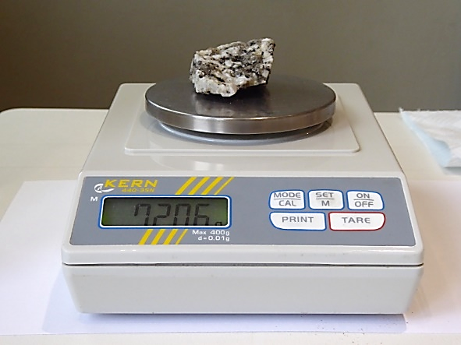
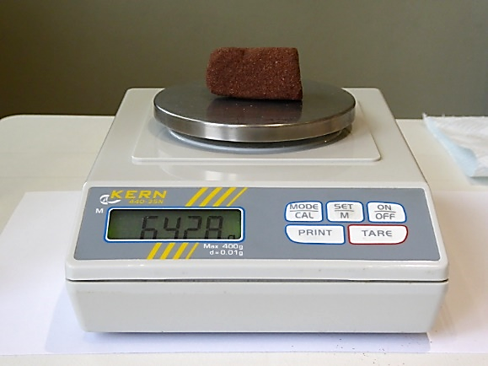
Optional extra
Spot that rock
3. Predicting properties
If you have time – ask each group to find the mass of each of the wet rocks using an electronic balance, and record the masses
For the rocks shown in the photos:
Rock type | Mass before putting in water, g | Mass after putting in water, g | Difference, g | % change
Speckled rock | 72.01 | 72.06 | 0.06 | 0.08
Grainy rock | 58.31 | 64.28 | 5.97 | 10.24
Speckled rock porosity = 0%
Grainy rock porosity = just over 10%
Notes:
22

Slide 23
Spot that rock
3. Predicting properties
The grainy rock has increased markedly in mass but the speckled hasn’t (very sensitive scales show that the speckled rock has increased slightly in mass because it is still damp).
Possible answer
The predictions were probably correct (apart from the small increase in mass of the speckled rock).
Notes:
23

Slide 24
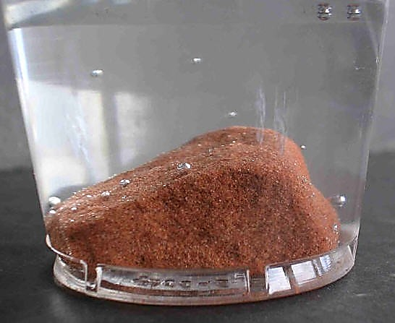
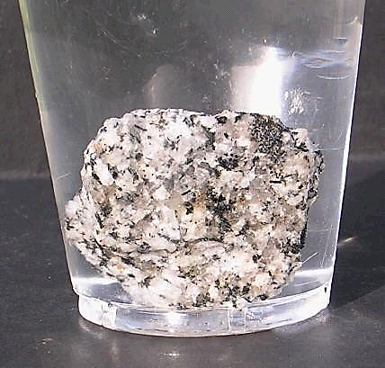
Spot that rock
3. Predicting properties
If you have observed the samples carefully, you should have seen a few bubbles on the surface of the speckled rock. But many more bubbles come from the grainy rock, and continue to bubble as the air is driven out.
Grainy rock ‘bubbling’
in a plastic beaker (Peter Kennett)
Speckled rock not ‘bubbling’ in a plastic beaker (Peter Kennett)
Notes:
24

Slide 25
Spot that rock
3. Predicting properties
It is useful to have a discussion on how the air is driven out. Do most of the bubbles come from the bottom or the top? Does most of the water go in at the bottom or the top? Are the pores (gaps between the grains) likely to be interconnected?
The air rises from the top, as it has a lower density than water, this allows atmospheric pressure to push water into the bottom to replace it, showing that the pore spaces must be interconnected and the rock is permeable (permeability is the flow of fluid through a material). So, the bubbles come from the top as water is pushed into the bottom.
Notes:
25

Slide 26
Spot that rock
3. Predicting properties
Note: The rate of flow of a fluid (liquid or gas) through a material is its permeability. This depends on the porosity – which is the percentage of pore space in the material.
So permeability is a measure of fluid flow (e.g. 22 millilitres per second through a surface area of 1 centimetre squared) whilst porosity is a measure of the percentage pore space (e.g. 15% porosity)
Rocks with a high percentage of porosity (lots of pore space), where the pores are interconnected and not too small for fluid to flow through, also have high permeability. Low porosity gives low permeability.
Notes:
26

Slide 27
Spot that rock
4. Rocky modelling
Go to: https://www.earthlearningidea.com/Video/V15_Spotrock4.html hyperlink
Notes:
27

Slide 28
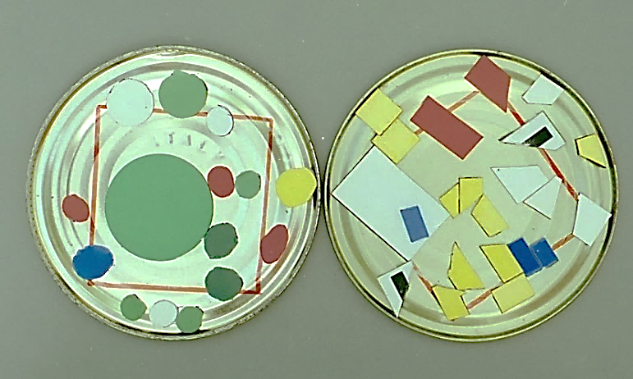
Spot that rock
4. Rocky modelling
Make a 2D model of the grains in the grainy and the speckled rock in a tessellation exercise using sticky shapes stuck onto paper, magnetic shapes on a magnetic board or shapes on an interactive whiteboard.
Use circular and square or rectangular shapes that don’t overlap to cover up as much space as possible.
Tessellation exercise with magnetic shapes (Peter Kennett)
It quickly becomes clear that the circular shapes leave gaps, whilst the rectangular shapes do not.
Tessellation exercise with
sticky shapes (Chris King)
Notes:
28

Slide 29
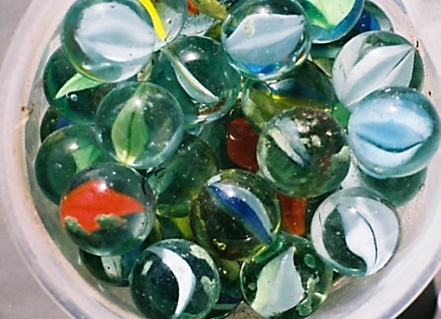
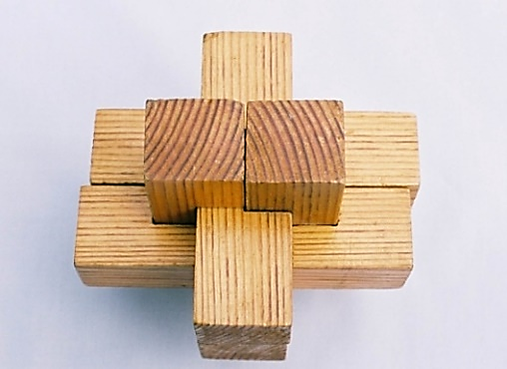
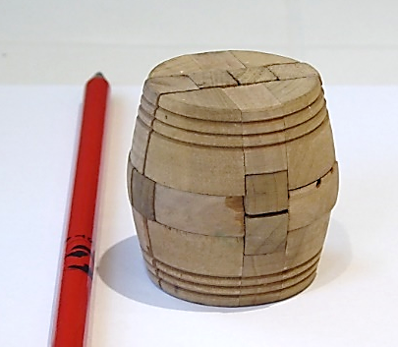
Spot that rock
4. Rocky modelling
Go from this 2D pattern into a 3D concept using an interlocking wooden model (or a Lego™ model) and marbles in a glass or jar.
Container of marbles
(Peter Kennett)
Interlocking wooden
model (Peter Kennett)
Interlocking wooden
model (Chris King)
Interlocking Lego™
model (Chris King)
How much space do you think there is in the interlocking model and in the container of marbles?
Notes:
29

Slide 30
Spot that rock
4. Rocky modelling
How much space do you think there is in the interlocking model and in the container of marbles?
Possible answer
The interlocking model will have no space;
The container of marbles may have about a quarter space.
Notes:
30

Slide 31
Spot that rock
4. Rocky modelling
How much space do you think there is in the interlocking model and in the container of marbles?
Possible answer
The interlocking model will have no space;
The container of marbles may have about a quarter space.
Go to: https://www.earthlearningidea.com/Video/V15_Spotrock5.html hyperlink
Notes:
31

Slide 32
Spot that rock
4. Rocky modelling
How much space do you think there is in the interlocking model and in the container of marbles?
You might be amazed as more and more water is poured into the container of marbles – which is almost half space. This is a measure of porosity – the porosity here is nearly 50%. Rocks with high porosity are usually very permeable, allowing fluids to flow through (except when pore spaces are very small and water can’t flow through, as in clay). The interlocking model has no pore-space.
The marbles in the container are like the grainy rock – with lots of gaps between the spherical grains. The interlocking model is like the speckled rock, made of interlocking grains with no spaces.
Notes:
32

Slide 33
Optional extra
Spot that rock
4. Rocky modelling
Go to: https://www.earthlearningidea.com/Video/V15_Spotrock6.html hyperlink
Notes:
33

Slide 34
Optional extra
Spot that rock
4. Rocky modelling
Calculate the porosity of the container full of marbles seen, by:
measuring the volume of water needed to fill the marble-filled container to the top with water
removing the marbles and measuring the volume of the empty container, to the top
calculating the percentage porosity, using the equation:
volume of water needed to fill the marble-filled container, ml X 100
volume of water needed to fill the empty container, ml
The porosity of the marble-filled container seen in the video was:
150 ml X 100 = 50%
300 ml
Notes:
34

Slide 35
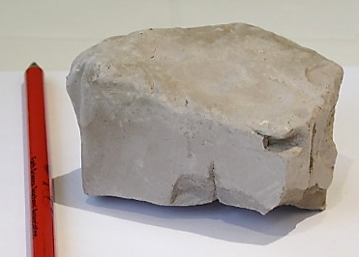
Optional extra
Spot that rock
4. Rocky modelling
More on porosity and permeability
The Lego™ model shows the difference between porosity and permeability. The model is porous (because the bricks are hollow) but impermeable because the pore spaces are not connected.
Interlocking Lego™
model (Chris King)
This is like a solid lava with bubbles (basalt) – the bubbles make the rock porous but they are not interconnected so it is impermeable
It is also like clay, which has lots of pore spaces making it porous, but these are so small that fluids cannot flow though so it is impermeable
Impermeable lava with bubbles (Chris King)
Impermeable clay (Chris King)
Notes:
35

Slide 36
Spot that rock
4. Rocky modelling
When the pot is tipped the marbles fall out – but you can’t tip out the grains from the grainy rock. Why not?
Go to: https://www.earthlearningidea.com/Video/V15_Spotrock7.html hyperlink
Notes:
36

Slide 37
Spot that rock
4. Rocky modelling
When the pot is tipped the marbles fall out – but you can’t tip out the grains from the grainy rock. Why not?
Possible answer
The grains in the grainy rock are stuck together – by some sort of ‘glue’.
This natural ‘glue’ is called ‘cement’ by Earth scientists.
Note: Grains are naturally glued together to form rocks when cement is deposited between the grains. As water flows through the pore spaces minerals crystallise out, sticking the grains together. Minerals are naturally formed chemical compounds and common mineral cements are quartz (silicon dioxide), calcite (calcium carbonate) and iron minerals.
Notes:
37

Slide 38
Spot that rock
5. Weak or strong?: Which are the strongest rocks?
Go to: https://www.earthlearningidea.com/Video/V15_Spotrock8.html hyperlink
Teaspoon (S. Sepp)
Notes:
38

Slide 39
Spot that rock
5. Weak or strong?: Which are the strongest rocks?
This investigates which makes a rock stronger, having interlocking grains or cemented grains.
Compare the two rocks by scraping them with a spoon or other metal object, such as a coin, on to a piece of paper.
Teaspoon (S. Sepp)
Notes:
39

Slide 40
Spot that rock
5. Weak or strong?: Which are the strongest rocks?
This investigates which makes a rock stronger, having interlocking grains or cemented grains.
Compare the two rocks by scraping them with a spoon or other metal object, such as a coin, on to a piece of paper.
Teaspoon (S. Sepp)
The difference is usually very clear – rocks crumble if the cement between the grains is not very strong (the grainy rock), whilst having interlocking crystals makes rocks strong (the speckled rock).
Notes:
40

Slide 41
Spot that rock
6. Rock sort 1 – two great groups
Go to: https://www.earthlearningidea.com/Video/V15_Spotrock9.html hyperlink

Slide 42
Spot that rock
You can now put the rocks into two great groups using two rock sorting cards (Cards 1 and 2):
‘Sedimentary’ rocks have grains stuck together (by glue or cement) and are permeable and weak
‘Crystalline’ rocks have interlocking grains/ crystals with no permeability and are strong
6. Rock sort 1 – two great groups
Note: if these printed off rock sorting cards are not available, either use the cut out rock description cards or paper/sticky notes and a pen or pencil to write labels for the specimens.

Slide 43
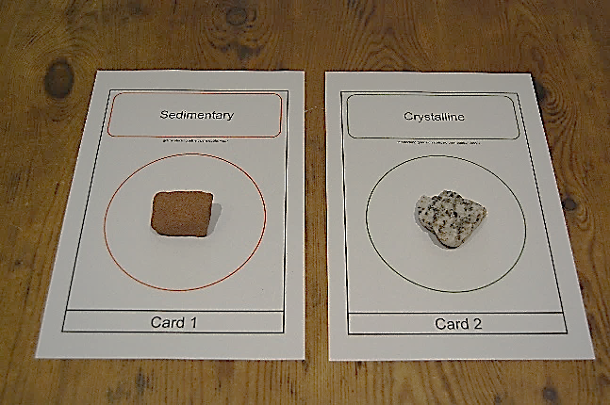
Spot that rock
You can now put the rocks into two great groups using two sorting cards (Cards 1 and 2) :
‘Sedimentary’ rocks have grains stuck together (by glue or cement) and are permeable and weak
‘Crystalline’ rocks have interlocking grains/ crystals with no permeability and are strong
6. Rock sort 1 – two great groups
The clues are in how the grains are linked to each other – the grain relationships.

Slide 44
Spot that rock
You can now put the rocks into two great groups using two sorting cards (Cards 1 and 2) :
‘Sedimentary’ rocks have grains stuck together (by glue or cement) and are permeable and weak
‘Crystalline’ rocks have interlocking grains/ crystals with no permeability and are strong
6. Rock sort 1 – two great groups
The clues are in how the grains are linked to each other – the grain relationships.

Slide 45
Spot that rock
6. Rock sort 1 – two great groups
Sedimentary rocks
These are so called because they are formed of sediment. Sediment grains are pieces of material which have been transported before being deposited.
Crystalline rocks
These are made of crystals which have grown during formation of the rock and so are interlocking. The crystals are minerals. Minerals are naturally formed chemical compounds and sometimes (although not here), chemical elements.
Notes:
45

Slide 46
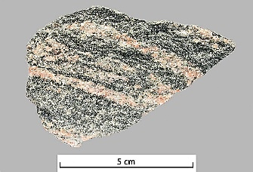
The striped rock
Spot that rock
7. Rock sort 2 – the striped rock
Take a specimen of the striped rock. Test it like you tested the other two rocks. Then put it onto the correct sorting card
Go to: https://www.earthlearningidea.com/Video/V15_Spotrock10.html hyperlink
Notes:
46

Slide 47
The striped rock
Spot that rock
7. Rock sort 2 – the striped rock
Take a specimen of the striped rock. Test it like you tested the other two rocks. Then put it onto the correct sorting card
It is another crystalline rock with interlocking grains/ crystals, with no permeability and strong.
Now sort the crystalline rocks into two major groups, based on their grain arrangements
(Cards 3 and 4):
‘Crystalline – Metamorphic’ rocks – crystals aligned in metamorphic layers
‘Crystalline – Igneous’ rocks – crystals have random orientations
Notes:
47

Slide 48
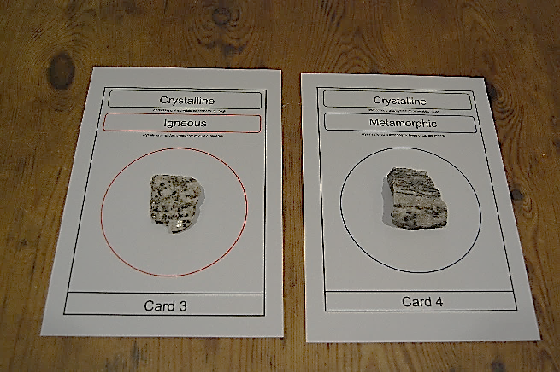
Spot that rock
7. Rock sort 2 – the striped rock
Take a specimen of the striped rock. Test it like you tested the other two rocks. Then put it onto the correct sorting card.
It is another crystalline rock with interlocking grains/ crystals with no permeability and strong.
Now sort the crystalline rocks into two major groups, based on their grain arrangements
(Cards 3 and 4):
‘Crystalline – Metamorphic’ rocks – crystals aligned in metamorphic layers
‘Crystalline – Igneous’ rocks – crystals have random orientations

Slide 49
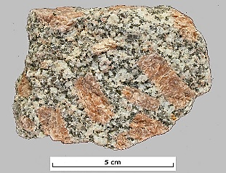
Spot that rock
7. Rock sort 2 – the striped rock
Take a specimen of the striped rock. Test it like you tested the other two rocks. Then put it onto the correct sorting card.
It is another crystalline rock with interlocking grains/ crystals with no permeability and strong.
Now sort the crystalline rocks into two major groups, based on their grain arrangements
(Cards 3 and 4):
‘Crystalline – Metamorphic’ rocks – crystals aligned in metamorphic layers
‘Crystalline – Igneous’ rocks – crystals have random orientations

Slide 50
Spot that rock
7. Rock sort 2 – the striped rock
Igneous rocks
These are formed from cooling liquid rock called magma. As magma cools different minerals with different properties crystallise with random orientations – eventually becoming a mass of interlocking crystals with no pore spaces between the grains that is very strong.
Metamorphic rocks
These are formed from other rocks (sedimentary, igneous or metamorphic) in the solid state by great increases of temperature and/or pressure. Those formed by pressure have layers or bands formed by aligned minerals as they recrystallise. The interlocking crystals have no pore spaces and the rocks are very strong.
Notes:
50

Slide 51
Spot that rock
To stop or to continue?
If the aim of your teaching is just to enable your pupils to investigate, name and understand the three great groups of rocks, you may want to stop this workshop here
However, if the aim of your teaching is to enable your pupils to investigate, name and understand not only the three rock groups but a range of sedimentary, igneous and metamorphic rocks as well – then continue on through the workshop, including:
8. Rock sort 3
9. From sedimentary to metamorphic
10. Naming rocks
Notes:
51

Slide 52
Spot that rock
8. Rock sort 3 – all rocks
Take all the other specimens. Test them like you tested the other rocks. Then take the new set of three sorting cards (Cards 5, 6 and 7) and use the clues in the rocks to put them onto the cards in the correct places.
Go to: https://www.earthlearningidea.com/Video/V15_Spotrock11.html hyperlink

Slide 53
Spot that rock
8. Rock sort 3 – all rocks
Take all the other specimens. Test them like you tested the other rocks. Then take the new set of three sorting cards (Cards 5, 6 and 7) and use the clues in the rocks to put them onto the cards in the correct places.
The right hand side of the ‘Metamorphic’ sorting card (Card 6) should be folded over

Slide 54
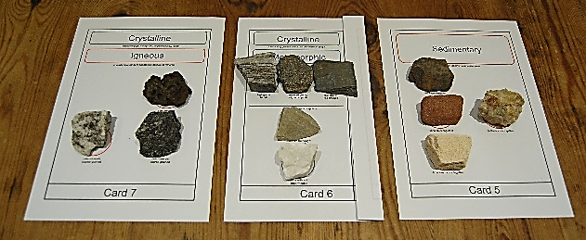
Spot that rock
8. Rock sort 3
Take all the other specimens. Test them like you tested the other rocks. Then take the new set of three sorting cards (Cards 5, 6 and 7) and use the clues in the rocks to put them onto the cards in the correct places.
The right hand side of the ‘Metamorphic’ sorting card (Card 6) should be folded over

Slide 55
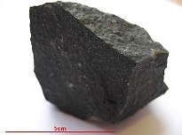
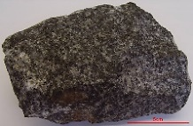
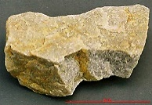
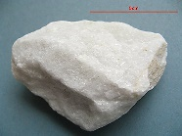
Spot that rock
8. Rock sort 3
Take all the other specimens. Test them like you tested the other rocks. Then take the new set of three sorting cards (Cards 5, 6 and 7) and use the clues in the rocks to put them onto the cards in the correct places.
The right hand side of the ‘Metamorphic’ sorting card (Card 6) should be folded over

Slide 56
Spot that rock
9. From sedimentary to metamorphic
Go to: https://www.earthlearningidea.com/Video/V15_Spotrock12.html hyperlink

Slide 57
Spot that rock
9. From sedimentary to metamorphic
Unfold the right hand side of the ‘metamorphic’ sorting card (Card 6).
Then put the sedimentary rocks in the right places.
This shows how different sorts of metamorphic rocks are formed from different types of sedimentary rocks.

Slide 58
Spot that rock
9. From sedimentary to metamorphic
Unfold the right hand side of the ‘metamorphic’ sorting card (Card 6).
Then put the sedimentary rocks in the right places.
This shows how different sorts of metamorphic rocks are formed from different types of sedimentary rocks.

Slide 59
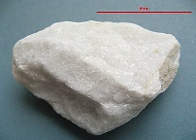
Spot that rock
9. From sedimentary to metamorphic
Unfold the right hand side of the ‘metamorphic’ sorting card (Card 6).
Then put the sedimentary rocks in the right places.
This shows how different sorts of metamorphic rocks are formed from different types of sedimentary rocks.

Slide 60
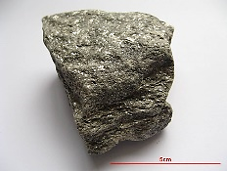
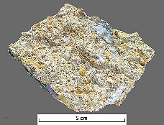
mudstone
Spot that rock
slate
9. From sedimentary to metamorphic
From mudstone to …
Under increasing heat and pressure, a mudstone first becomes slate, then schist, then gneiss
From sandstone to …
Under increasing heat and pressure, a sandstone becomes metaquartzite (sometimes called just ‘quartzite’)
From limestone to …
Under increasing heat and pressure, limestone becomes marble
Metamorphic rocks are not porous; they are stronger than sedimentary rocks
schist
gneiss
sandstone
metaquartzite
limestone
marble
Notes:
60

Slide 61
Spot that rock
Naming rocks
Use the remaining set of three sorting cards (Cards 8, 9 and 10) to place the rocks in the right places – so naming the rocks
Go to: https://www.earthlearningidea.com/Video/V15_Spotrock13.html hyperlink

Slide 62
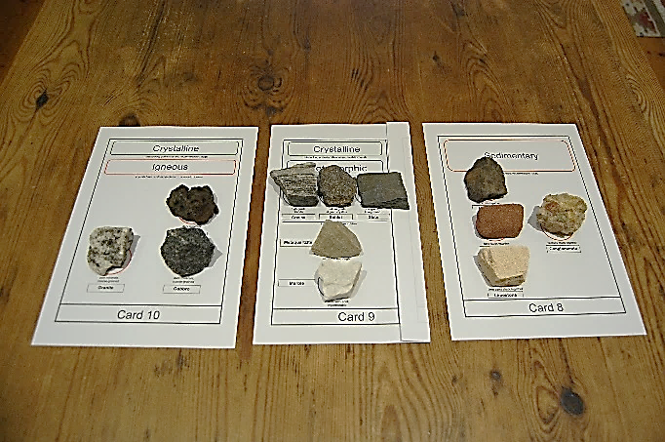
Spot that rock
Naming rocks
Use the remaining set of three sorting cards (Cards 8, 9 and 10) to place the rocks in the right places – so naming the rocks

Slide 63
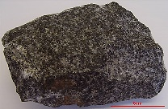
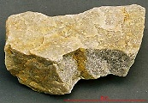
Spot that rock
Naming rocks
Use the remaining set of three sorting cards (Cards 8, 9 and 10) to place the rocks in the right places – so naming the rocks

Slide 64
Spot that rock
10. Naming rocks
Sedimentary rocks
Fine-grained sedimentary rocks are mudstones (or shale or clay); medium-grained sedimentary rocks are sandstones; coarse-grained sedimentary rocks are conglomerates. Sedimentary rocks made of carbonate minerals (react with acid) are limestones
Igneous rocks
Coarse-grained igneous rock, formed by slow cooling from liquid rock (magma). If they are pale in colour they are granites, if they are dark in colour they are gabbro. Fine-grained dark igneous rock, formed by fast cooling from liquid rock (magma) in lava flows is called basalt
Gabbro and basalt are both dark in colour because they contain the same iron-rich minerals
mudstone
sandstone
conglomerate
limestone
granite
gabbro
basalt
Notes:
64

Slide 65
Spot that rock
10. Naming rocks
As we are dealing with ‘the real world’ there are some important exceptions to this classification method:
some sedimentary rocks are well cemented with a strong cement and so are not porous or weak – but are nevertheless formed of grains stuck together;
some metamorphic rocks are not formed under pressure (but mainly by heat) and so have random grain orientation;
some metamorphic rocks contain only one mineral, and so banding or layering cannot be seen;
some igneous rocks can be weakened by gas bubbles or weathering and so can be fairly weak.
Notes:
65

Slide 66
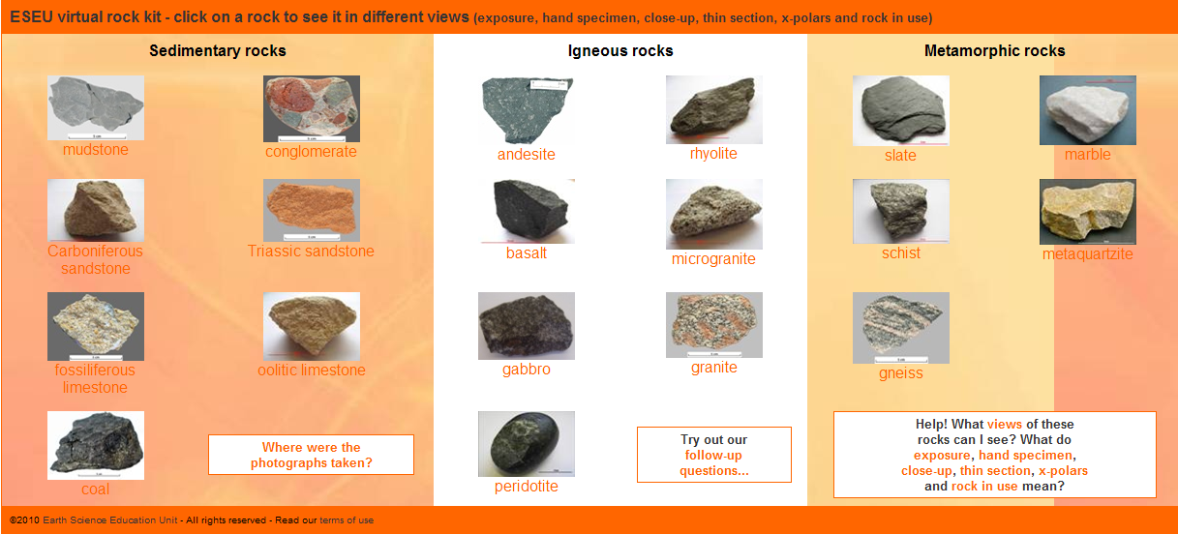
Spot that rock
Virtual Rock Kit
See https://www.earthlearningidea.com/virtual_rock_kit/START.htm to see a ‘kit’ of specimens of common rocks; they are also shown enlarged, under the microscope, in exposure and in use

Slide 67
Spot that rock
Workshop outcomes
The workshop and its activities provide the following outcomes:
an introduction to a structured scheme of rock description and identification based upon the reliable characteristics of rocks, involving:
identifying key terms in describing rocks;
identifying key terms in describing the grains in rocks, using a magnifier/ hand lens;
testing for permeability;
modelling rock structures;
testing the strength of rocks;
classifying and naming rock groups;
practical activities giving opportunity for investigation and discussion.
Notes:
67

Slide 68
Spot that rock – online
Earth Science for science and geography
– online workshop
Developed from the Earth Science Education Unit ‘Spot that rock’ workshop, with permission
© Copyright is waived for original material contained in this workshop if it is required for use within the laboratory or classroom. Copyright material contained herein from other publishers rests with them. Any organisation wishing to use this material should contact the Earthlearningidea team.
Notes:
68

