Slide 1
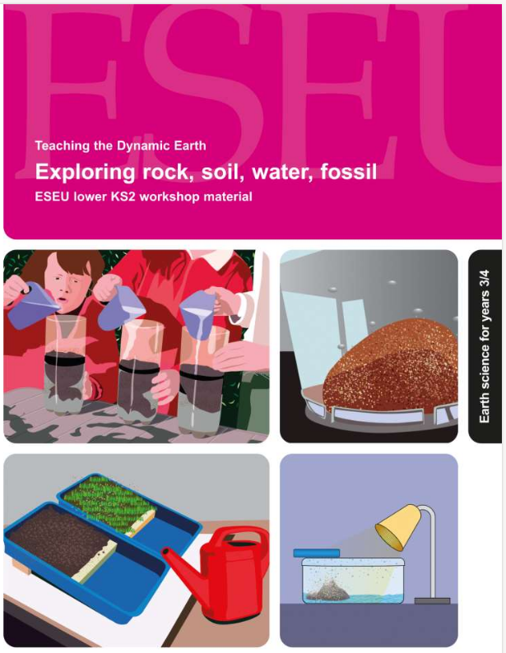
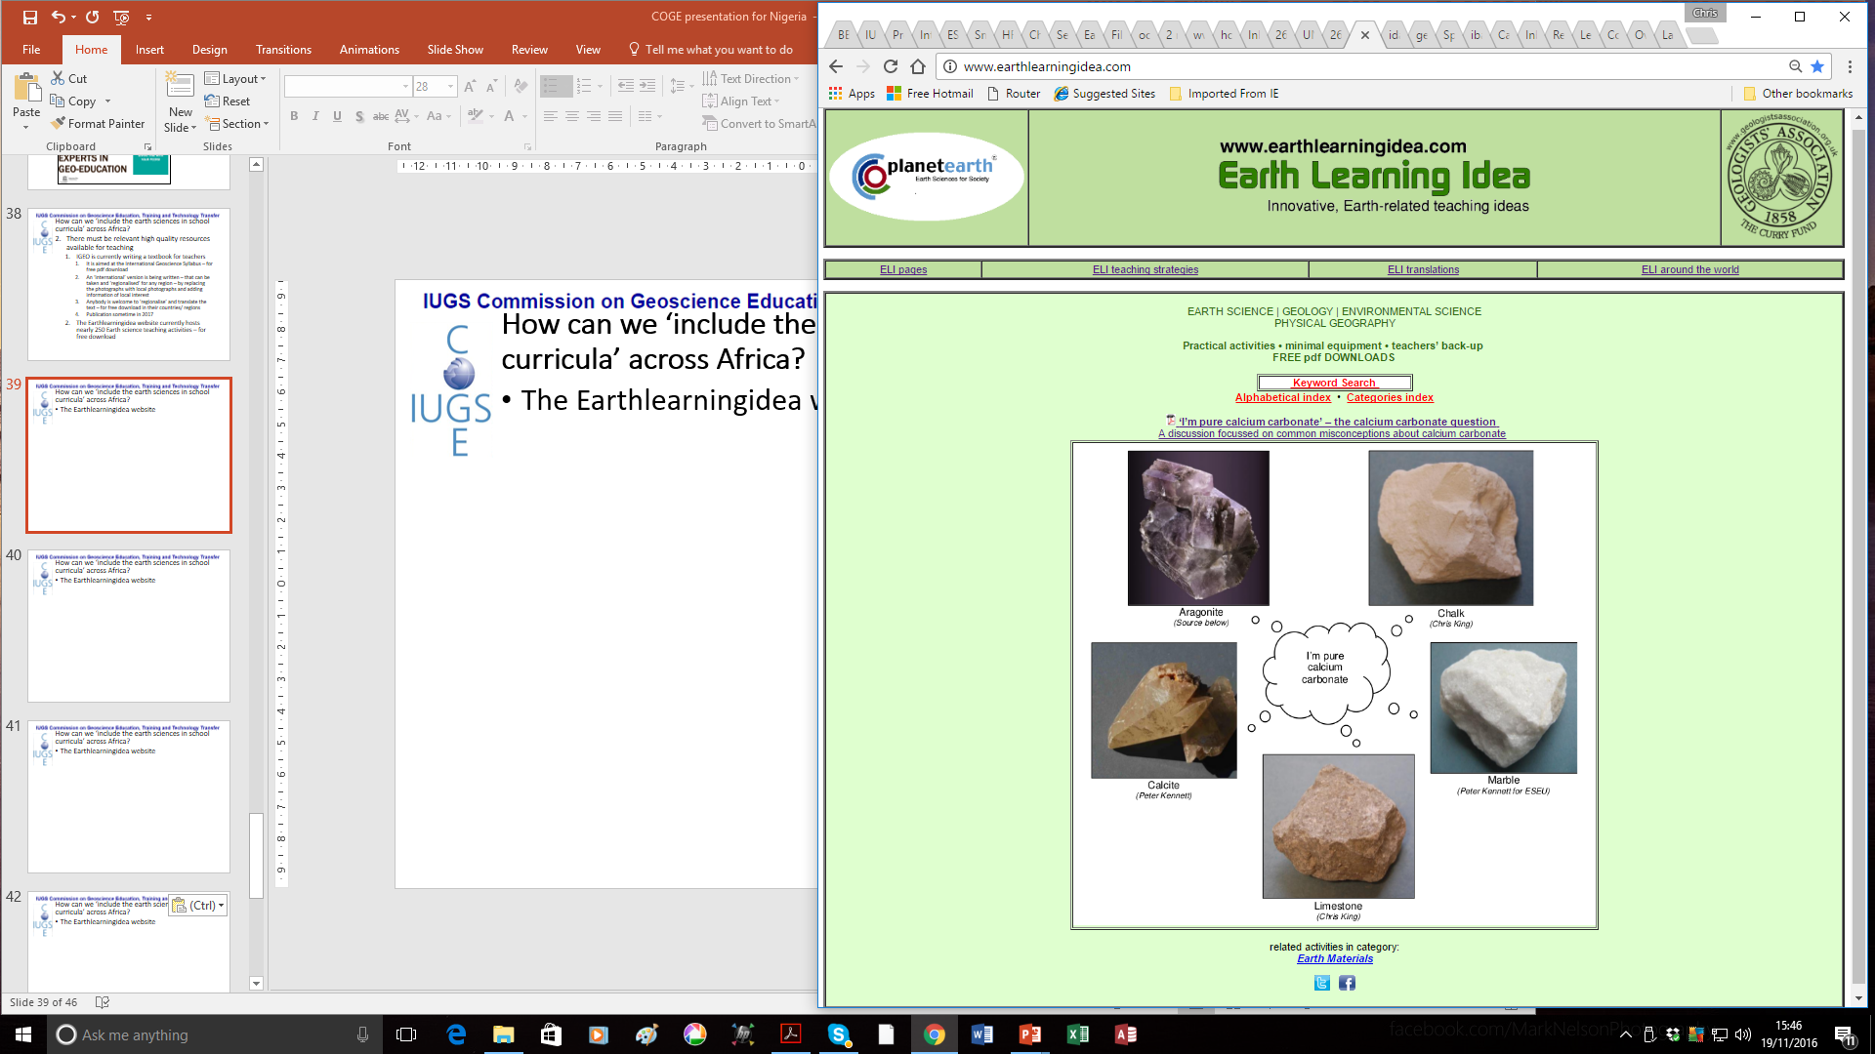
Exploring rock, soil, water, fossil – online
For ages 7 to 9
Developed from the Earth Science Education Unit
‘Exploring, rock, soil, water, fossil’ workshop, with permission
© Copyright is waived for original material contained in this workshop if it is required for use within the laboratory or classroom. Copyright material contained herein from other publishers rests with them. Any organisation wishing to use this material should contact the Earthlearningidea team.
Notes:
<number>

Slide 2
Earthlearningidea online video workshops
Purpose – ESEU background
Most Earthlearningidea online video workshops are based, with permission, on workshops originally developed by the Earth Science Education Unit (ESEU)
These were designed as interactive workshops for teachers and trainees, involving interaction, discussion and presentations by participants to others
Global research into professional development workshops shows that these aspects are critical to success
ESEU research shows that this workshop approach is highly successful in changing teaching in schools; evaluation feedback has also been very strong

Slide 3
Earthlearningidea online video workshops
Purpose – Earthlearningidea development
The Earthlearningidea Team has developed the ESEU workshops into online video workshops for those unable to take part in face to face interactive workshops
Each workshop is led by a PowerPoint presentation and has an accompanying booklet that contains all the activity background details, resource lists, risk assessments, etc.
The individual workshop activities have been published for open access online at the website: https://www.earthlearningidea.com/
Each workshop activity has a question script and a video keyed into CASE principles, that can be accessed through the PowerPoint hyperlinks
The aim is to facilitate online Earth science learning

Slide 4
Earthlearningidea online video workshops
Teaching Earth science using the Cognitive Acceleration through Science (CASE) approach
The activities in this workshop are keyed into the CASE approach – to develop thinking skills while teaching key Earth science material
If you are unfamiliar with the CASE approach, you can access a video introduction at: https://www.earthlearningidea.com/Video/CASE.html
An exemplar Earth science teaching activity with a question script using the CASE approach is at: https://www.earthlearningidea.com/Video/Atmosphere_ocean.html
Notes:
<number>

Slide 5
Earthlearningidea online video workshops
Running Earthlearningidea online video workshops
Each workshop is led by a PowerPoint presentation
Launch the PowerPoint
Some slides contain hyperlinks to MP4 video files
Run the hyperlinked files and then return to the PowerPoint, flick through any slides you have already seen, and continue
The workshop is presented in this way so that the workshop itself, or individual videos, can be used in classroom teaching

Slide 6
Exploring rock, soil, water, fossil
Video run times | m | s
Starter: Found in the ground | 8 | 33
A rocky look, touch, tell | 16 | 14
Will my rock hold water? | 10 | 32
The soil water shake test | 7 | 29
Make your own soil | 5 | 59
The great soil race | 8 | 39
Changing state – transforming water | 5 | 23
Make your own rain | 9 | 41
Fossil or not? | 9 | 07
Plenary: What was it like to be there? - bringing fossil to life | 6 | 41
Optional: Save our soil | 7 | 40
Optional: Soil doughnuts | 10 | 20
Optional: Will my gravestone last? | 33 | 20
Notes:
<number>

Slide 7
Exploring rock, soil, water, fossil
Earth science
for Years 3 & 4
ages 7 to 9
The workshop is based on this pdf booklet originally prepared by the Earth Science Education Unit and now available on the Earthlearningidea website. It contains a workshop summary, the outcomes, teacher guidance, risk assessments and resources lists – as in the following slides
Notes:
<number>

Slide 8
Exploring rock, soil, water, fossil
Summary
Try a series of ‘hands-on’ activities to describe, classify and identify rocks, investigate soils, explore the changing states of water, with their links to the water cycle, and find out what fossils can tell us. Have a go at the ‘Great soil race’, making your own rain, bringing a fossil to life and much more through a range of practical and investigative activities.
Notes:
<number>

Slide 9
Exploring rock, soil, water, fossil
Workshop outcomes
The workshop and its activities provide the following outcomes:
insights into how rocks can be; sorted, classified and identified most effectively;
opportunities to investigate soils through a range of activities;
an approach to understanding the different states of water and how these link to the water cycle;
an introduction to fossils and what they can tell us about life in the past;
practical activities that develop skills of investigation, discussion, argumentation and creativity;
background information on some of the Earth science processes active in the UK;
exploration of the elements of science and geography that provide the underpinning to later Earth science study;
guidance on how the elements of Earth science in the curriculum can be taught most effectively.
Notes:
<number>

Slide 10
Exploring rock, soil, water, fossil
Explore the Earth using this wide range of activities:
Note: those practical activities needing apparatus/materials are shown with a *
Starter: Found in the ground
Circus activity 1: A rocky look, touch and tell*
Circus activity 2: Will my rock hold water?*
Circus activity 3: The soil water shake test*
Circus activity 4: Make your own soil*
Circus activity 5: The great soil race*
Circus activity 6: Changing state - transforming water*
Circus activity 7: Make your own rain*
Circus activity 8: Fossil or not?
Plenary: What was it like to be there? – bringing a fossil to life
Optional activity: Save our soil*
Optional activity: Soil doughnuts*
Optional activity: Will my gravestone last?
* risk assessment
Notes:
<number>

Slide 11
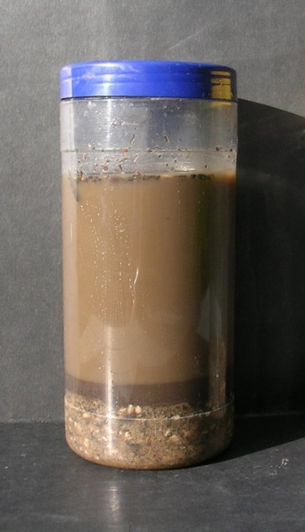
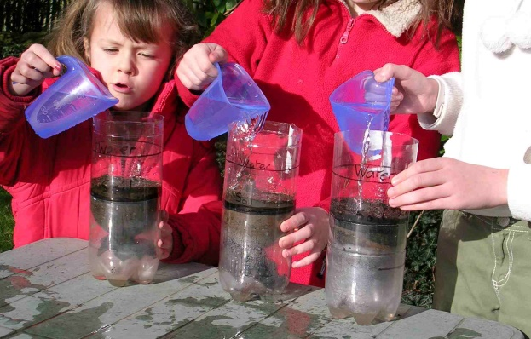
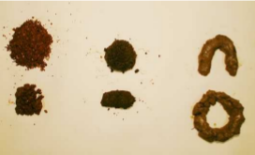
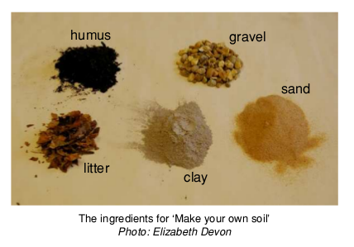
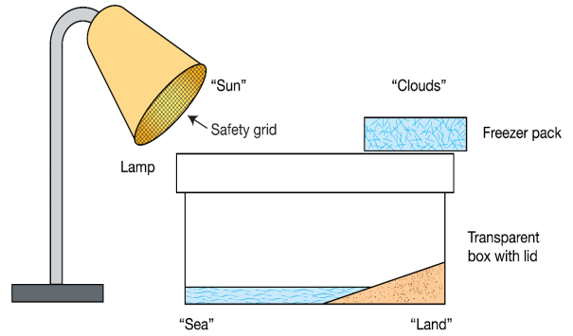
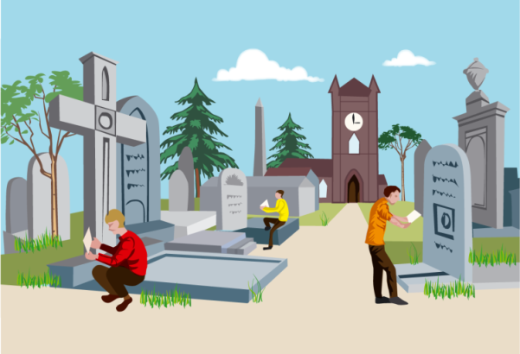
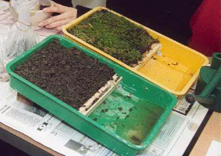
Exploring rock, soil, water, fossil
Carry out risk assessments before the following activities:
The soil water shake test
The great soil race
Make your own soil
Make your own rain
Save our soil
Soil doughnuts
Will my gravestone last?
Notes:
<number>

Slide 12
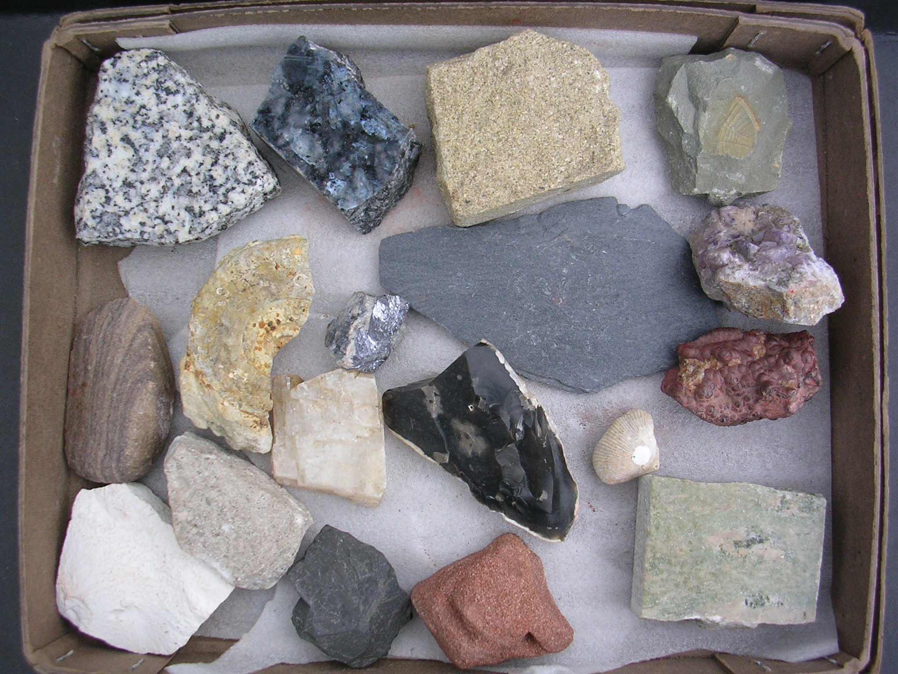
Exploring rock, soil, water, fossil
Starter: Found in the ground
Go to video hyperlink:
https://www.earthlearningidea.com/Video/Pr_Found_in_ground.html
Notes:
<number>

Slide 13
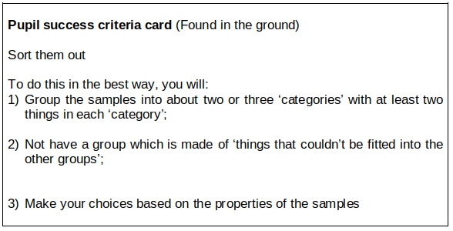
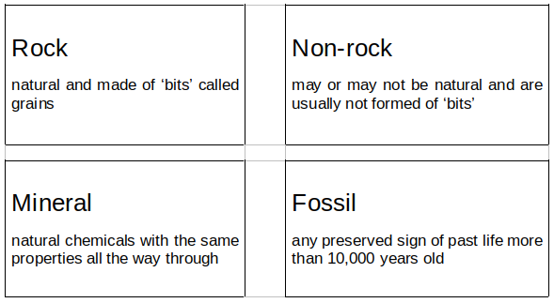
Exploring rock, soil, water, fossil
Starter:
Found in
the ground
- helpful cards
Notes:
<number>

Slide 14
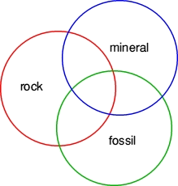
Exploring rock, soil, water, fossil
Starter: Found in the ground – using the Venn diagram approach
Notes:
<number>

Slide 15
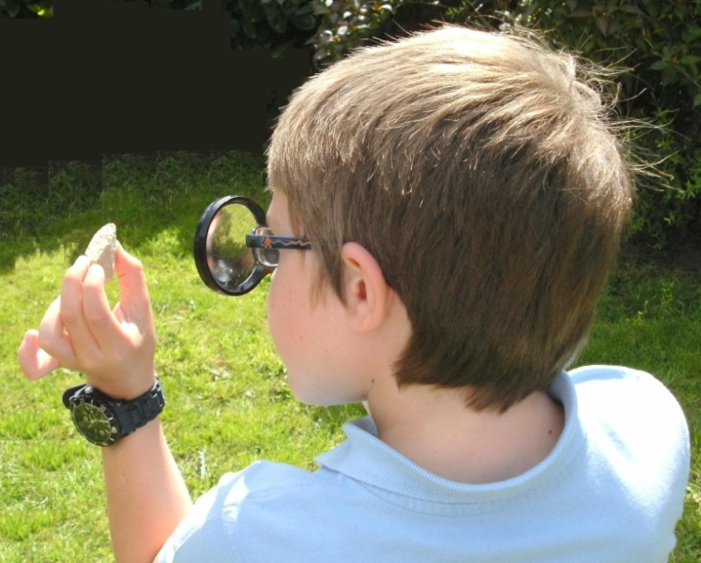
Exploring rock, soil, water, fossil
Circus activity 1: A rocky look, touch and tell
Go to video hyperlink:
https://www.earthlearningidea.com/Video/Pr_Rocky_look_touch_tell.html
Notes:
<number>

Slide 16
Exploring rock, soil, water, fossil
Circus activity 1: A rocky look, touch and tell – helpful cards
Sedimentary rocks are usually made of grains that are stuck together and can often easily be scratched off |  | Crystalline rocks are usually made of interlocking grains that are very hard to scratch off
Igneous rocks are crystalline rocks made of different minerals scattered through them |  | Metamorphic rocks are crystalline rocks with minerals in layers or bands or made of just one material
Notes:
<number>

Slide 17
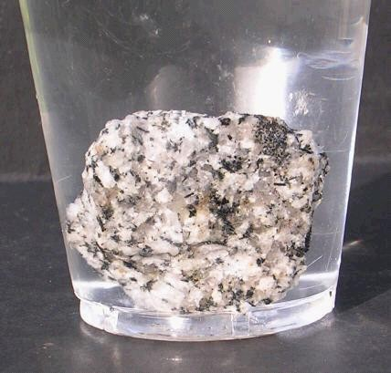
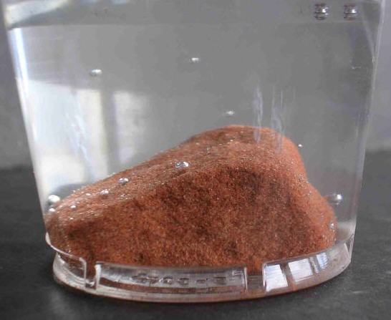
Exploring rock, soil, water, fossil
Circus activity 2: Will my rock hold water?
Go to video hyperlink:
https://www.earthlearningidea.com/Video/Pr_Will_rock_hold_water.html
Notes:
<number>

Slide 18

Exploring rock, soil, water, fossil
Circus activity 3: The soil water shake test
Go to video hyperlink:
https://www.earthlearningidea.com/Video/Pr_Soil_water_shake.html
Notes:
<number>

Slide 19
Exploring rock, soil, water, fossil
Circus activity 4: Make your own soil
Go to video hyperlink:
https://www.earthlearningidea.com/Video/Pr_Make_own_soil.html
Notes:
<number>

Slide 20

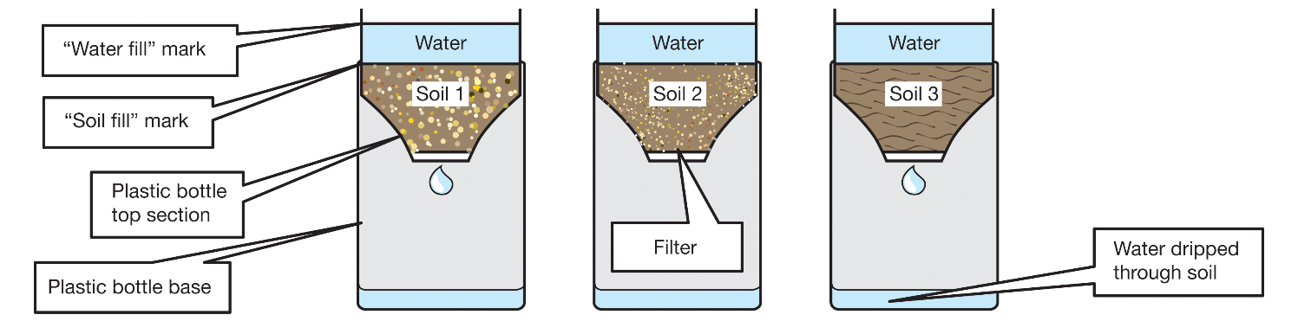
Exploring rock, soil, water, fossil
Circus activity 5: The great soil race
Go to video hyperlink:
https://www.earthlearningidea.com/Video/Pr_Great_soil_race.html
Notes:
<number>

Slide 21
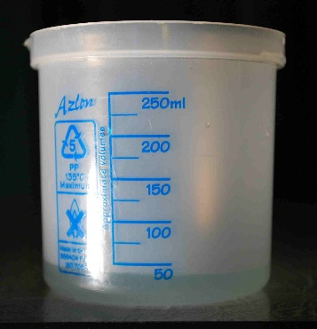
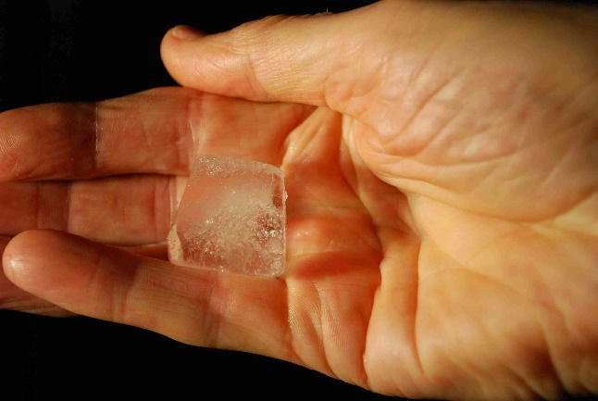
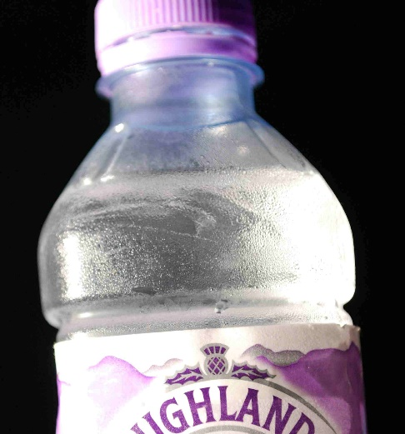
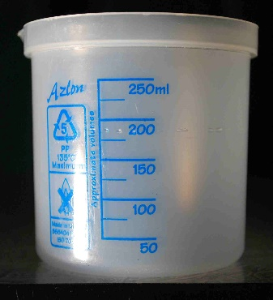
Exploring rock, soil, water, fossil
Circus activity 6: Changing state - transforming water
Go to video hyperlink:
https://www.earthlearningidea.com/Video/Pr_Changing_state_water.html
Notes:
<number>

Slide 22

Exploring rock, soil, water, fossil
Circus activity 7: Make your own rain
Go to video hyperlink:
https://www.earthlearningidea.com/Video/Pr_Make_own_rain.html
Notes:
<number>

Slide 23
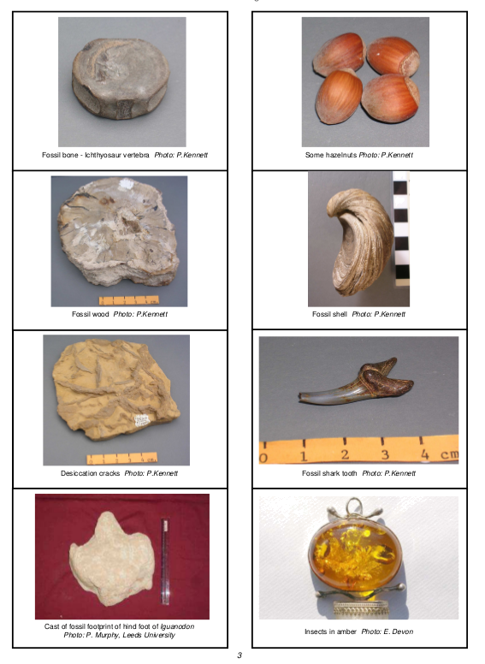
Exploring rock, soil, water, fossil
Circus activity 1: Fossil or not?
Go to video hyperlink:
https://www.earthlearningidea.com/Video/Pr_Fossil_or_not.html
Notes:
<number>

Slide 24
Exploring rock, soil, water, fossil
Circus activity 8: Fossil or not? – helpful cards
A body fossil: |  | A body fossil: is the remains of the body of an animal or plant, or the imprint or cast of it
A trace fossil: |  | A trace fossil: indicates that an animal or plant was there, but is not a body fossil; it includes footprints, burrows, signs of roots, tooth marks, etc.
Not a fossil: |  | A fossil: is any preserved sign of past life more than 10,000 years old
Notes:
<number>

Slide 25
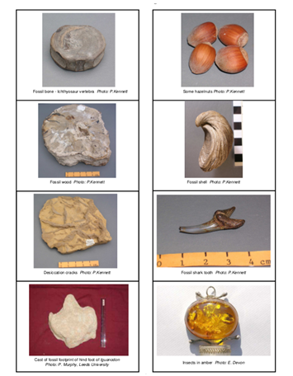
Exploring rock, soil, water, fossil
Circus activity 1: Fossil or not?
The pictures are of:
fossil bone
hazelnuts
fossilised wood
fossil shell
desiccation cracks
fossil tooth
dinosaur footprint
insects in amber
Notes:
<number>

Slide 26
Exploring rock, soil, water, fossil
Circus activity 1: Fossil or not?
Which of the following are fossils?
4000 year-old footprints like ours as found in mud north of Liverpool, UK | not old enough to be a trace fossil
a squirrel killed on the road | not a fossil, not old enough
3500 million year old cell filaments | body fossil
a petrified tree stump | body fossil
the trail of a trilobite in 530 million year-old rocks | trace fossil
‘tree-like’, dendritic mineral growths | not a fossil – not produced by life
a beach pebble with holes bored by marine organisms | probably not a fossil, unless the boring took place more than 10,000 years ago, in which case the boring is a trace fossil
a human shape preserved in volcanic ash at Pompeii | not old enough to be a fossil – Vesuvius erupted, burying Pompeii, in AD79
a piece of dinosaur skin | body fossil
Notes:
<number>

Slide 27
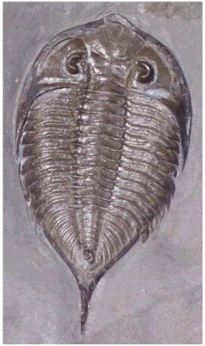
Exploring rock, soil, water, fossil
Plenary: What was it like to be there? – bringing a fossil to life
A fossil trilobite of the species Dalmanites limulurus, 7cm long.
From Silurian age (443 – 416 million years old) mudstone strata of
New York state (USA).
(Taken by DanielCD. Permission is granted to copy, distribute and/or modify this document under the terms of the GNU Fee Documentation License.)
Go to video hyperlink:
https://www.earthlearningidea.com/Video/Pr_What_like_be_there.html
Notes:
<number>

Slide 28
Exploring rock, soil, water, fossil
Plenary: What was it like to be there? – bringing a fossil to life
Albertosaurus skeleton in its burial position. Skeleton about 4m across.
(From the American Geological Institute, Earth science World Image Bank
http://www.earthscienceworld.org/images/index.html.
Photo ID: hpdzvh, copyright Abi Howe, AGI.)
Notes:
<number>

Slide 29
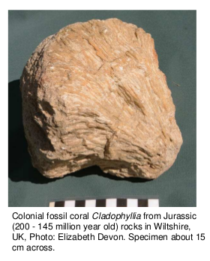
Exploring rock, soil, water, fossil
Plenary: What was it like to be there? – bringing a fossil to life
Notes:
<number>

Slide 30
Exploring rock, soil, water, fossil
Optional activity: Save our soil
Go to video hyperlink:
https://www.earthlearningidea.com/Video/Pr_Save_our_soil.html
Notes:
<number>

Slide 31
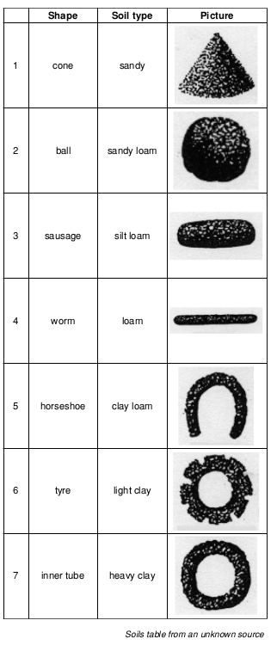
Exploring rock, soil, water, fossil
Optional activity: Soil doughnuts
Go to video hyperlink:
https://www.earthlearningidea.com/Video/Pr_Soil_doughnuts.html
Notes:
<number>

Slide 32

Exploring rock, soil, water, fossil
Optional activity: Will my gravestone last?
Go to video hyperlink:
https://www.earthlearningidea.com/Video/V14_Gravestones1.html
Notes:
<number>

Slide 33
Exploring rock, soil, water, fossil
Workshop outcomes
The workshop and its activities provide the following outcomes:
insights into how rocks can be; sorted, classified and identified most effectively;
opportunities to investigate soils through a range of activities;
an approach to understanding the different states of water and how these link to the water cycle;
an introduction to fossils and what they can tell us about life in the past;
practical activities that develop skills of investigation, discussion, argumentation and creativity;
background information on some of the Earth science processes active in the UK;
exploration of the elements of science and geography that provide the underpinning to later Earth science study;
guidance on how the elements of Earth science in the curriculum can be taught most effectively.
Notes:
<number>

Slide 34
Exploring rock, soil, water, fossil – online
For ages 7 to 9
Developed from the Earth Science Education Unit
‘Exploring, rock, soil, water, fossil’ workshop, with permission
© Copyright is waived for original material contained in this workshop if it is required for use within the laboratory or classroom. Copyright material contained herein from other publishers rests with them. Any organisation wishing to use this material should contact the Earthlearningidea team.
Notes:
<number>

