Slide 1
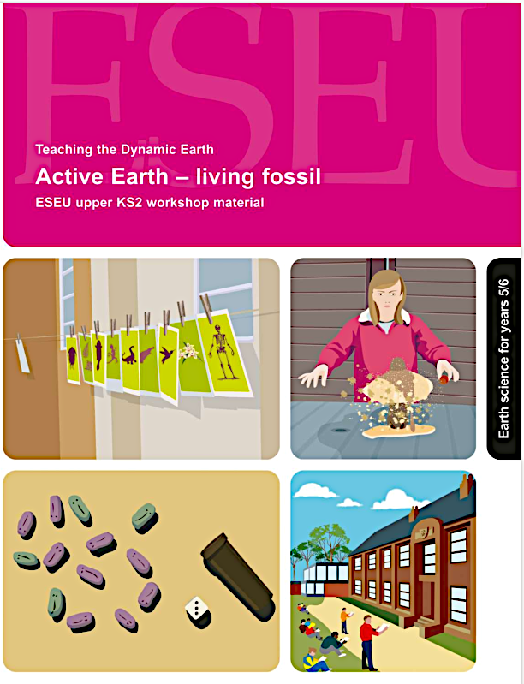
Active Earth – living fossil
Earth science for
9 - 11 years old
The workshop is based on this pdf booklet originally prepared by the Earth Science Education Unit and now available on the Earthlearningidea website. It contains a workshop summary, the outcomes, teacher guidance, risk assessments and resources lists - as in the following slides
Notes:
<number>

Slide 2
Earthlearningidea online video workshops
Purpose – ESEU background
Most Earthlearningidea online video workshops are based, with permission, on workshops originally developed by the Earth Science Education Unit (ESEU)
These were designed as interactive workshops for teachers and trainees, involving interaction, discussion and presentations by participants to others
Global research into professional development workshops shows that these aspects are critical to success
ESEU research shows that this workshop approach is highly successful in changing teaching in schools; evaluation feedback has also been very strong

Slide 3
Earthlearningidea online video workshops
Purpose – Earthlearningidea development
The Earthlearningidea Team has developed the ESEU workshops into online video workshops for those unable to take part in face to face interactive workshops
Each workshop is led by a PowerPoint presentation and has an accompanying booklet that contains all the activity background details, resource lists, risk assessments, etc.
The individual workshop activities have been published for open access online at the website: https://www.earthlearningidea.com/
Each workshop activity has a question script and a video keyed into CASE principles, that can be accessed through the PowerPoint hyperlinks
The aim is to facilitate online Earth science learning

Slide 4
Earthlearningidea online video workshops
Teaching Earth science using the Cognitive Acceleration through Science (CASE) approach
The activities in this workshop are keyed into the CASE approach – to develop thinking skills while teaching key Earth science material
If you are unfamiliar with the CASE approach, you can access a video introduction at: https://www.earthlearningidea.com/Video/CASE.html
An exemplar Earth science teaching activity with a question script using the CASE approach is at: https://www.earthlearningidea.com/Video/Atmosphere_ocean.html
Notes:
<number>

Slide 5
Earthlearningidea online video workshops
Running Earthlearningidea online video workshops
Each workshop is led by a PowerPoint presentation
Launch the PowerPoint
Some slides contain hyperlinks to MP4 video files
Run the hyperlinked files and then return to the PowerPoint, flick through any slides you have already seen, and continue
The workshop is presented in this way so that the workshop itself, or individual videos, can be used in classroom teaching

Slide 6
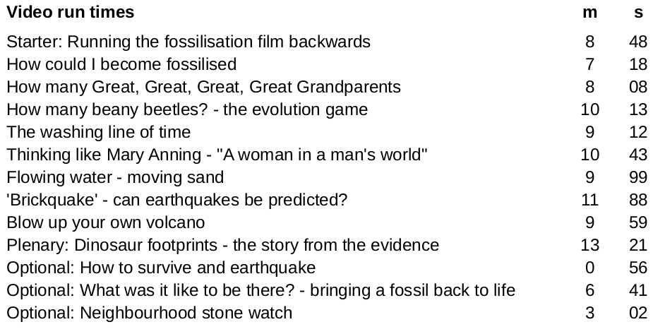
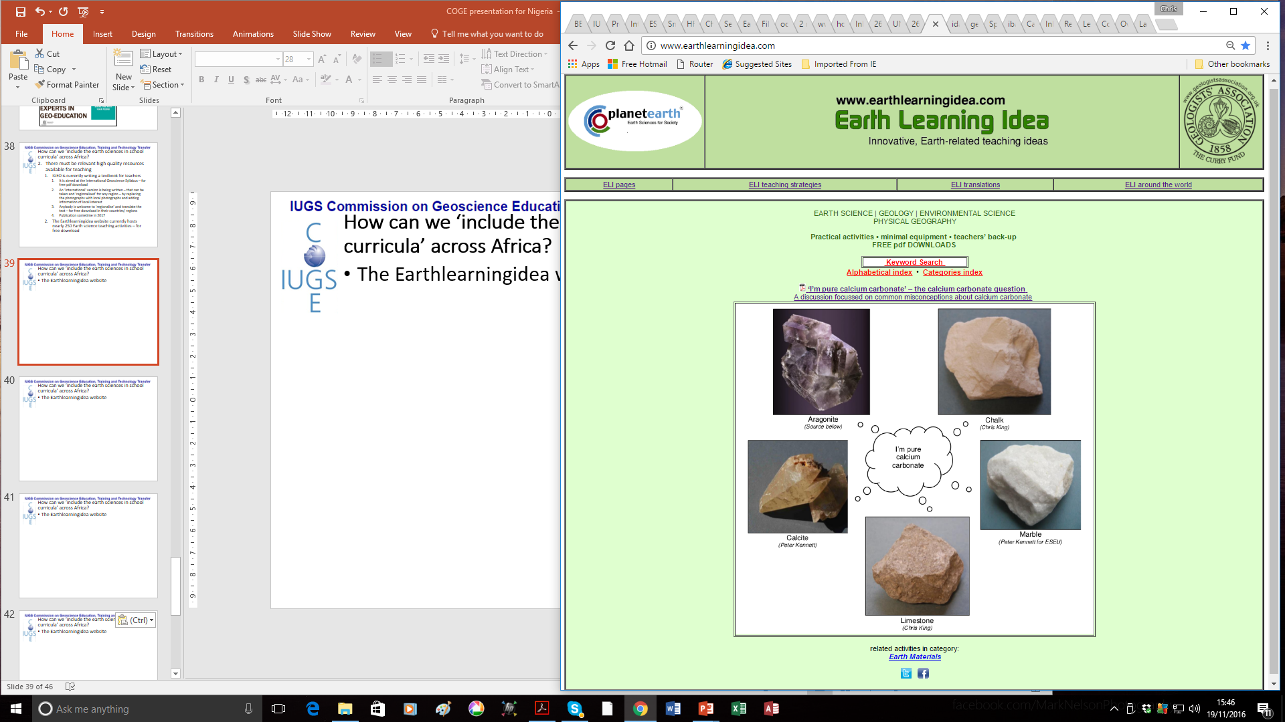
Active Earth – living fossil
Notes:
<number>

Slide 7
Active Earth – living fossil
Summary
Try a series of ‘hands-on’ activities to explore how organisms inherit their characteristics and become fossilised before investigating a range of landscape -forming and potentially hazardous Earth processes - in a practical, enquiry-based way.
Notes:
<number>

Slide 8
Active Earth – living fossil
Workshop outcomes
The workshop and its activities provide the following outcomes:
insights into what fossils are, how they form and what they can tell us about evolving life on Earth;
how organisms inherit characteristics and the processes that result in evolution;
insights into the life of a fossil hunter;
opportunities for exploring landscape-forming and potentially hazardous Earth processes
practical activities that develop skills of investigation, discussion, argumentation and creativity;
exploration of the elements of science and geography that affect the landscape;
guidance on how the elements of Earth science in the curriculum can be taught most effectively.
Notes:
<number>

Slide 9
Active Earth – living fossil
Explore the Earth using this wide range of activities:
Note: those practical activities needing apparatus/materials are shown with a *
Starter: Running the fossilisation film backwards to ‘bring a fossil back to life’
Circus activity 1: How could I become fossilised?
Circus activity 2: How many Great Great Great Great Grandparents?
Circus activity 3: How many beany beetles? - the evolution game*
Circus activity 4: The washing line of time*
Circus activity 5: Thinking like Mary Anning - “A woman in a man’s world”
Circus activity 6: Flowing water - moving sand*
Circus activity 7: ‘Brickquake’ - can earthquakes be predicted?*
Circus activity 8: Blow up your own volcano!*
Plenary: Dinosaur footprints - the story from the evidence
Optional activity: How to survive an earthquake
Optional activity: What was it like to be there? - bringing a fossil to life
Optional activity: Neighbourhood stone watch
Notes:
<number>

Slide 10
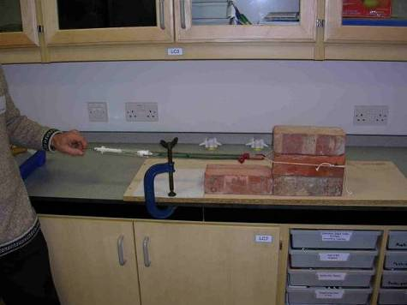
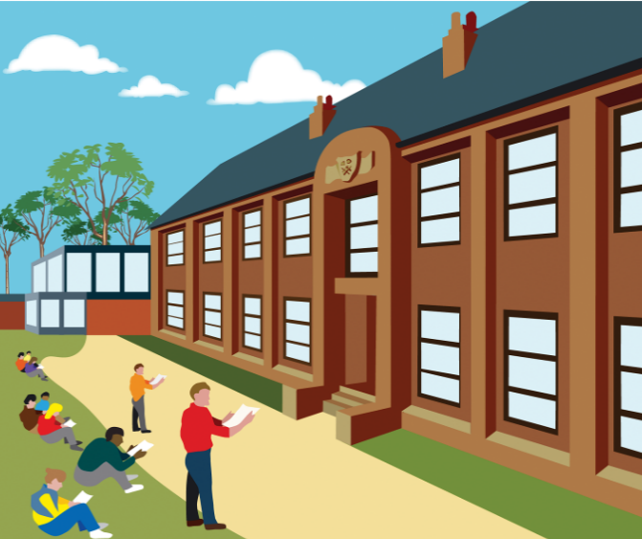
Active Earth living fossil
Carry out risk assessments before the following activities:
Circus activity 7: ‘Brickquake’ - can earthquakes be predicted?
Optional activity: Neighbourhood stone watch
Notes:
<number>

Slide 11
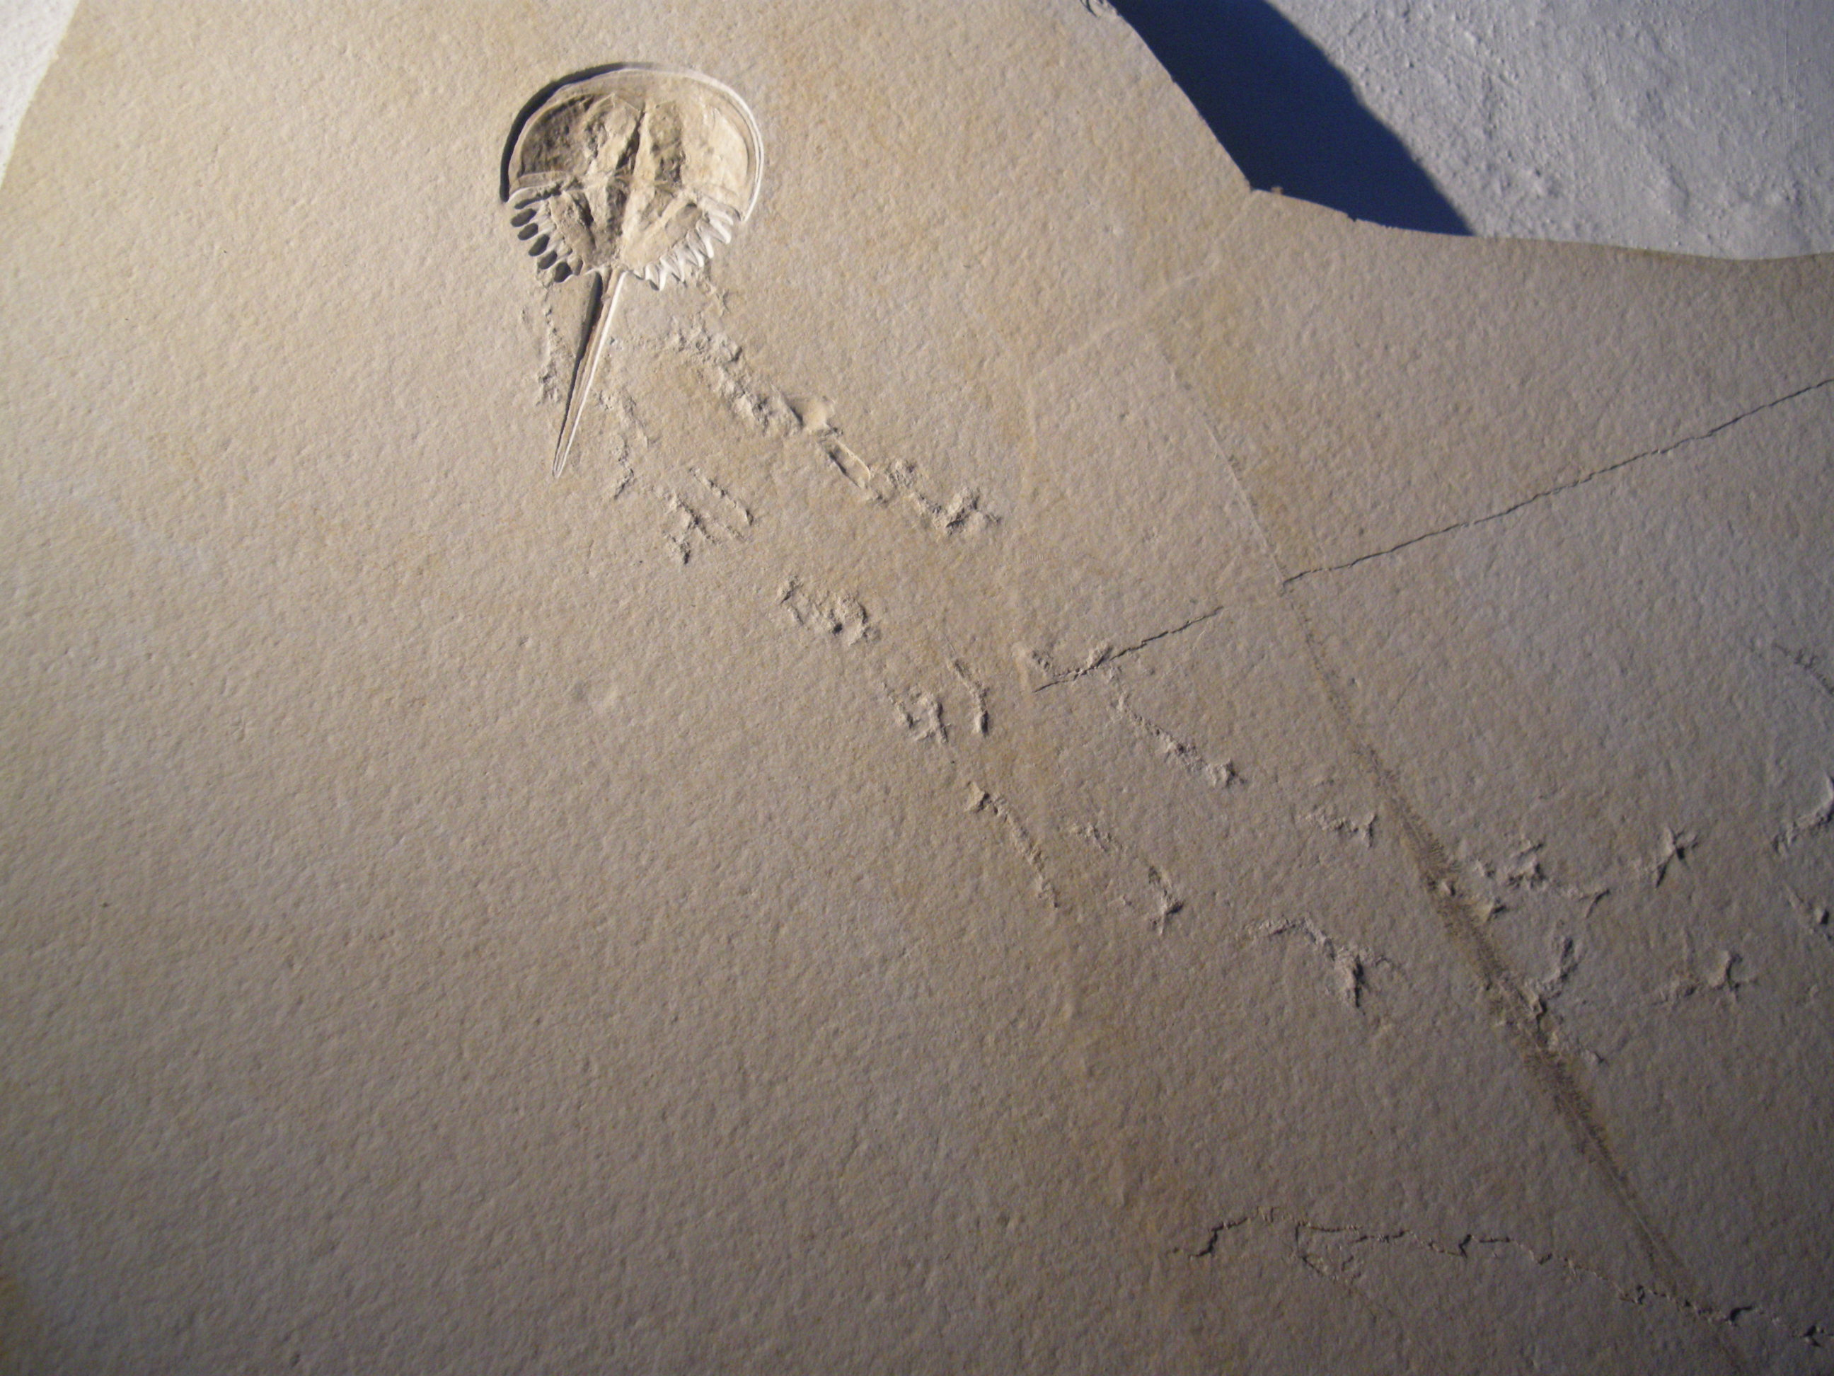
Active Earth – living fossil
Starter: Running the fossilisation film backwards to ‘bring a fossil back to life’
Go to video hyperlink:
https://www.earthlearningidea.com/Video/Pr_Fossilisation_film.html
Notes:
<number>

Slide 12

Active Earth – living fossil
Starter: Running the fossilisation film backwards to ‘bring a fossil back to life - the dying moments’
Notes:
<number>

Slide 13
Active Earth – living fossil
Starter: Running the fossilisation film backwards to ‘bring a fossil back to life’
Notes:
<number>

Slide 14
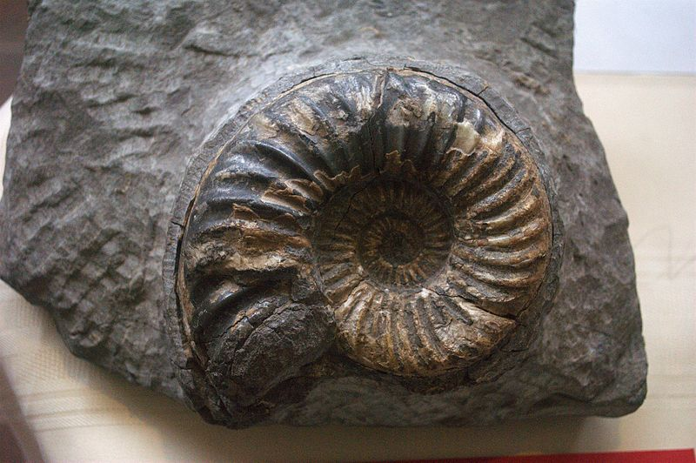
Active Earth – living fossil
Starter: Running the fossilisation film backwards to ‘bring a fossil back to life’
Notes:
<number>

Slide 15
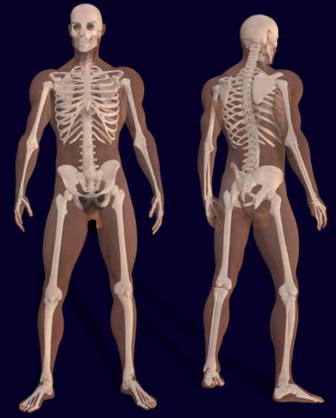
Active Earth – living fossil
Circus activity 1: How could I become fossilised?
Go to video hyperlink:
https://www.earthlearningidea.com/Video/Pr_How_become_fossilised.html
Notes:
<number>

Slide 16
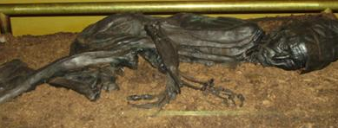
Active Earth – living fossil
Circus activity 1: How could I become fossilised?
Notes:
<number>

Slide 17
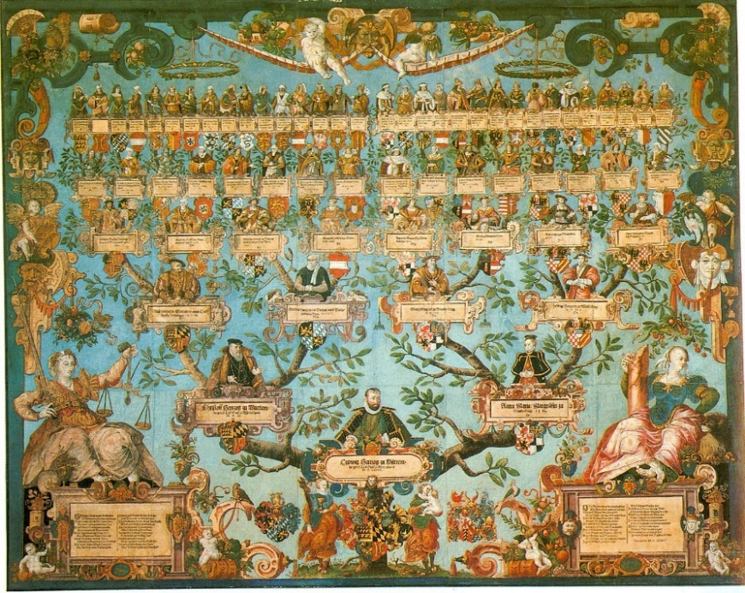
Active Earth – living fossil
Circus activity 2: How many Great Great Great Great Grandparents?
Go to video hyperlink:
https://www.earthlearningidea.com/Video/Pr_Great_grandparents.html
Notes:
<number>

Slide 18
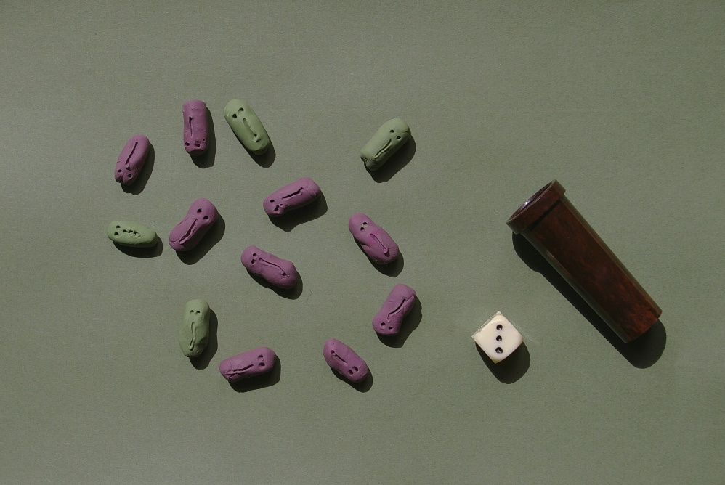
Active Earth – living fossil
Circus activity 3: How many beany beetles? - the evolution game
Go to video hyperlink:
https://www.earthlearningidea.com/Video/Pr_Beany_beetles.html
Notes:
<number>

Slide 19
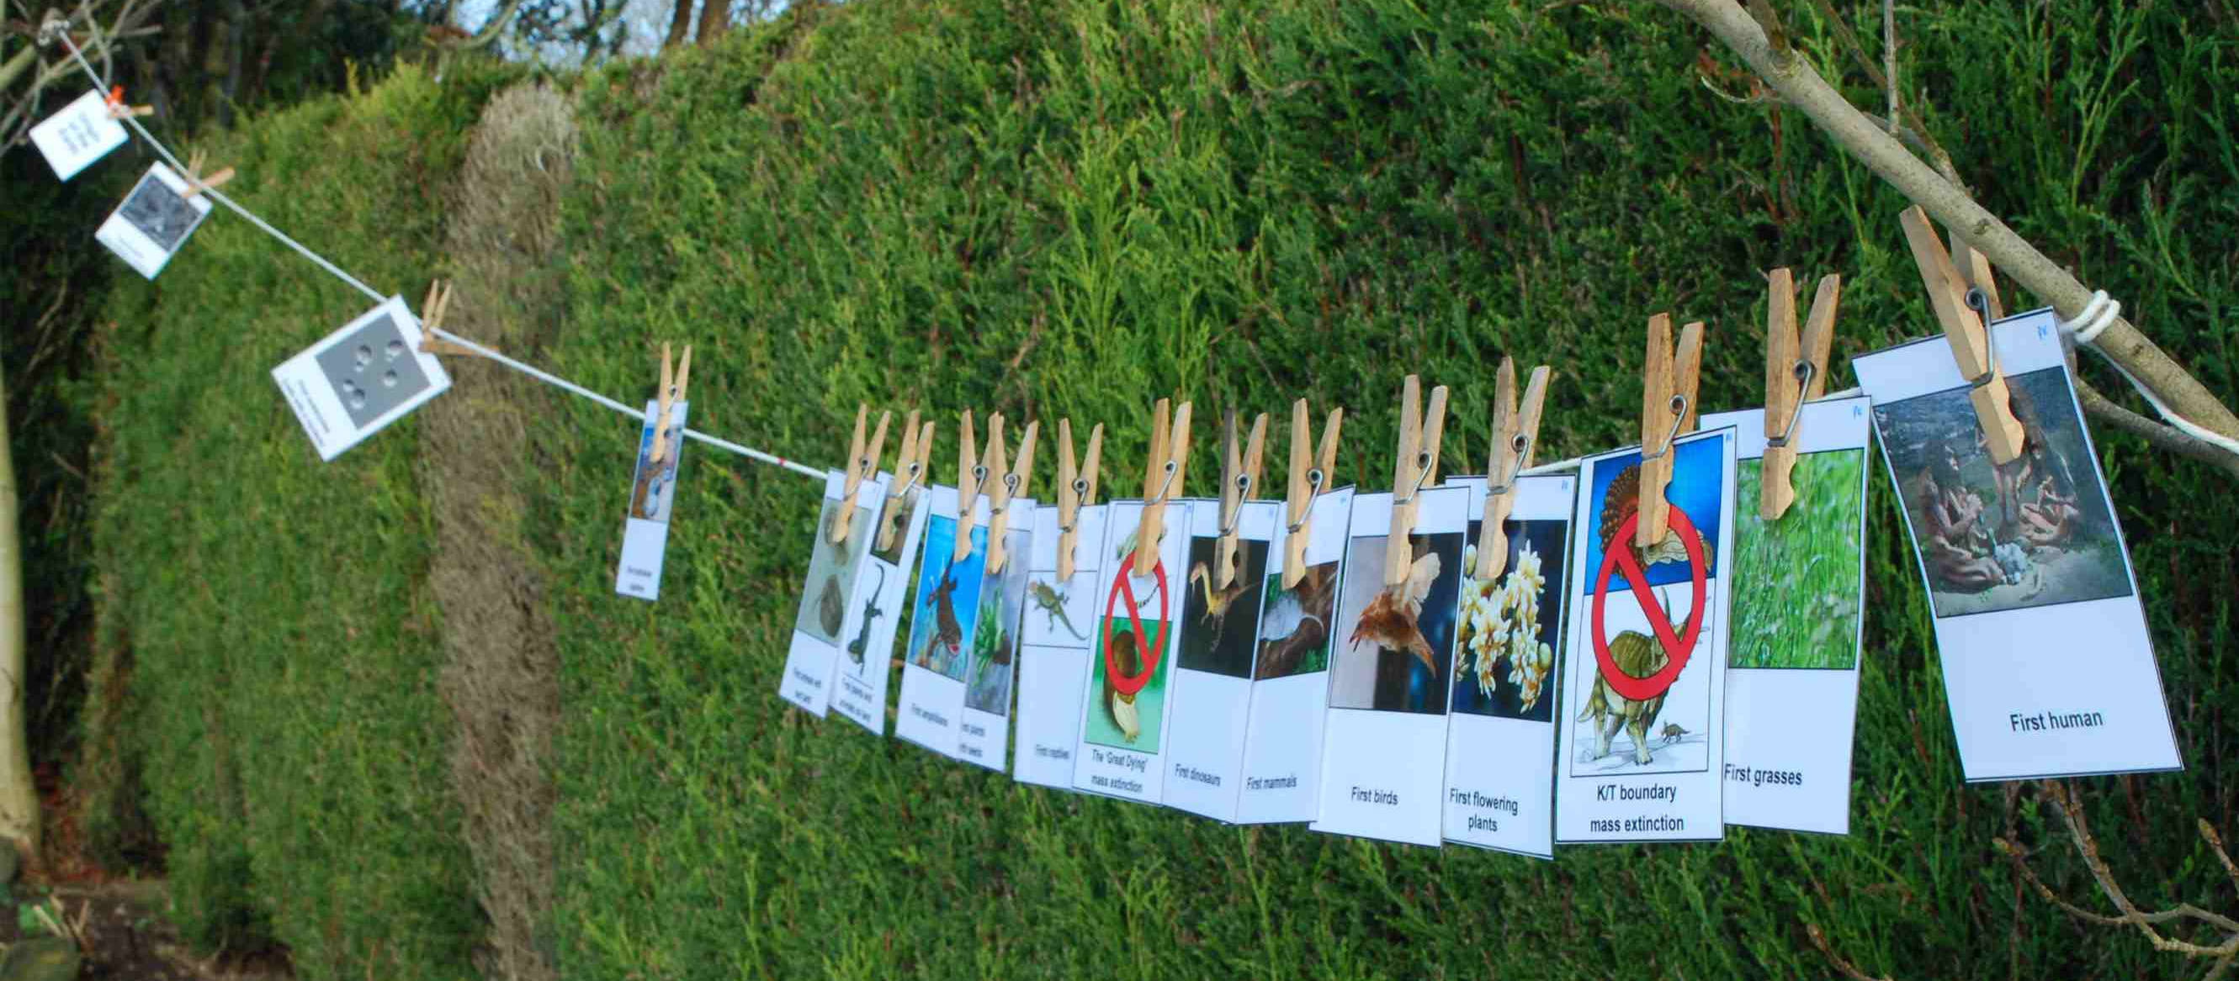
Active Earth – living fossil
Circus activity 4: The washing line of time
Go to video hyperlink:
https://www.earthlearningidea.com/Video/Pr_Washing_line_time.html
Notes:
<number>

Slide 20
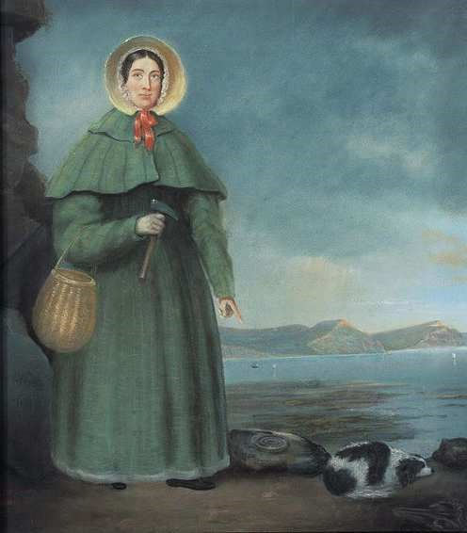
Active Earth – living fossil
Circus activity 5: Thinking like Mary Anning - “A woman in a man’s world”
Go to video hyperlink:
https://www.earthlearningidea.com/Video/Pr_Mary_Anning.html
Notes:
<number>

Slide 21
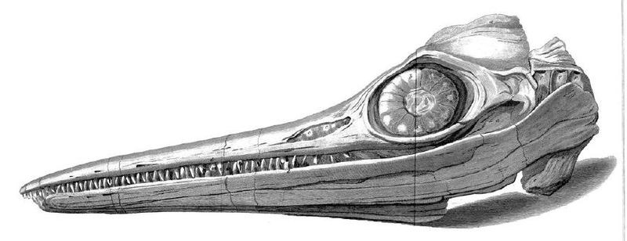
Active Earth – living fossil
Circus activity 5: Thinking like Mary Anning - “A woman in a man’s world” - Ichthyosaur
Notes:
<number>

Slide 22
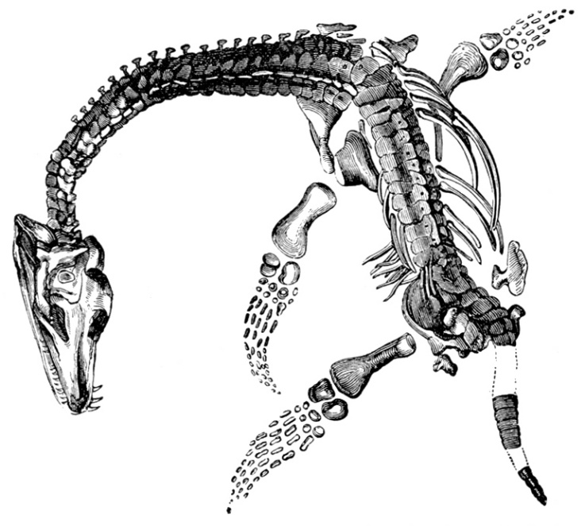
Active Earth – living fossil
Circus activity 5: Thinking like Mary Anning - “A woman in a man’s world” - plesiosaur
Notes:
<number>

Slide 23
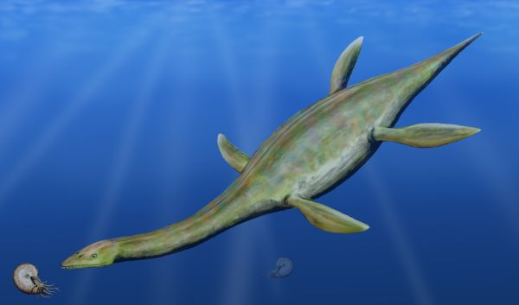
Active Earth – living fossil
Circus activity 5: Thinking like Mary Anning -
“A woman in a man’s world” - plesiosaur
Notes:
<number>

Slide 24
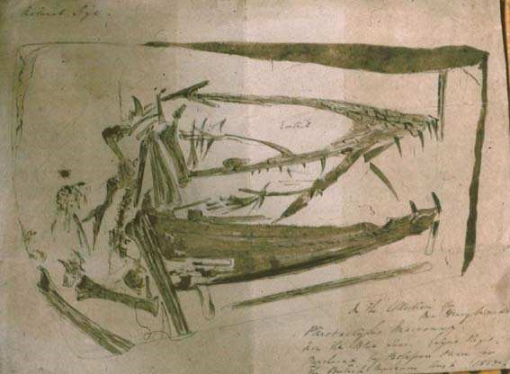
Active Earth – living fossil
Circus activity 5: Thinking like Mary Anning -
“A woman in a man’s world” - Pterodactyl
Notes:
<number>

Slide 25
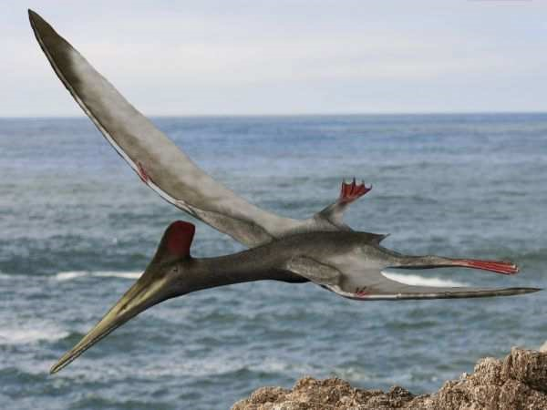
Active Earth – living fossil
Circus activity 5: Thinking like Mary Anning -
“A woman in a man’s world” - Pterodactyl
Notes:
<number>

Slide 26
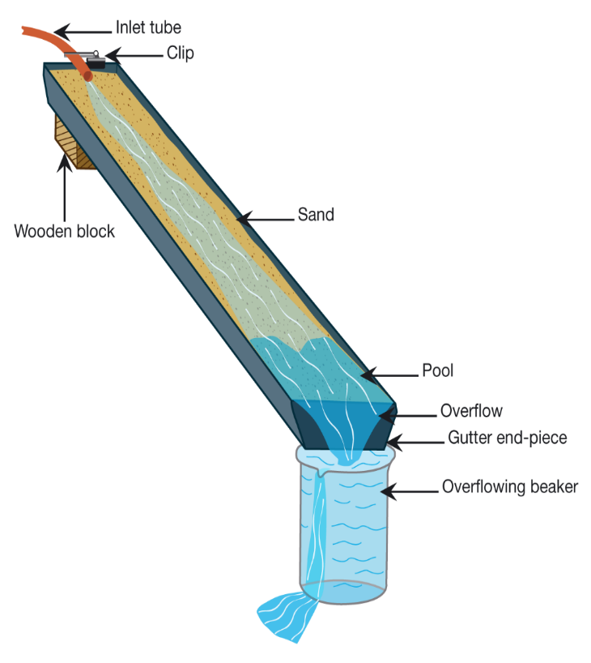
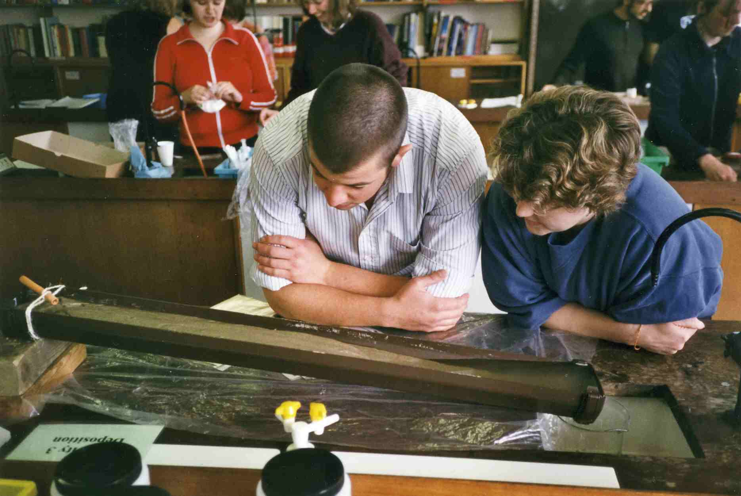
Active Earth – living fossil
Circus activity 6: Flowing water – moving sand
Go to video hyperlink:
https://www.earthlearningidea.com/Video/Pr_Flowing_water_moving_sand_part1.html
Notes:
<number>

Slide 27
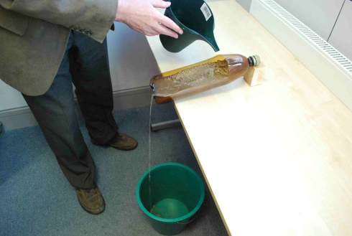
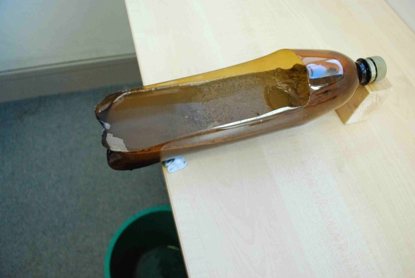
Active Earth – living fossil
Circus activity 6: Flowing water – moving sand
Notes:
<number>

Slide 28
Active Earth – living fossil
Circus activity 7: ‘Brickquake’ - can earthquakes be predicted?
Go to video hyperlink:
https://www.earthlearningidea.com/Video/Pr_Brickquake_part1.html
Notes:
<number>

Slide 29
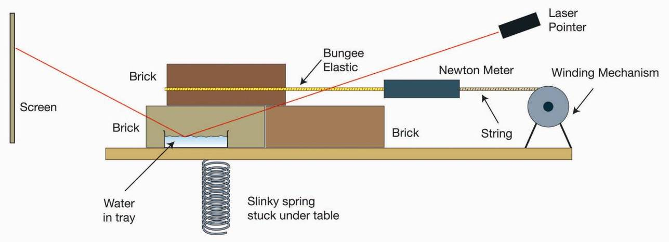
Active Earth – living fossil
Circus activity 7: ‘Brickquake’ - can earthquakes be predicted?
Notes:
<number>

Slide 30
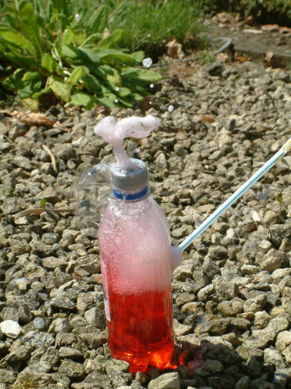
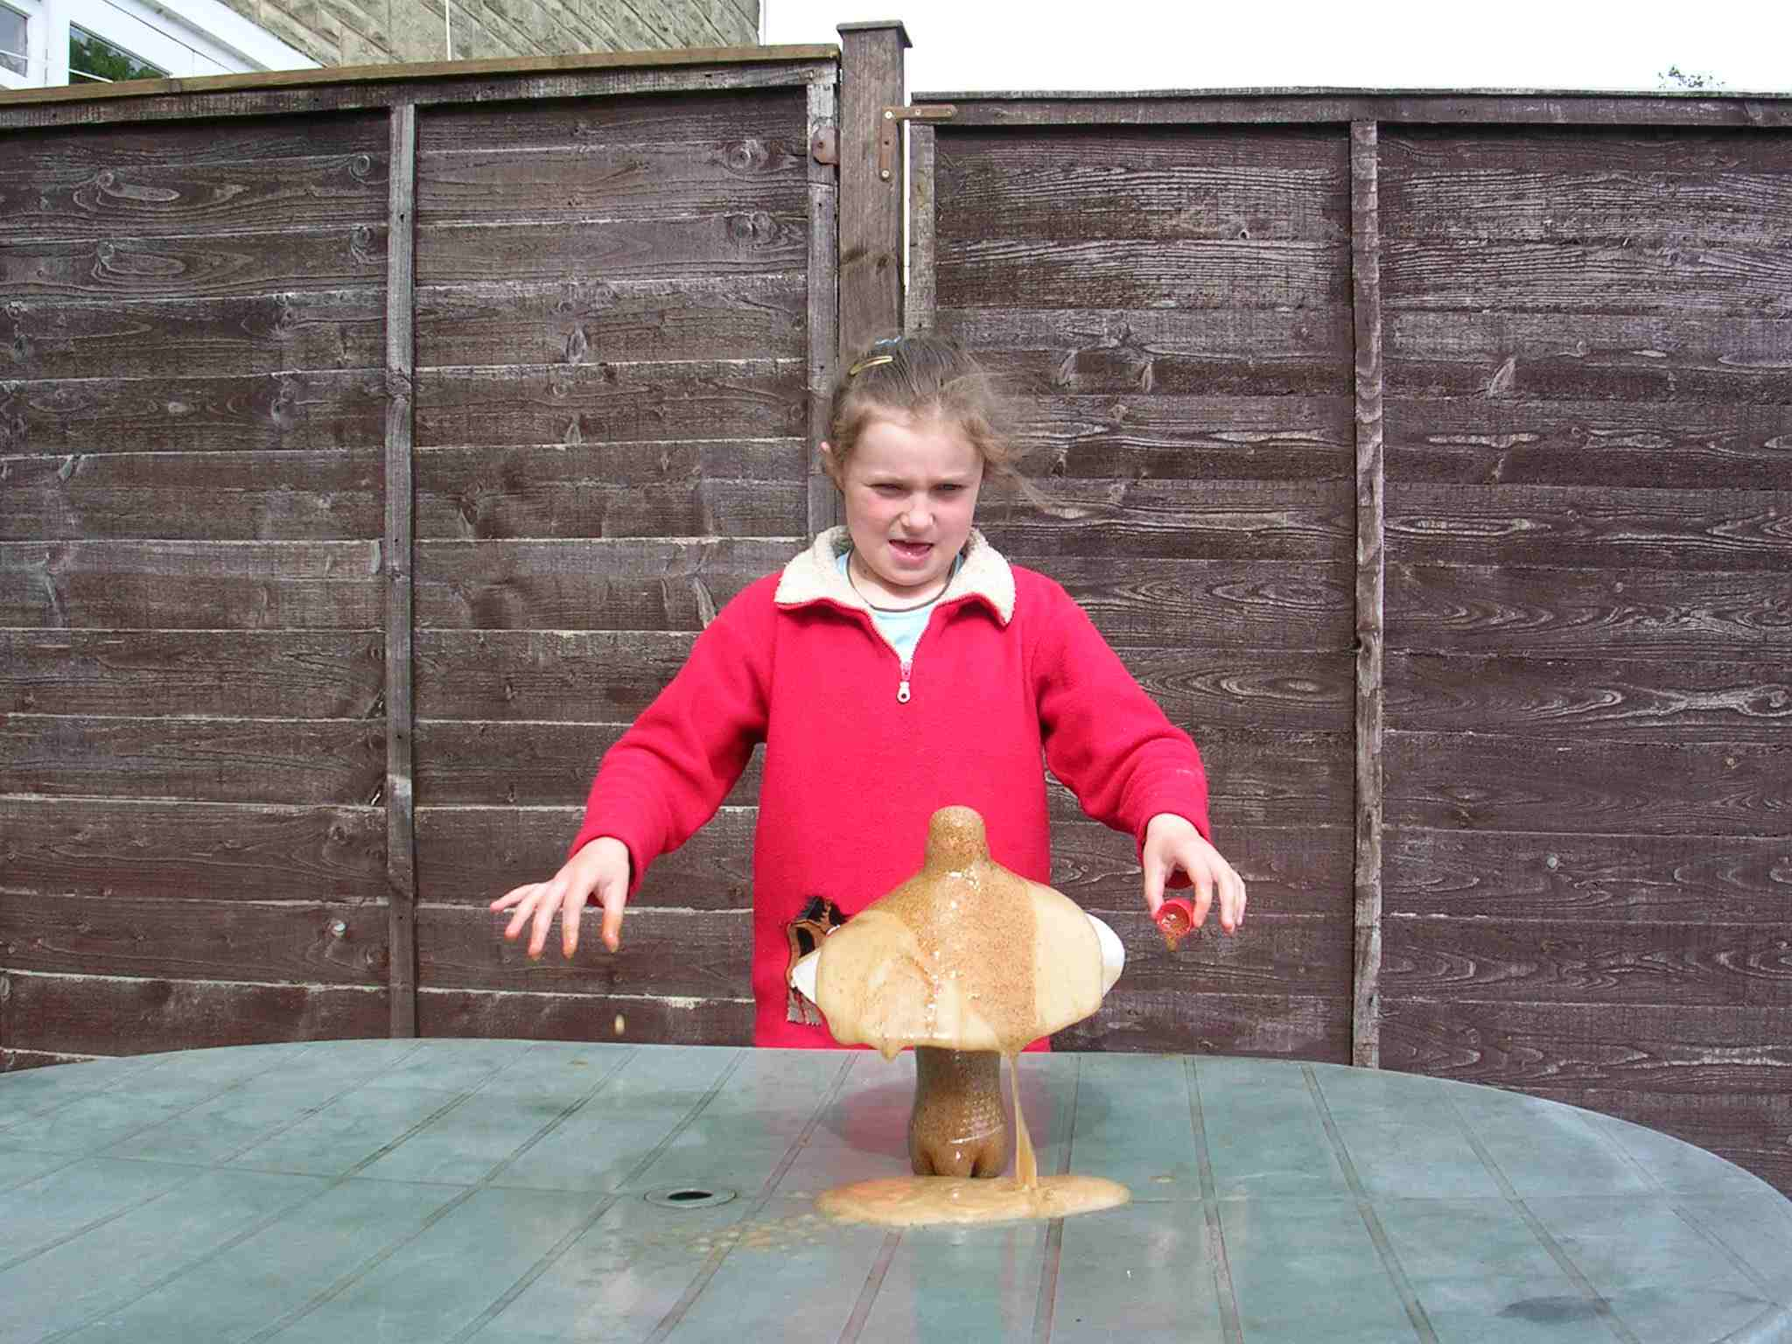
Active Earth – living fossil
Circus activity 8: Blow up your own volcano!
Go to video hyperlink:
https://www.earthlearningidea.com/Video/Pr_Blow_up_volcano.html
Notes:
<number>

Slide 31
Active Earth – living fossil
Plenary: Dinosaur footprints - the story from the evidence
Go to video hyperlink:
https://www.earthlearningidea.com/Video/Pr_Dino_footprints.html
Notes:
<number>

Slide 32
Active Earth – living fossil
Plenary: Dinosaur footprints - the story from the evidence
Notes:
<number>

Slide 33
Active Earth – living fossil
Plenary: Dinosaur footprints - the story from the evidence
Notes:
<number>

Slide 34
Active Earth – living fossil
Optional activity: How to survive an earthquake
What to do in an earthquake - the California Office of Emergency Services recommends:
If indoors, bend down or lie on the floor, taking cover under a sturdy desk, table or other furniture. Hold on and be prepared to move with it, remaining in position until the ground stops shaking and it's safe to move. Avoid windows, fireplaces, wood stoves, heavy furniture or appliances. In a crowded area, take cover and stay put.
If outside, get into the open, away from buildings, trees, lamp posts, power lines or signs.
If driving, remain in your car. Stay away from bridges, tunnels, overpasses. Move your car out of traffic, but avoid stopping under trees, lamp posts, power lines or signs.
In a mountainous area, or near unstable land, be alert to falling rock and debris that could be loosened by the earthquake.
If you are at the beach, move to higher ground.
Go to video hyperlink:
https://www.earthlearningidea.com/Video/Pr_Surviving_earthquake.html
Notes:
<number>

Slide 35
Active Earth – living fossil
Optional activity: What was it like to be there? - bringing a fossil to life - trilobite
When it was alive:
What sort of place was this animal living in?
What did it breathe?
What did it eat?
Was it a hunter? - or hunted? - or both?
What could it have seen?
What could it have sensed?
How did it die? - can we tell?
What happened after it died?
Go to video hyperlink:
https://www.earthlearningidea.com/Video/Pr_What_like_be_there.html
Notes:
<number>

Slide 36
Active Earth – living fossil
Optional activity: What was it like to be there? - bringing a fossil to life - dinosaur
Notes:
<number>

Slide 37
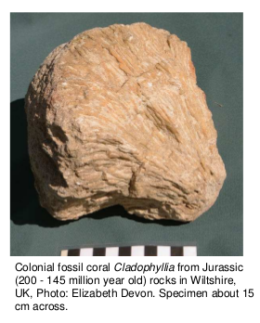
Active Earth – living fossil
Optional activity: What was it like to be there? - bringing a fossil to life - coral
Notes:
<number>

Slide 38
Active Earth – living fossil
Optional activity: Neighbourhood stone watch
Go to video hyperlink:
https://www.earthlearningidea.com/Video/Pr_Neighbourhood_stone.html
Notes:
<number>

Slide 39
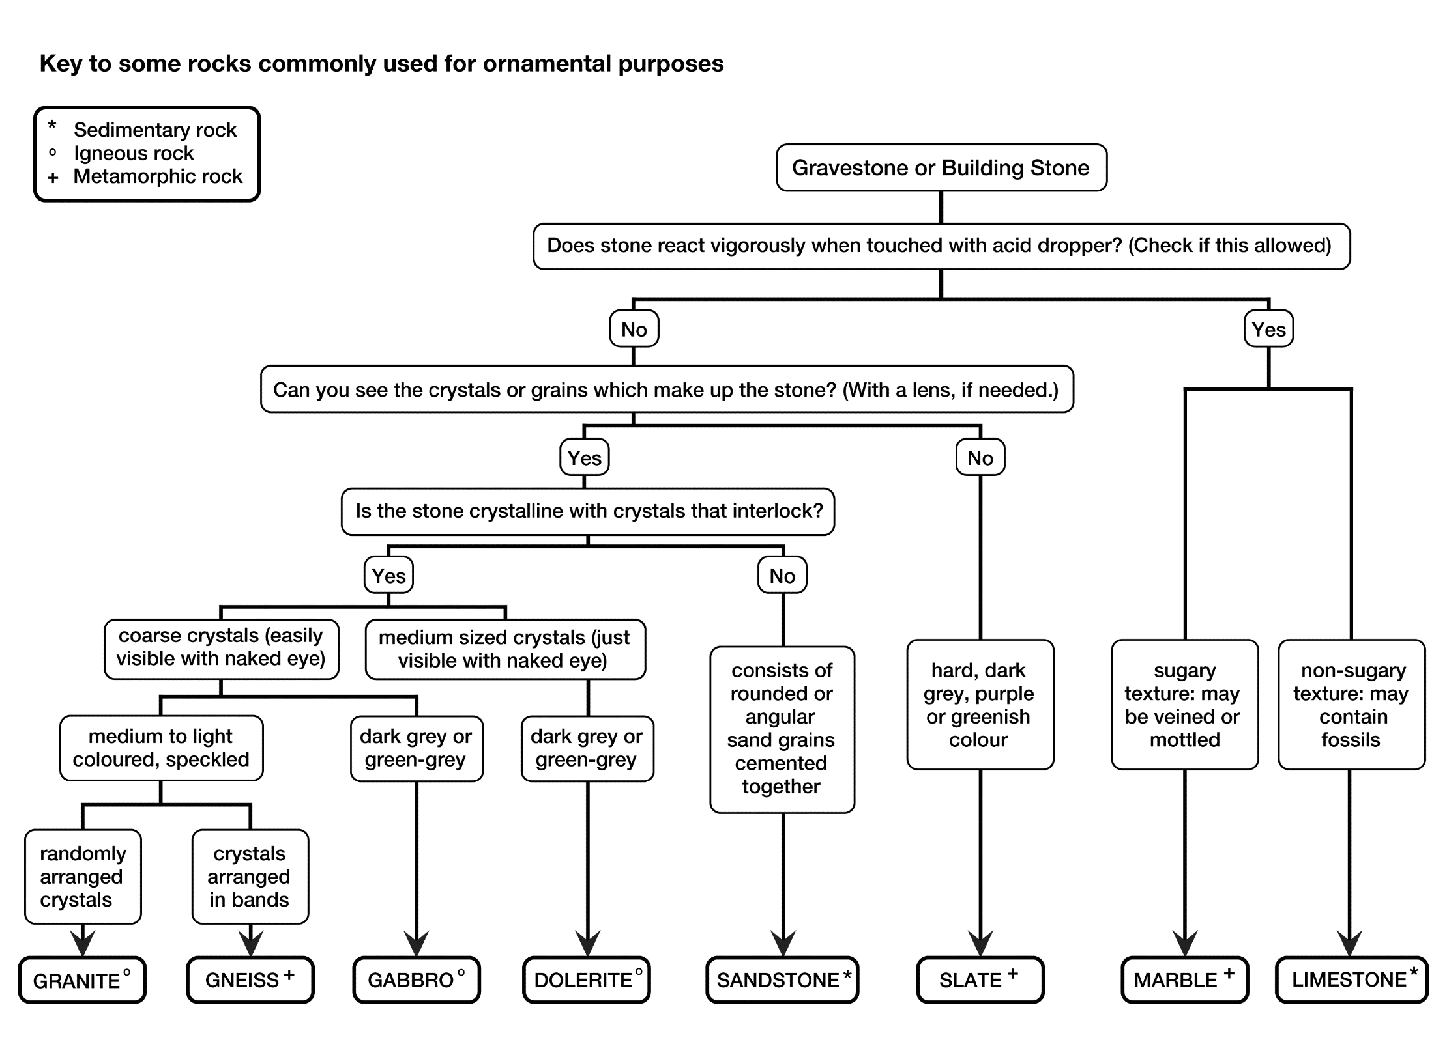
Active Earth – living fossil
Optional activity: Neighbourhood stone watch
Notes:
<number>

Slide 40
Active Earth – living fossil
Workshop outcomes
The workshop and its activities provide the following outcomes:
insights into what fossils are, how they form and what they can tell us about evolving life on Earth;
how organisms inherit characteristics and the processes that result in evolution;
insights into the life of a fossil hunter;
opportunities for exploring landscape-forming and potentially hazardous Earth processes
practical activities that develop skills of investigation, discussion, argumentation and creativity;
exploration of the elements of science and geography that affect the landscape;
guidance on how the elements of Earth science in the curriculum can be taught most effectively.
Notes:
<number>

Slide 41
Notes:
<number>

