Slide 1
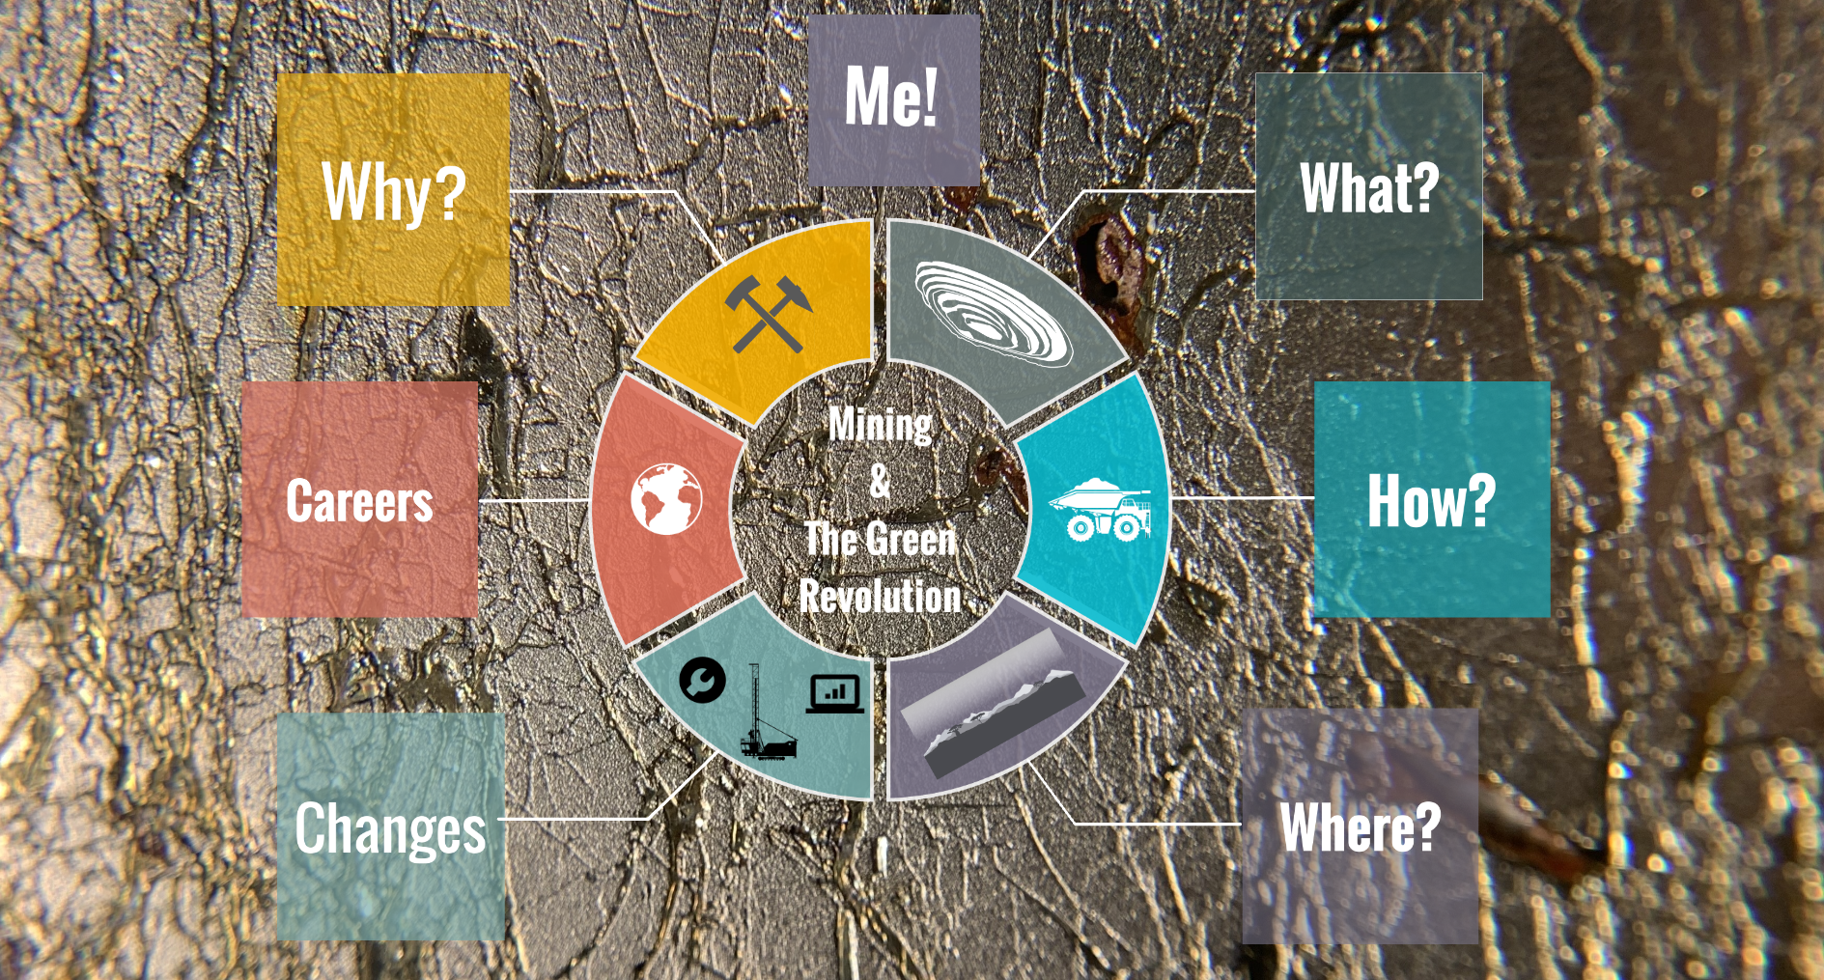

Slide 2
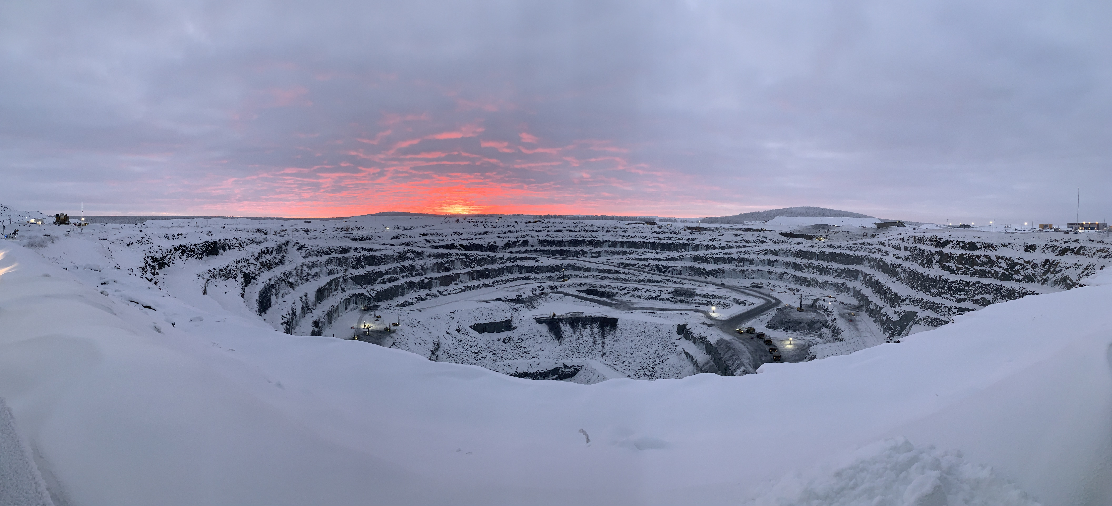
Mining is essential for the green technology revolution. Fact.
Mining has been responsible for huge environmental and social disasters. Fact.
Mining is changing and can be done in responsible and sustainable ways. Fact.
Humans need mining to fuel the changes required to help improve air quality, slow climate change and biodiversity loss.
Intro Video: 2 Minutes
https://www.earthlearningidea.com/Video/Mining_Green_Revolution_0.html
Notes:
Note that the Cononish Gold mine started operations during 2020 and so becomes the only operating metal mine in the UK as of April 2021.
<number>

Slide 3
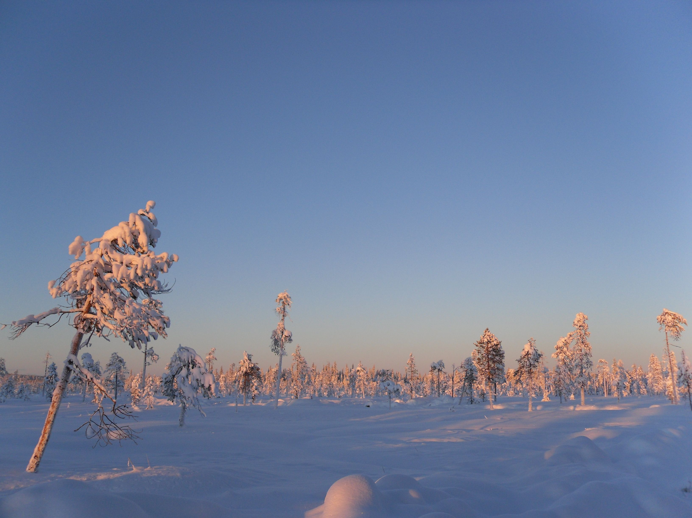

The aim of this series of short talks is to provide an understanding of how important mining is and will be to decarbonising our lives.
We will also explore what changes have happened and will be happening to reduce the negative impacts.
There are 6 topics:
Why we mine
What we mine
How we mine
Where we mine
Changes in the industry
Careers in exploration and mining

Slide 4
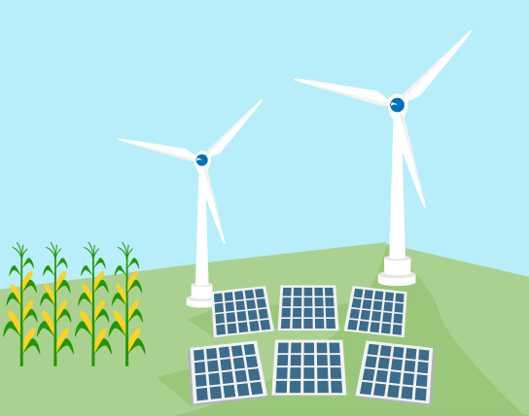
Part 1: Why do we have to mine?
In the first video we explore the key drivers behind mining?
Population growth and technology changes
Climate change and air quality targets
Material requirements
Recycling vs mining
Video Time: 13 minutes
https://www.earthlearningidea.com/Video/Mining_Green_Revolution_1.html

Slide 5
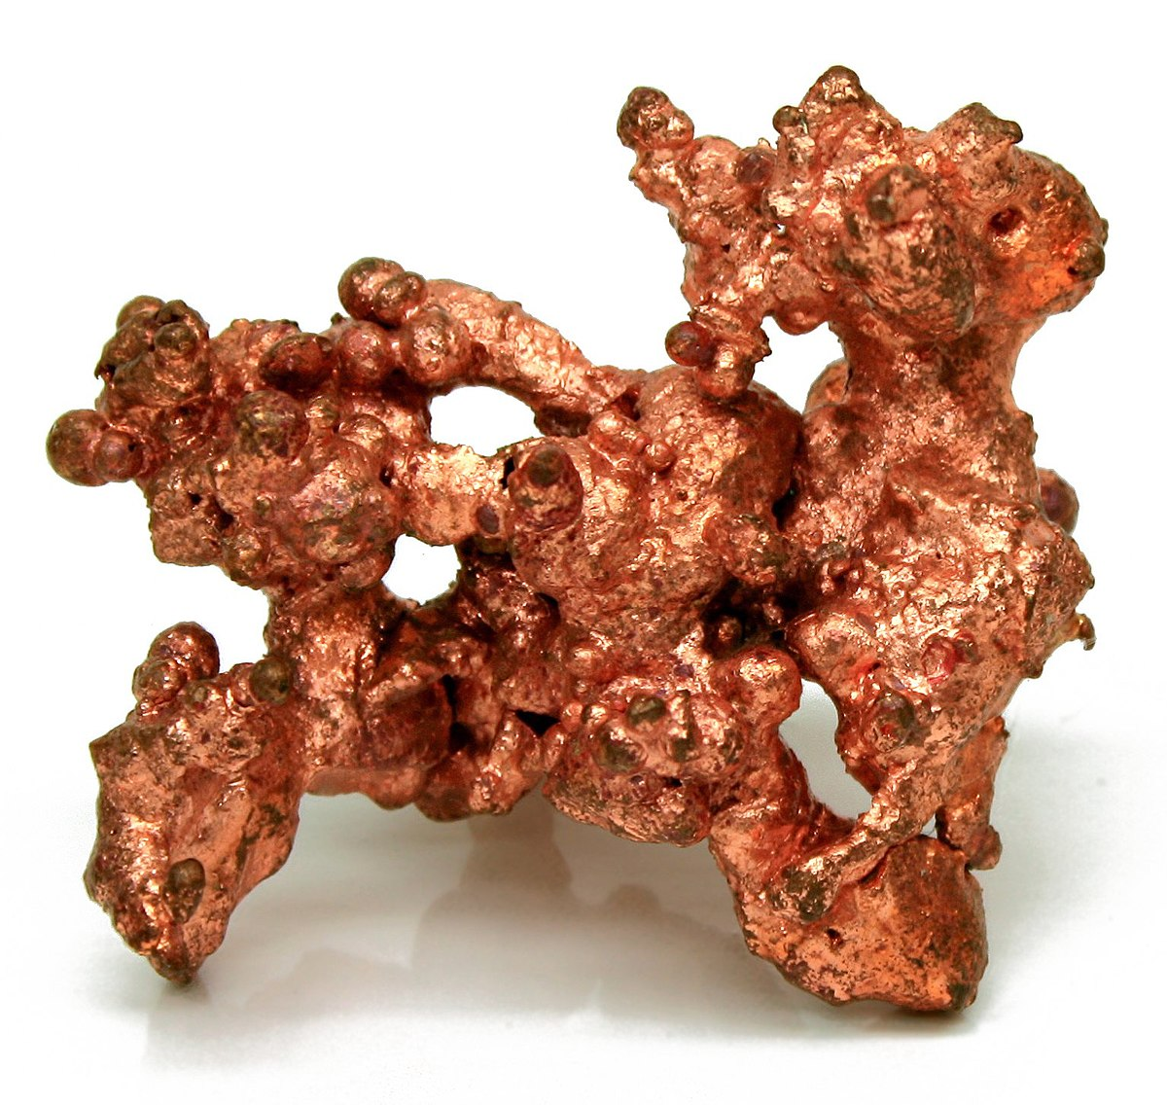
Part 2: What do we have to mine?
In the second video we ask what do we need to mine?
Diversity of metals/minerals in green technology
Solar panels, wind turbines, electric vehicles and batteries
Video Time: 4 minutes
https://www.earthlearningidea.com/Video/Mining_Green_Revolution_2.html

Slide 6
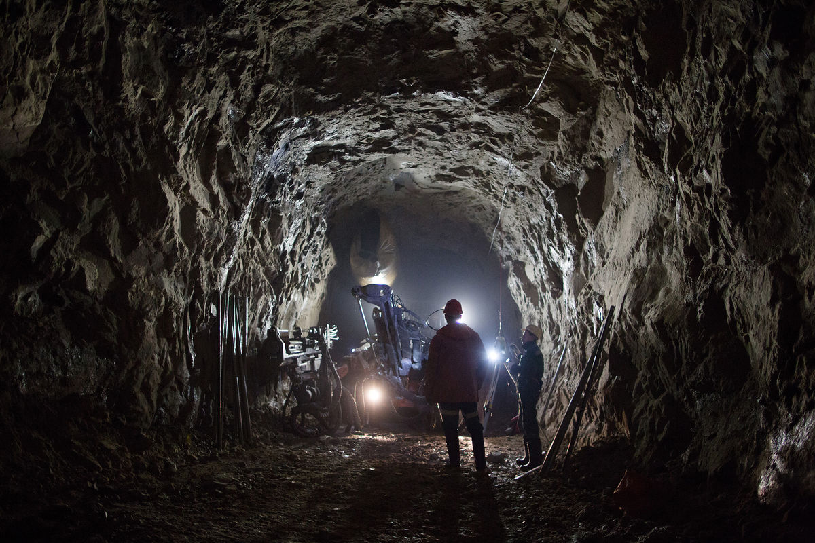
Part 3: How do you mine?
In the third video we look at the processes involved in mining
Exploration to reclamation
Stages of a mine life cycle
Many disciplines required
Likelihood of success and timescales
Video Time: 6 minutes
https://www.earthlearningidea.com/Video/Mining_Green_Revolution_3.html

Slide 7
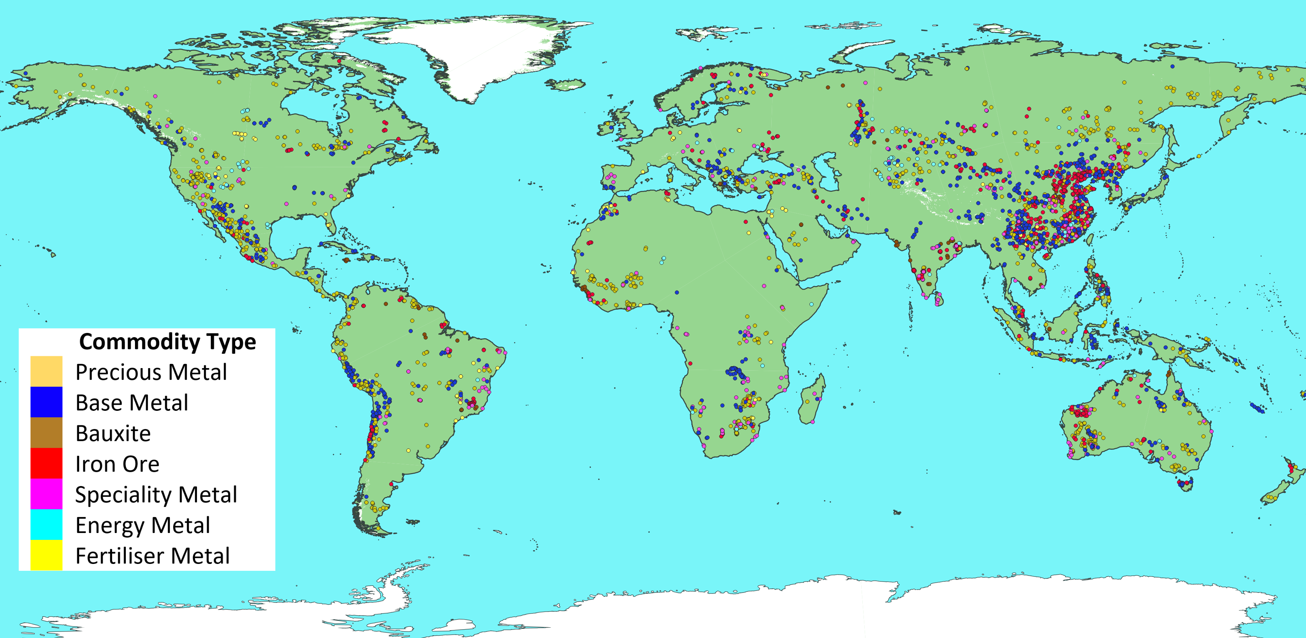
Part 4: Where do we mine?
In the fourth video we look at where we mine
Four main metals – aluminium, copper, iron and lithium
Global distribution of mines
UK mining and quarrying snapshot
Video Time: 4 minutes
https://www.earthlearningidea.com/Video/Mining_Green_Revolution_4.html

Slide 8
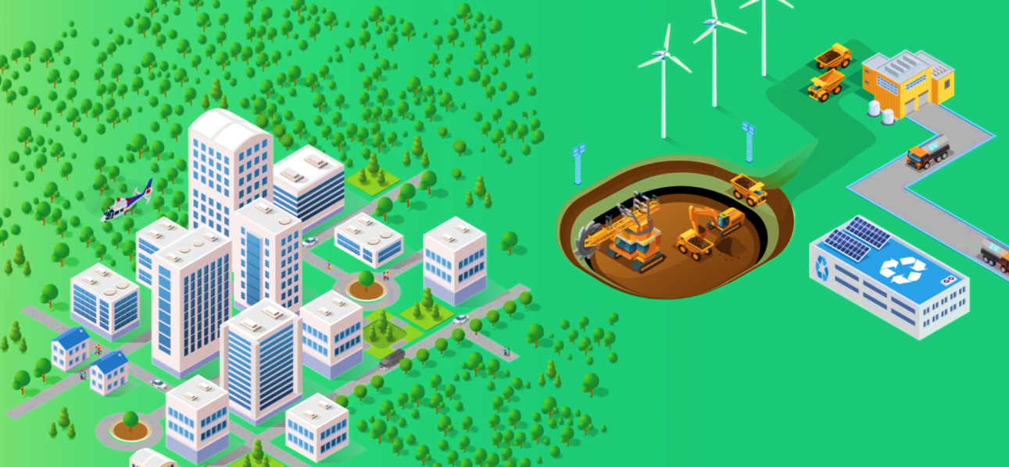
Part 5: What are the changes?
In the fifth video we look at the changes to the industry and how the future looks
Exploration
Mining operations
Environment, social and governance (ESG)
Health and safety
Artisanal and small-scale miners (ASM)
Carbon footprint
Social Impact Game
Video Time: 15 minutes
https://www.earthlearningidea.com/Video/Mining_Green_Revolution_5.html

Slide 9
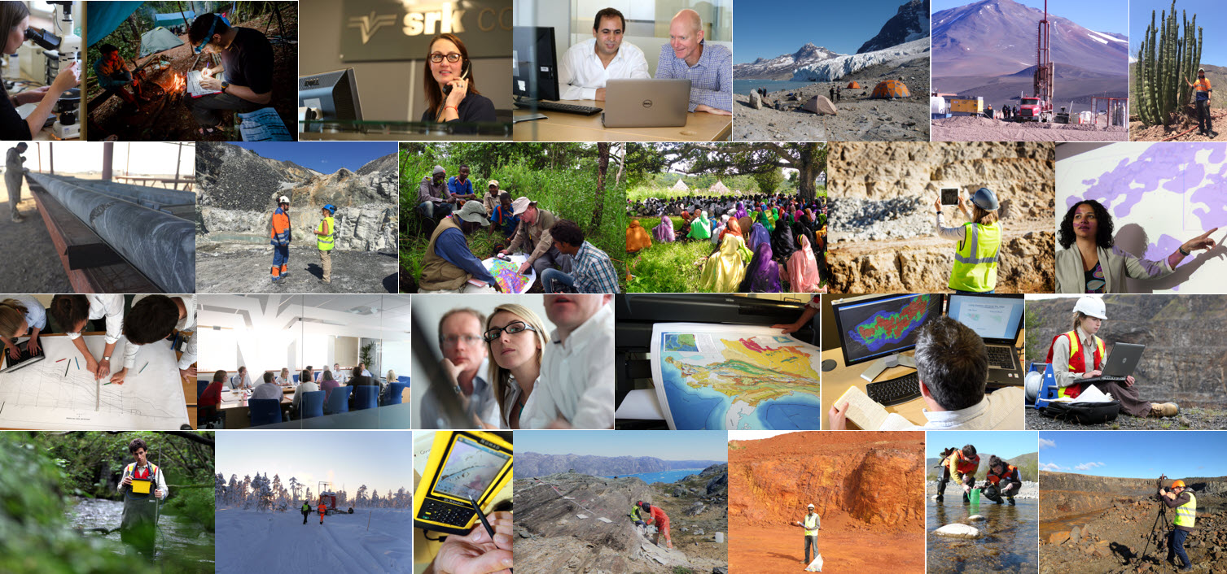
Part 6: What careers are there?
In the sixth and last instalment we look at careers in the exploration and mining industry
Geologists
Engineers
Scientists
Many others!
Video Time: 8 minutes
https://www.earthlearningidea.com/Video/Mining_Green_Revolution_6.html

Slide 10
Mining Needs You!
Mining has a bad reputation for a good reason
Mining required until complete circular economy possible
Mining does not have to be bad for the environment - massive changes already and more planned
Varied jobs - explore the world!
Mining needs people who care about the planet – change from the inside out

Slide 11
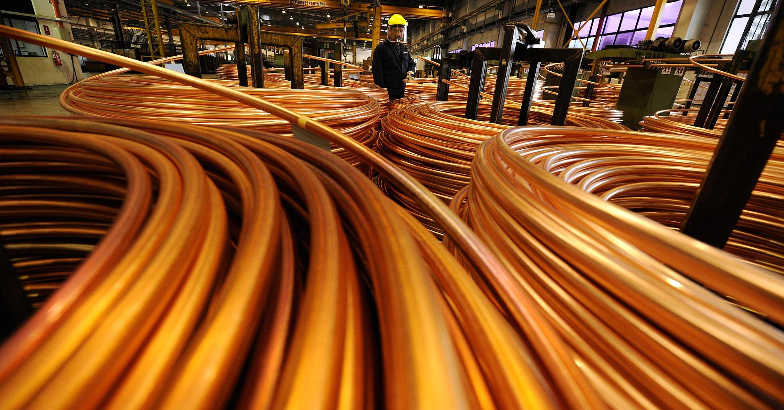
References
Alac (2019). Asociación Los Andes de Cajamarca (Alac) website. (www.losandes.org.pe/)
Briefcase Game (2019) www.thebriefcasegame.eu/comojugar.php.
Caterpillar (2014). Video from youtube called 'Improve Autonomous Mining Safety & Productivity'. www.youtube.com/watch?v=jhjjKGgggOw&t=37s.
E3 Metals Corp (2019). Website article. (www.thinkgeoenergy.com/canadian-firm-to-scale-up-testing-of-brine-for-lithium-extraction-in-alberta-canada/)
IEO (2019). U.S. Energy Information Administration’s International Energy Outlook 2019 (IEO2019). Center for Strategic and International Studies Presentation (www.eia.gov/outlooks/archive/ieo19/pdf/ieo2019.pdf)
IEO (2020). U.S. Energy Information Administration’s International Energy Outlook 2020 (IEO2020). Center for Strategic and International Studies Presentation (www.eia.gov/outlooks/ieo/pdf/ieo2020.pdf)
European Commission guidelines on non-financial reporting: Supplement on reporting climate-related information (2019/C 209/01)
Ey (2020). Website article on mining fiance risks. (www.ey.com/en_gl/mining-metals/10-business-risks-facing-mining-and-metals)
Glöser, S., Soulier, M., & Tercero Espinoza, L. A. (2013): Dynamic analysis of global copper flows. Global stocks, postconsumer material flows, recycling indicators & uncertainty evaluation.
Supporting Information. Environmental Science & Technology, 47, 6564–6572.
Hund, K., La Porta, D., Fabregas, T.P., Laing, T. & Drexhage, J. (2020). Minerals for Climate Action: The Mineral Intensity of the Clean Energy Transition. Report by The World Bank.
International Council for Mining and Metals (2016). Website article. www.icmm.com/en-gb/case-studies/restoring-biodiversity-through-research-partnerships-in-the-brazilian-amazon).
International Council for Mining and Metals (2017). Website article, www.icmm.com/en-gb/case-studies/promoting-gender-diversity-and-inclusion-in-the-drc.
Kerr, R. 2014. The coming copper peak. Science 343(6172). 722-724
Kitco News (2016). Infographic on 'Bring a Mine to Life'.
Kleijn, R., van der Voet, E., Kramer, G.J., van Oers, L., van der Giesen, C. 2011. Metal requirements of low-carbon power generation. Energy 36(9). 5640-5648.
Kutcho Copper Corp & Visual Capitalist (2018). Copper Driving the Green Revolution. Infographic hosted by Visual Capitalist (www.visualcapitalist.com/copper-driving-green-energy-revolution/)
Li-Co & Visual Capitalist (2017). Lithium and the Green Revolution. Infographic hosted by Visual Capitalist (www.visualcapitalist.com/lithium-fuel-green-revolution/)
Nickless, E., Ali, S., Arndt, N., Brown, G., Demetriades, A., Durrheim, R., Enriquez M.A., Giurco, D.,Kinnaird, J., Littleboy, A., Masotti, F., Meinert, L., Nyanganyura, D., Oberhänsli, R., Salem, J., Schneider, G., Yakovleva., N. Resourcing Future Generations: A Global Effort to Meet The World's Future Needs Head-on. International Union of Geological Sciences. 2015
Mining.com (2017) Move over, Tesla! China holds the keys to electric vehicles. http://www.mining.com/web/move-tesla-china-holds-keys-electric-vehicles/.
Nakanishi (2008). World Energy Supply 1971-2030. Infographic hosted by Visually.
Nickless, E. (2016) Resourcing Future Generations: A global effort to meet the world’s future needs head-on. European Geologist Journal 42 – International cooperation on raw materials
Northey, S., Mohr, S., Mudd, G.M., Weng, Z., Giurco, D. 2014. Modelling future copper ore grade decline based on a detailed assessment of copper resources and mining. Resources, Conservation and Recycling 83. 190-201
Prior, T., Giurco, D., Mudd, G., Mason, L., Behrisch, J. 2012. Resource depletion, peak minerals and the implications for sustainable resource management. Global Environmental Change 22(3). 577-587
Reuter, M. A., Hudson, C., van Schaik, A., Heiskanen, K., Meskers, C., Hagelüken, C. (2013). Metal Recycling: Opportunities, Limits, Infrastructure: A Report of the Working Group on the Global Metal Flows to the International Resource Panel. UNEP Report.
Tecnología (2019). Website article on Goldcorp's Borden Mine of the Future. latam-mining.com/tecnologia-newmont-goldcorp-launches-borden-ontarios-mine-of-the-future/.
Visual Capitalist (2016). Infographic on Battery Technology. www.visualcapitalist.com/critical-ingredients-fuel-battery-boom/
Visual Capitalist and LiCo Energy Metals Inc (2017). Infographic on Lithium is the fuel for the Green Revolution. www.visualcapitalist.com/lithium-fuel-green-revolution/
Visual Capitalist and Canadian Minerals and Metals Plan (2019). Infographic on Smart Solutions for Smart Mines. www.visualcapitalist.com/potential-smart-mining/
Wikipedia (2016). Lithium World Production Trend. en.wikipedia.org/wiki/Lithium_as_an_investment#/media/File:Lithium_world_production.svg.
Wilts, H., Tercero, L. & Wittmer, D. (2015). Recycling. Topic report.
World Bank Smart Mining infographic www.worldbank.org/en/news/infographic/2019/02/26/climate-smart-mining

