Slide 1
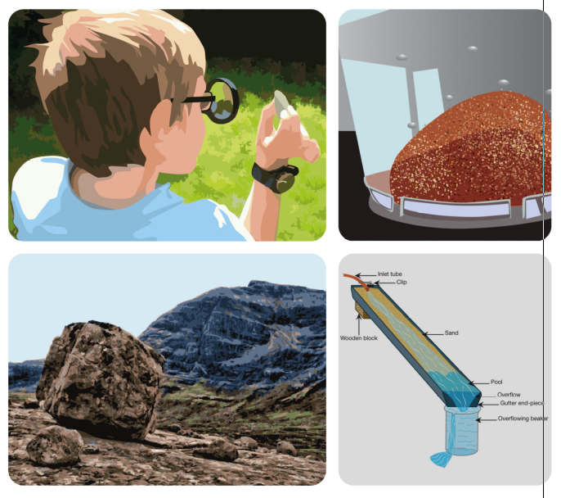
Earth’s surface activity
- quick to very, very slow
Geography video workshop
for ages 11 - 14
© Copyright is waived for original material contained in this workshop if it is required for use within the laboratory or classroom. Copyright material contained herein from other publishers rests with them. Any organisation wishing to use this material should contact the Earthlearningidea team.
Notes:
<number>

Slide 2
Earthlearningidea online video workshops
Purpose – ESEU background
Most Earthlearningidea online video workshops are based, with permission, on workshops originally developed by the Earth Science Education Unit (ESEU)
These were designed as interactive workshops for teachers and trainees, involving interaction, discussion and presentations by participants to others
Global research into professional development workshops shows that these aspects are critical to success
ESEU research shows that this workshop approach is highly successful in changing teaching in schools; evaluation feedback has also been very strong

Slide 3
Earthlearningidea online video workshops
Purpose – Earthlearningidea development
The Earthlearningidea Team has developed the ESEU workshops into online video workshops for those unable to take part in face to face interactive workshops
Each workshop is led by a PowerPoint presentation and has an accompanying booklet that contains all the activity background details, resource lists, risk assessments, etc.
The individual workshop activities have been published for open access online at the website: https://www.earthlearningidea.com/
Each workshop activity has a question script and a video keyed into CASE principles, that can be accessed through the PowerPoint hyperlinks
The aim is to facilitate online Earth science learning

Slide 4
Earth’s surface activity – using CASE
Teaching Earth science using the Cognitive Acceleration through Science (CASE) approach
The activities in this workshop are keyed into the CASE approach – to develop thinking skills while teaching key Earth science material
If you are unfamiliar with the case approach, you can access a video introduction at: https://www.earthlearningidea.com/Video/CASE.html
An exemplar Earth science teaching activity with a question script using the CASE approach is at: https://www.earthlearningidea.com/Video/Atmosphere_ocean.html
Notes:
<number>

Slide 5
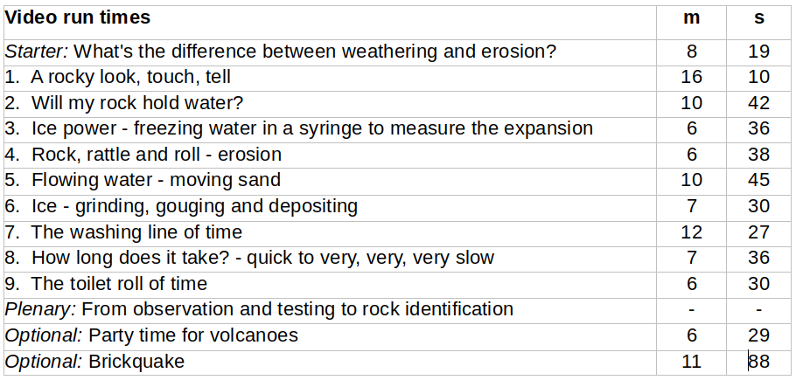
Earth’s surface activity
Notes:
<number>

Slide 6
Earth’s surface activity
Workshop outcomes
The workshop and its activities provide the following outcomes:
• Insights into ways of distinguishing and identifying different rocks based on their properties.
• Demonstrations of how rock properties affect landscape formation.
• Focus on the key processes of weathering, erosion, transportation and deposition by both water and ice.
• Different approaches to considering geological time and the rate of geological processes.
• Discussions and demonstrations about the state (solid/liquid) of the layers.
• Means of addressing common Earth science misconceptions.
• Links to the geography and science of Earth processes.
• Guidance on how the elements of Earth science in the curriculum can be taught most effectively.
Notes:
<number>

Slide 7
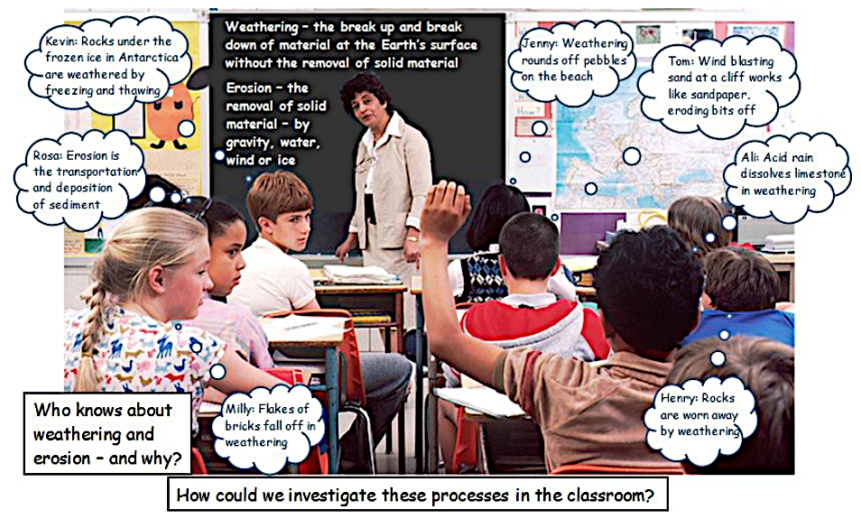
Earth’s surface activity
What’s the difference between weathering and erosion?
Go to: https://www.earthlearningidea.com/Video/Geog0.html hyperlink
Notes:
<number>

Slide 8
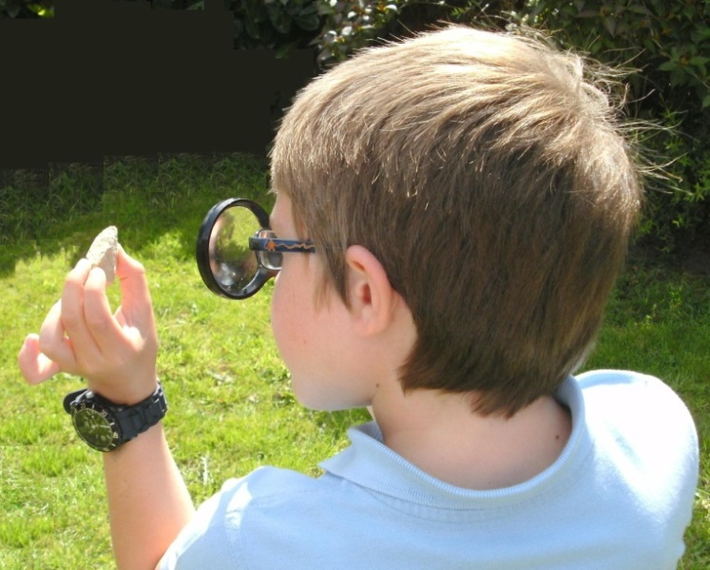
Earth’s surface activity
Circus activity 1: A rocky look, touch and tell
Go to: https://www.earthlearningidea.com/Video/Geog1.html hyperlink
Notes:
<number>

Slide 9
Earth’s surface activity
Circus activity 1: A rocky look, touch and tell
Sedimentary rocks are usually made of grains that are stuck together and can often easily be scratched off |  | Crystalline rocks are usually made of interlocking grains that are very hard to scratch off
Igneous rocks are crystalline rocks made of different minerals scattered through them |  | Metamorphic rocks are crystalline rocks with minerals in layers or bands or made of just one material
Notes:
<number>

Slide 10
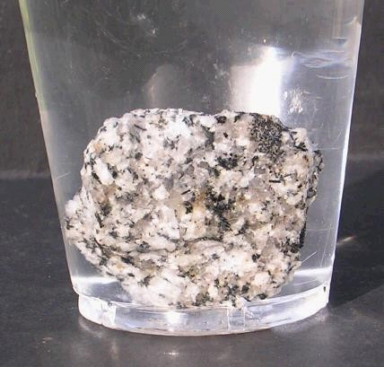
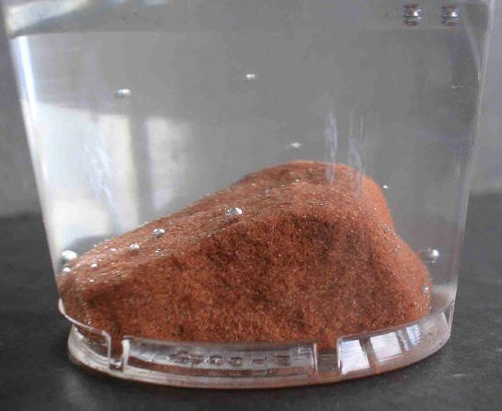
Earth’s surface activity
Circus activity 2: Will my rock hold water?
Go to: https://www.earthlearningidea.com/Video/Geog2.html hyperlink
Notes:
<number>

Slide 11
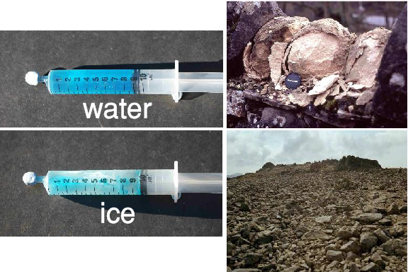
Earth’s surface activity
Circus activity 3: Ice power
Go to: https://www.earthlearningidea.com/Video/Geog3.html hyperlink
Notes:
<number>

Slide 12
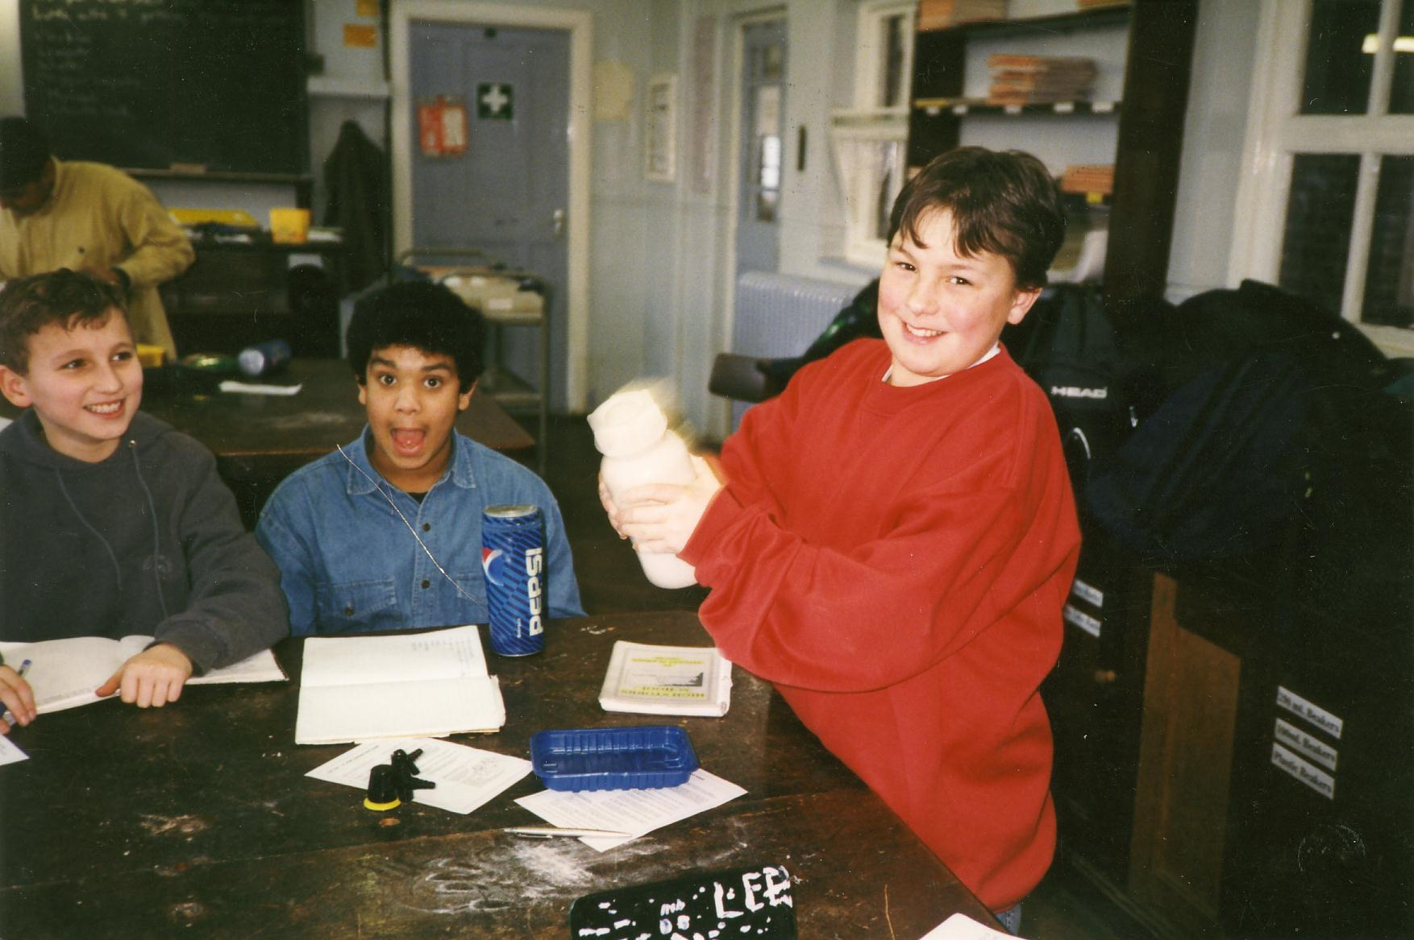
Earth’s surface activity
Circus activity 4: Rock, rattle and roll - erosion
Go to: https://www.earthlearningidea.com/Video/Geog4.html hyperlink
Notes:
<number>

Slide 13
Earth’s surface activity
Erosion – investigating the resistance of rock samples
This area formed of four different rock types has a straight coastline and a flat surface.
What will it look like in 10,000 years ?
Next slide shows the answer
Notes:
<number>

Slide 14
Earth’s surface activity
Erosion – investigating the resistance of rock samples
Which rocks form headlands, hills? Which form bays, valleys?
What does it mean when you walk uphill?
Notes:
<number>

Slide 15
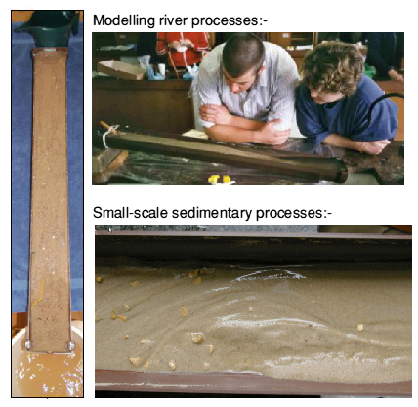
Earth’s surface activity
Circus activity 5: Flowing water – moving sand
Go to: https://www.earthlearningidea.com/Video/Geog5a.html hyperlink
Notes:
<number>

Slide 16
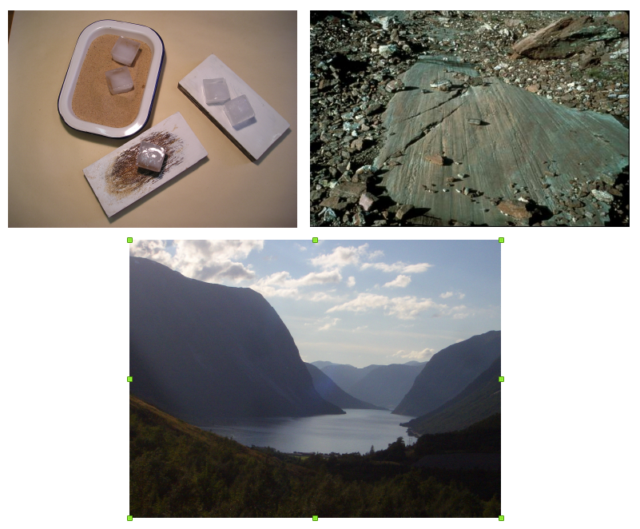
Earth’s surface activity
Circus activity 6: Ice – grinding, gouging and depositing
Go to: https://www.earthlearningidea.com/Video/Geog6.html hyperlink
Notes:
<number>

Slide 17
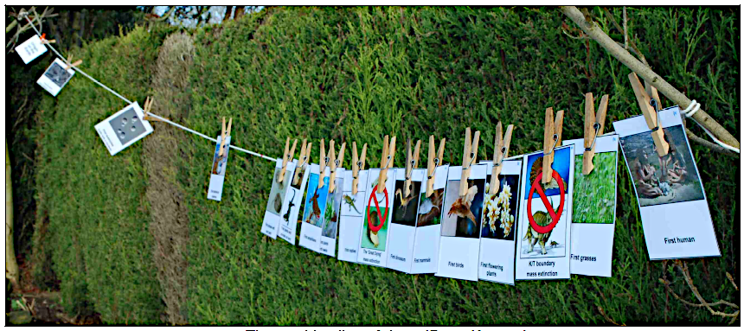
Earth’s surface activity
Circus activity 7: The washing line of time
Images for the cards can be found in the workshop booklet
Go to: https://www.earthlearningidea.com/Video/Geog7a.html hyperlink
Notes:
<number>

Slide 18
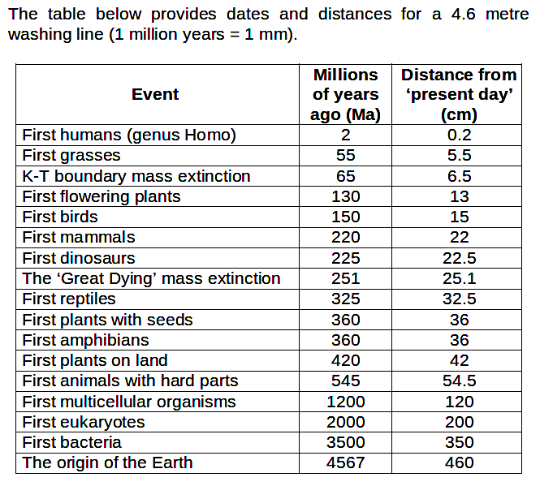
Earth’s surface activity
Circus activity 7: The washing line of time
Notes:
<number>

Slide 19
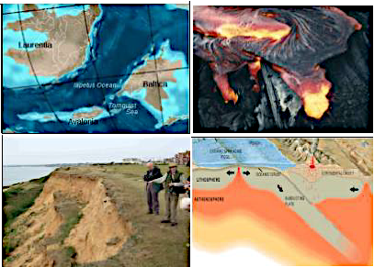
Earth’s surface activity
Circus activity 8: How long does it take?
- quick to very, very, very slow
Timing Earth events cards can be found in the workshop booklet
Go to: https://www.earthlearningidea.com/Video/Geog8.html hyperlink
Notes:
<number>

Slide 20
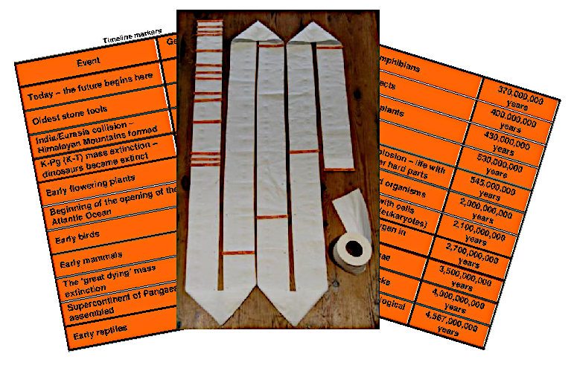
Earth’s surface activity
Circus activity 9: The toilet roll of time
Go to: https://www.earthlearningidea.com/Video/Geog9.html hyperlink
Notes:
<number>

Slide 21
Earth’s surface activity
Plenary: From observation and testing to rock identification
Give the pupils a selction of rock specimens and ask them to use the methods
From activities, ‘A rocky, look, touch, tell’ and ‘Will my rock hold water?’
To sort the rocks into:
Crystalline – made of interlocking grains and so usually impermeable and tough
Sedimentary – made of grains subjected to compression and compaction and so
usually permeable and weak
Then ask them to further subdivide the crystalline rocks into:
Igneous – crystalline rocks made of randomly oriented grains
Metamorphic – crystalline rocks usually made of aligned grains
Suitable rock specimens for identification
Notes:
<number>

Slide 22
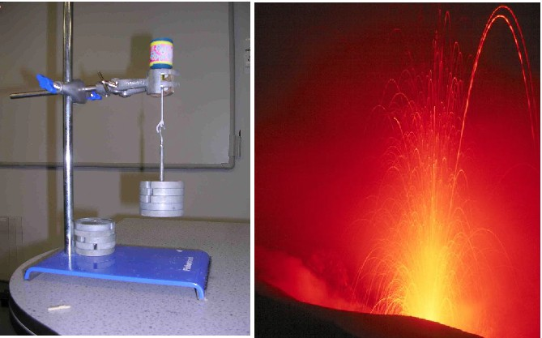
Earth’s surface activity
Optional: Party-time for volcanoes
Go to: https://www.earthlearningidea.com/Video/Geog10.html hyperlink
Notes:
<number>

Slide 23
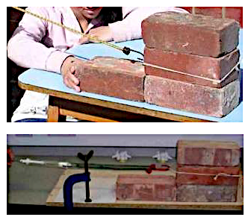
Earth’s surface activity
Optional: Brickquake
Go to: https://www.earthlearningidea.com/Video/Geog11a.html hyperlink
Notes:
<number>

Slide 24
Earth’s surface activity
Workshop outcomes
The workshop and its activities provide the following outcomes:
• Insights into ways of distinguishing and identifying different rocks based on their properties.
• Demonstrations of how rock properties affect landscape formation.
• Focus on the key processes of weathering, erosion, transportation and deposition by both water and ice.
• Different approaches to considering geological time and the rate of geological processes.
• Discussions and demonstrations about the state (solid/liquid) of the layers.
• Means of addressing common Earth science misconceptions.
• Links to the geography and science of Earth processes.
• Guidance on how the elements of Earth science in the curriculum can be taught most effectively.
Notes:
<number>

Slide 25
Earth’s surface activity
- quick to very, very slow
Geography video workshop
for ages 11 - 14
© Copyright is waived for original material contained in this workshop if it is required for use within the laboratory or classroom. Copyright material contained herein from other publishers rests with them. Any organisation wishing to use this material should contact the Earthlearningidea team.
Notes:
<number>

