Slide 1
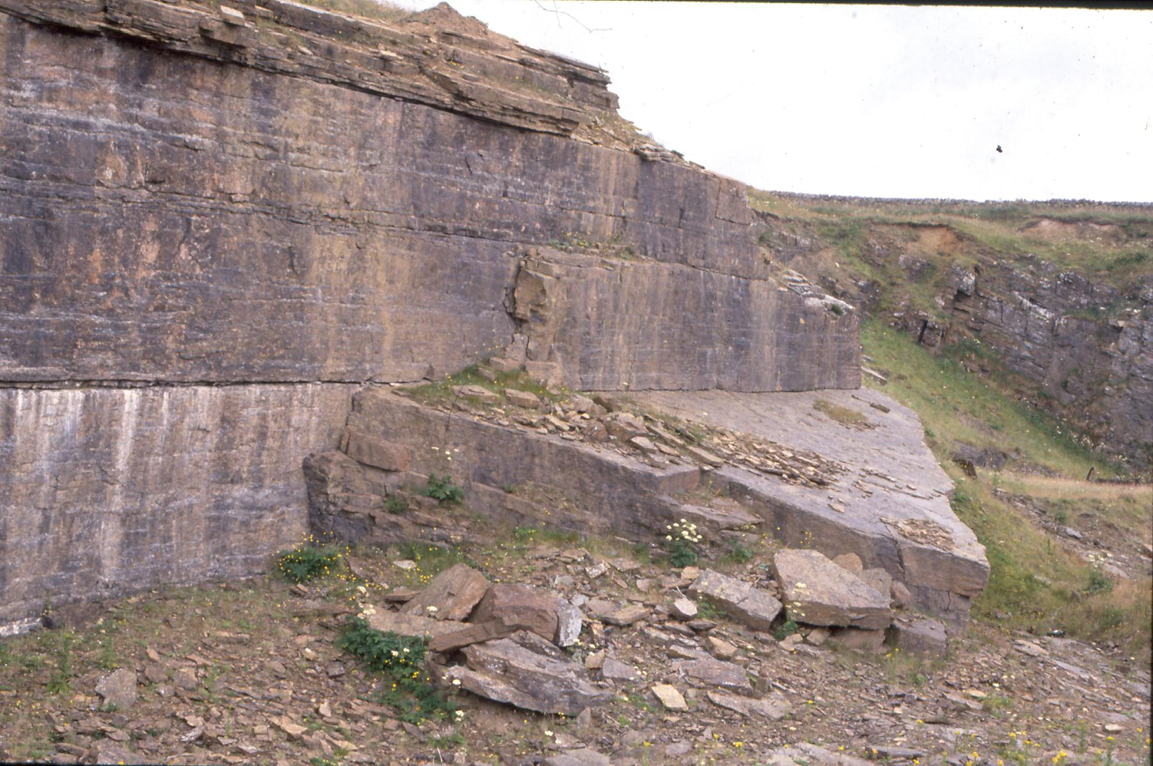
Any Quarry Guide :
good questions to ask and answer
at a quarry, cliff face or rock face
Earth science out of doors
for KS3 science/geography
© Copyright is waived for original material contained in this workshop if it is required for use within the laboratory or classroom. Copyright material contained herein from other publishers rests with them. Any organisation wishing to use this material should contact the Earthlearningidea team.
Notes:
1

Slide 2
Earthlearningidea online video workshops
Purpose – ESEU background
Most Earthlearningidea online video workshops are based, with permission, on workshops originally developed by the Earth Science Education Unit (ESEU)
These were designed as interactive workshops for teachers and trainees, involving interaction, discussion and presentations by participants to others.
Global research into professional development workshops shows that these aspects are critical to success.
ESEU research shows that this workshop approach is highly successful in changing teaching in schools; evaluation feedback has also been very strong.

Slide 3
Earthlearningidea online video workshops
Purpose – Earthlearningidea development
The Earthlearningidea Team has developed the ESEU workshops into online video workshops for those unable to take part in face to face interactive workshops
Most workshops are led by a PowerPoint presentation and have an accompanying booklet that contains all the activity background details, resource lists, risk assessments, etc.
The individual workshop activities have been published for open access online at the website: https://www.earthlearningidea.com/
Each workshop activity has a question script and a video keyed into CASE principles, that can be accessed through the PowerPoint hyperlinks.
The aim is to facilitate online Earth science learning.

Slide 4
Any Quarry Guide - using CASE
Teaching Earth science using the Cognitive Acceleration through Science (CASE) approach
The activities in this workshop are keyed into the CASE approach – to develop thinking skills while teaching key Earth science material
If you are unfamiliar with the case approach, you can access a video introduction at: https://www.earthlearningidea.com/Video/CASE.html
An exemplar Earth science teaching activity with a question script using the CASE approach is at: https://www.earthlearningidea.com/Video/Atmosphere_ocean.html
Notes:
1

Slide 5
Any Quarry Guide
Summary
What to look for during a field visit to a local disused quarry or natural rock exposure;
This PowerPoint covers each aspect of the ESEU Any Quarry Guide booklet;
The case-study videos were filmed in Brown Edge Quarry, Ringinglow, near Sheffield, (omitting aspects from the Guide which were not relevant to that quarry).
Notes:
1

Slide 6
Any Quarry Guide
Workshop outcomes
The quarry visit provides the following outcomes:
identification of a range of rock types;
knowledge and understanding about processes of weathering, erosion and soil formation;
skills of thinking in three dimensions;
understanding how the geological history of an area can be elucidated;
experience of bridging school-based learning with the outside environment.
Notes:
<number>

Slide 7
Any Quarry Guide
Workshop video run times | m | s | m | s
CASE – Cognitive Acceleration through Science Education |  |  | 21 | 51
Using CASE | 6 | 24
Atmosphere and ocean | 15 | 27
Any Quarry Guide |  |  | 46 | 77
A. Preparation |  |  | 6 | 30
B. Reconnaissance Visit |  |  | 3 | 18
Focus 1 and 2: Weathering and erosion |  |  | 4 | 14
Focus 3: Soils |  |  | 1 | 52
Focus 4: Rock Group |  |  | 2 | 14
Focus 5: Grains |  |  | 1 | 42
Focus 6: Sedimentary structures |  |  | 3 | 23
Focus 9: Tilted rocks |  |  | 2 | 57
Focus 13: Sequencing |  |  | 3 | 16
Focus 14: Tectonic plates |  |  | 3 | 02
Focus 15: Landscape |  |  | 2 | 25
Focus 16: Quarry economics |  |  | 5 | 33
Focus 17: Quarry potential |  |  | 1 | 37
Focus 18: Recording |  |  | 4 | 43
Notes:
<number>

Slide 8
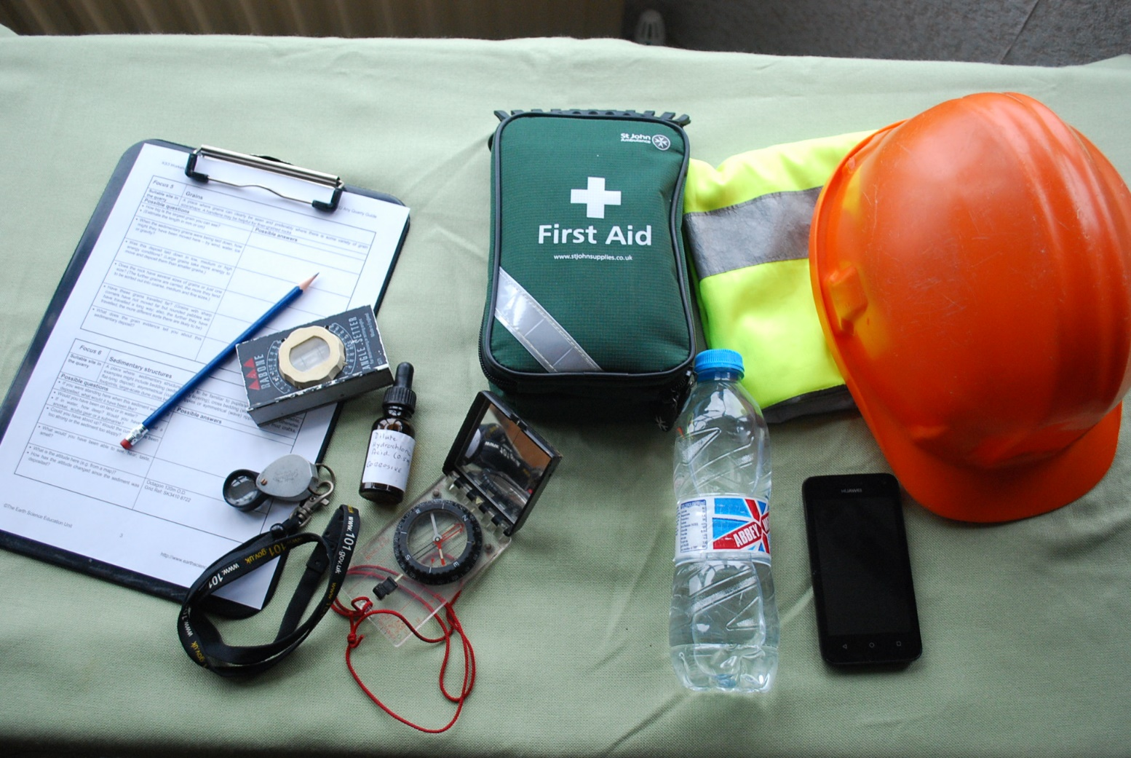
Any Quarry Guide
A.i Preparation at school: Field equipment

Slide 9
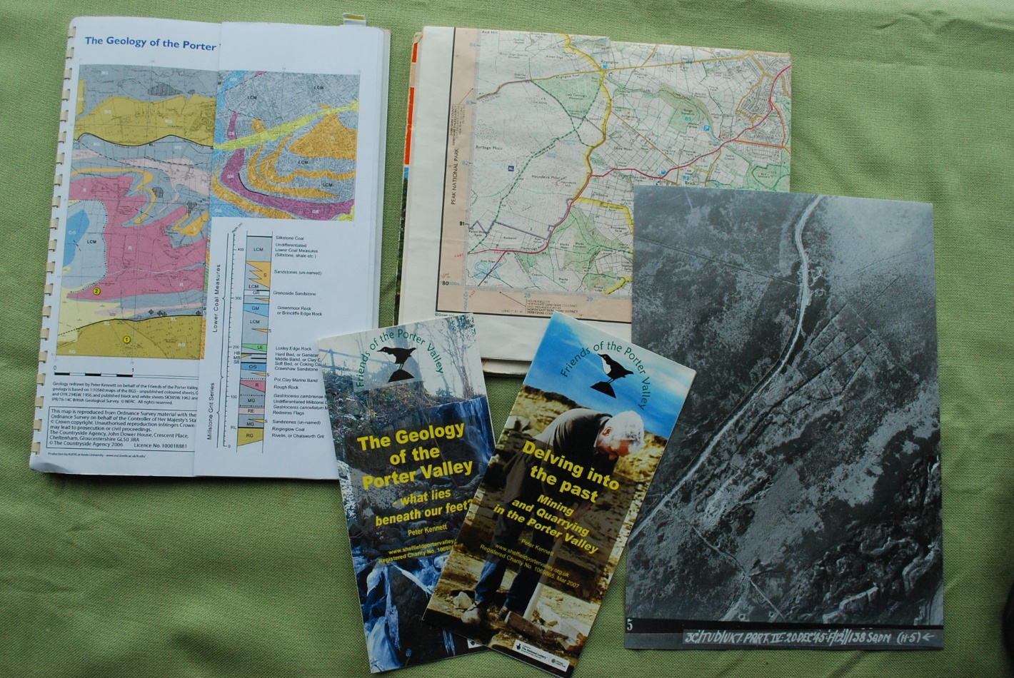
Any Quarry Guide
A.ii Preparation at school: Desk-top survey
Video - Preparation

Slide 10
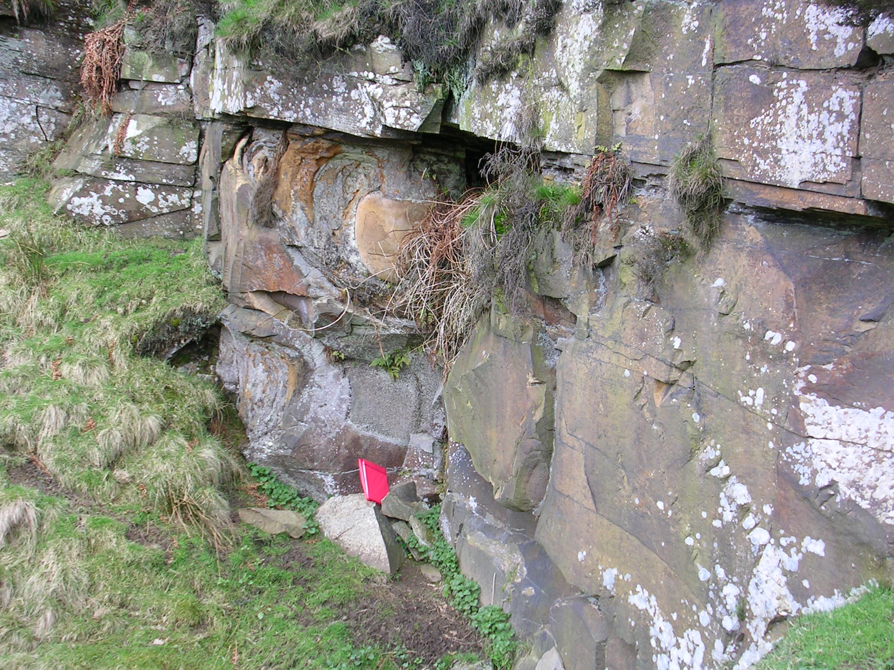
Any Quarry Guide
B. Field Reconnaissance
Video – Reconnaissance visit

Slide 11
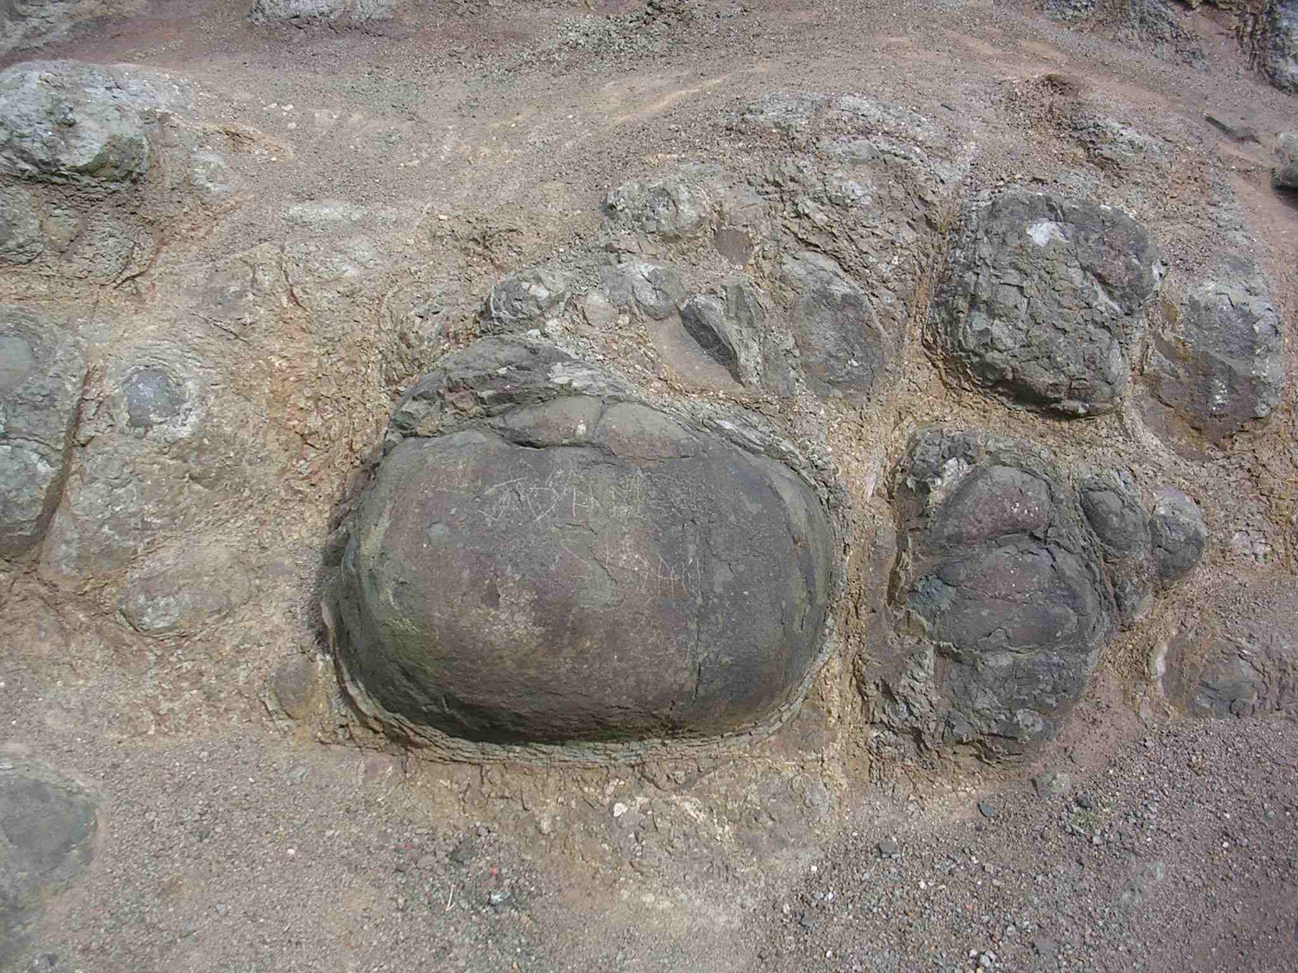
Any Quarry Guide
Focus 1: Weathering
Video – Weathering and erosion

Slide 12
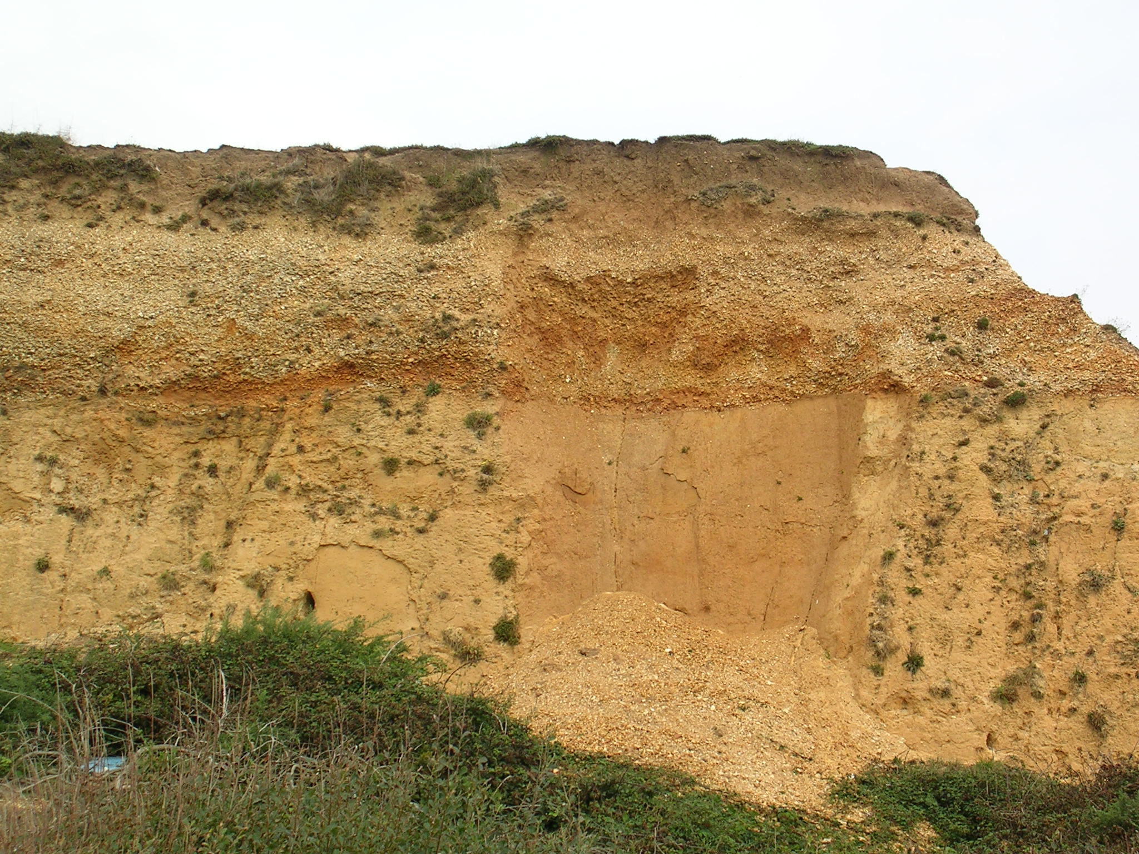
Any Quarry Guide
Focus 2: Erosion
Video – Weathering and erosion

Slide 13
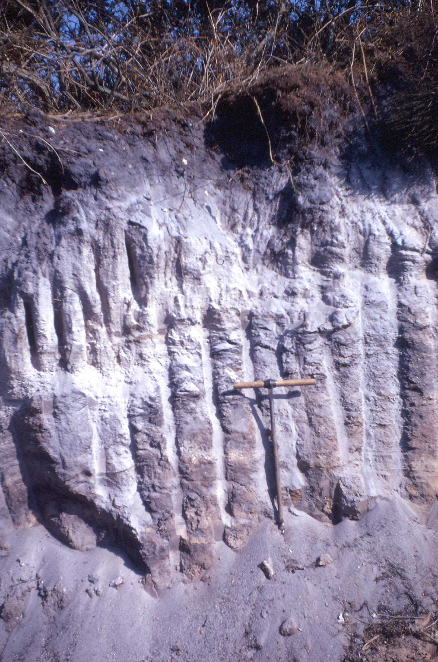
Any Quarry Guide
Focus 3: Soil
Video - Soil

Slide 14
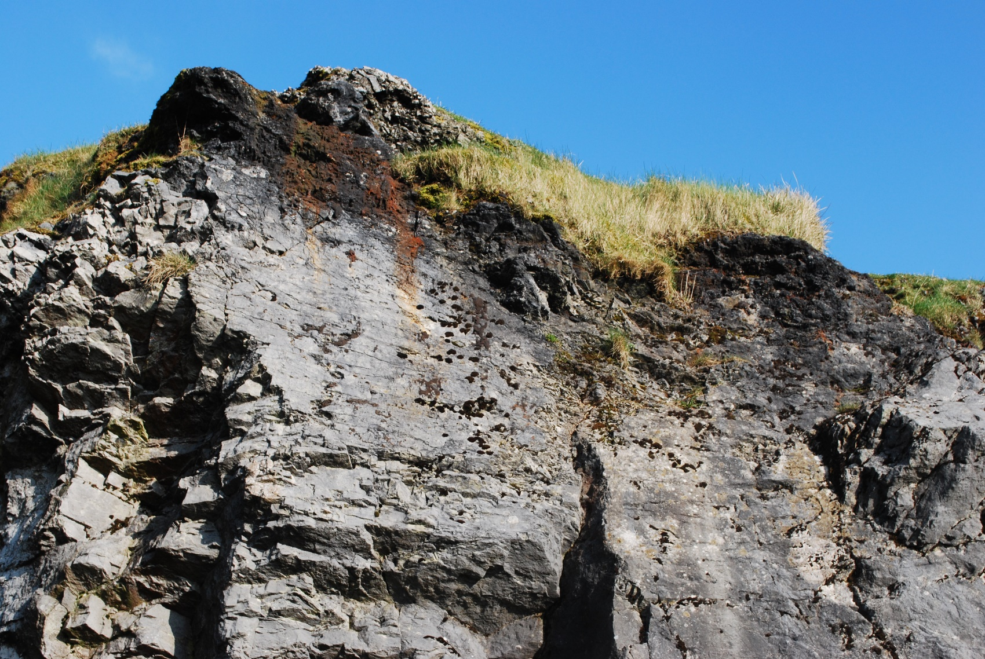
Any Quarry Guide
Focus 4: Rock group
Video – Rock group

Slide 15
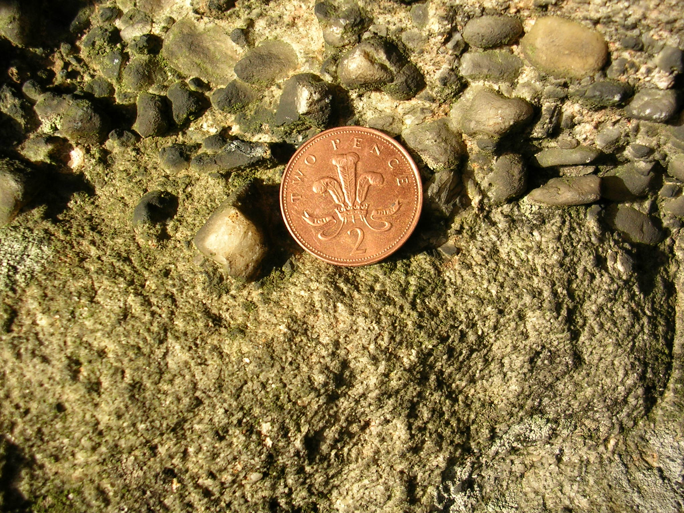
Any Quarry Guide
Focus 5: Grains (Coin = 25mm)
Video - Grains

Slide 16
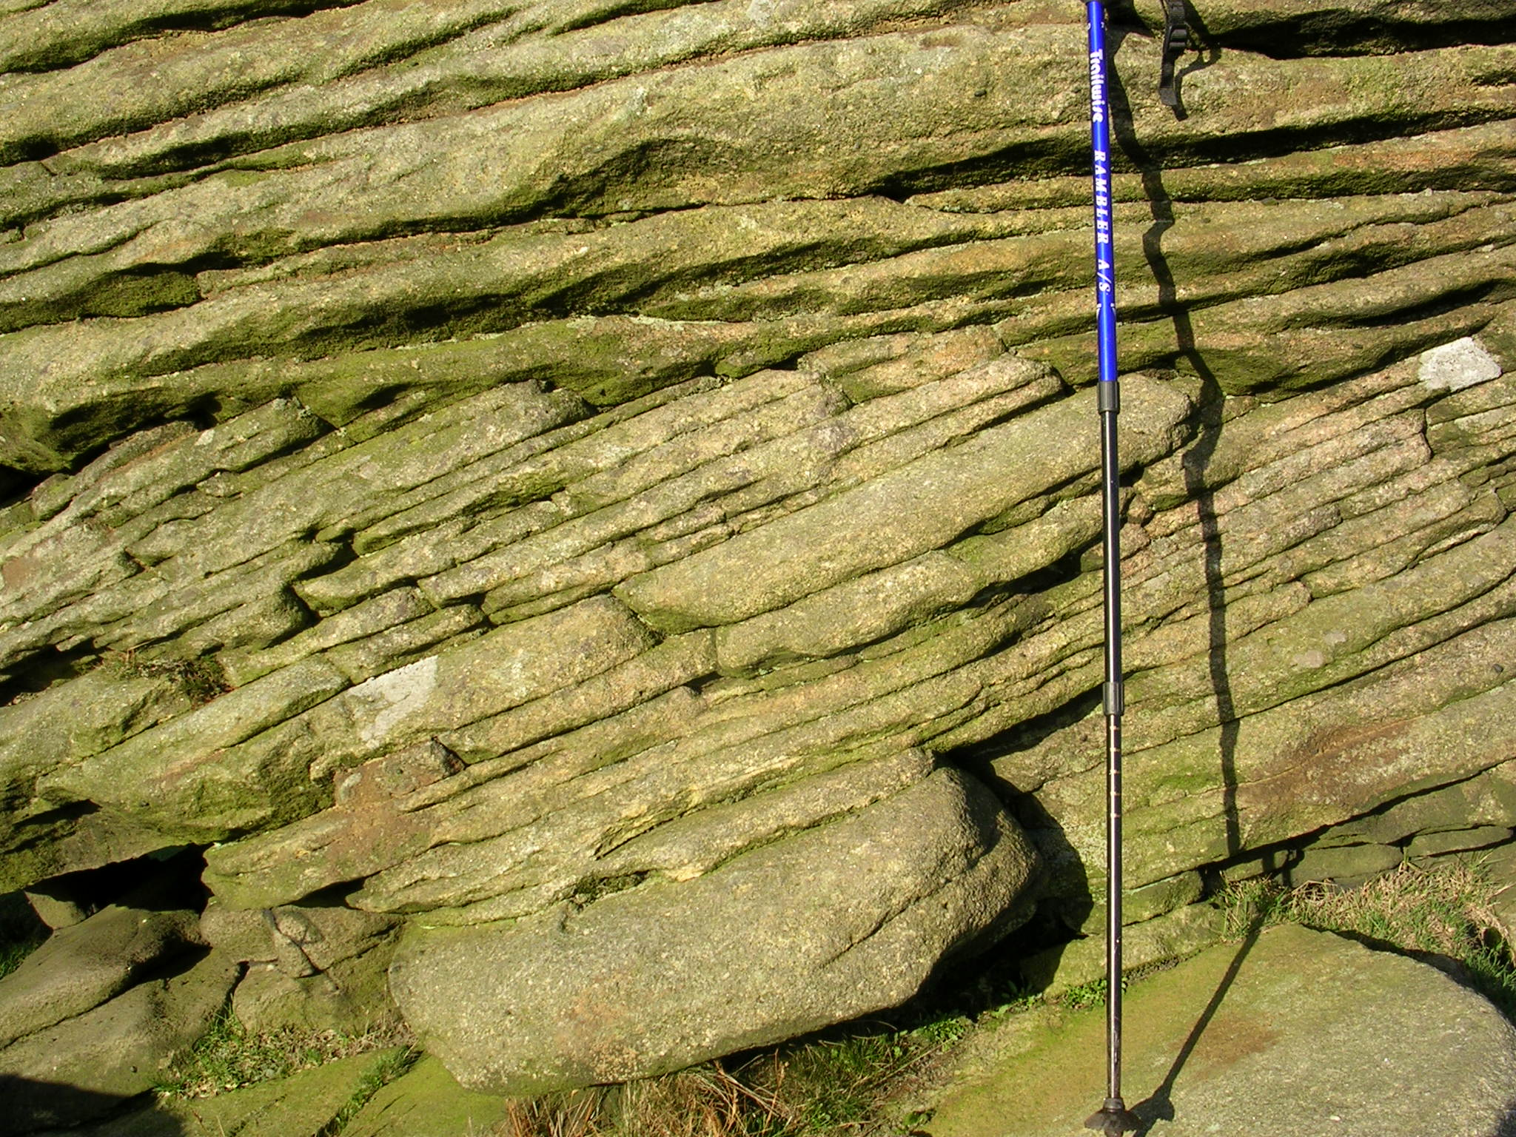
Any Quarry Guide
Focus 6: Sedimentary structures
Video – Sedimentary structures

Slide 17
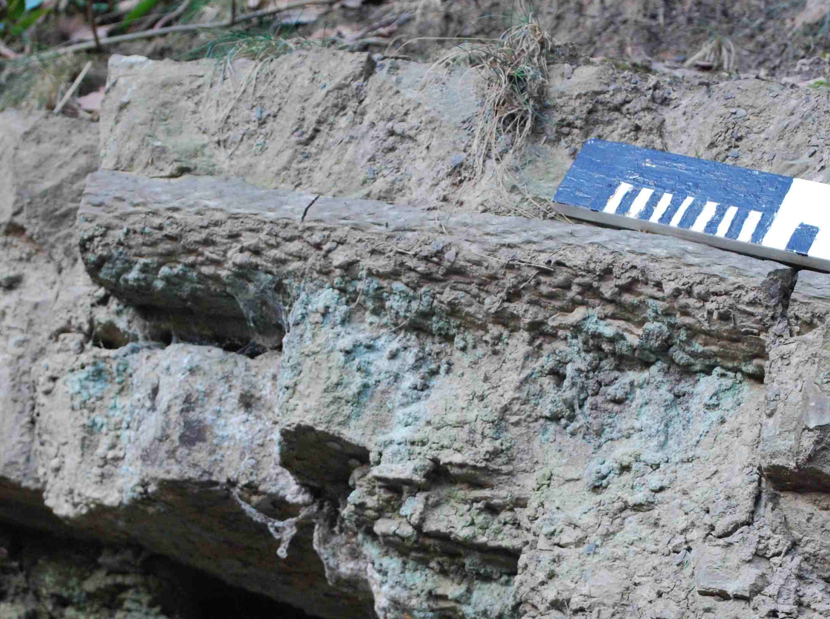
Any Quarry Guide
Focus 7: Fossils

Slide 18
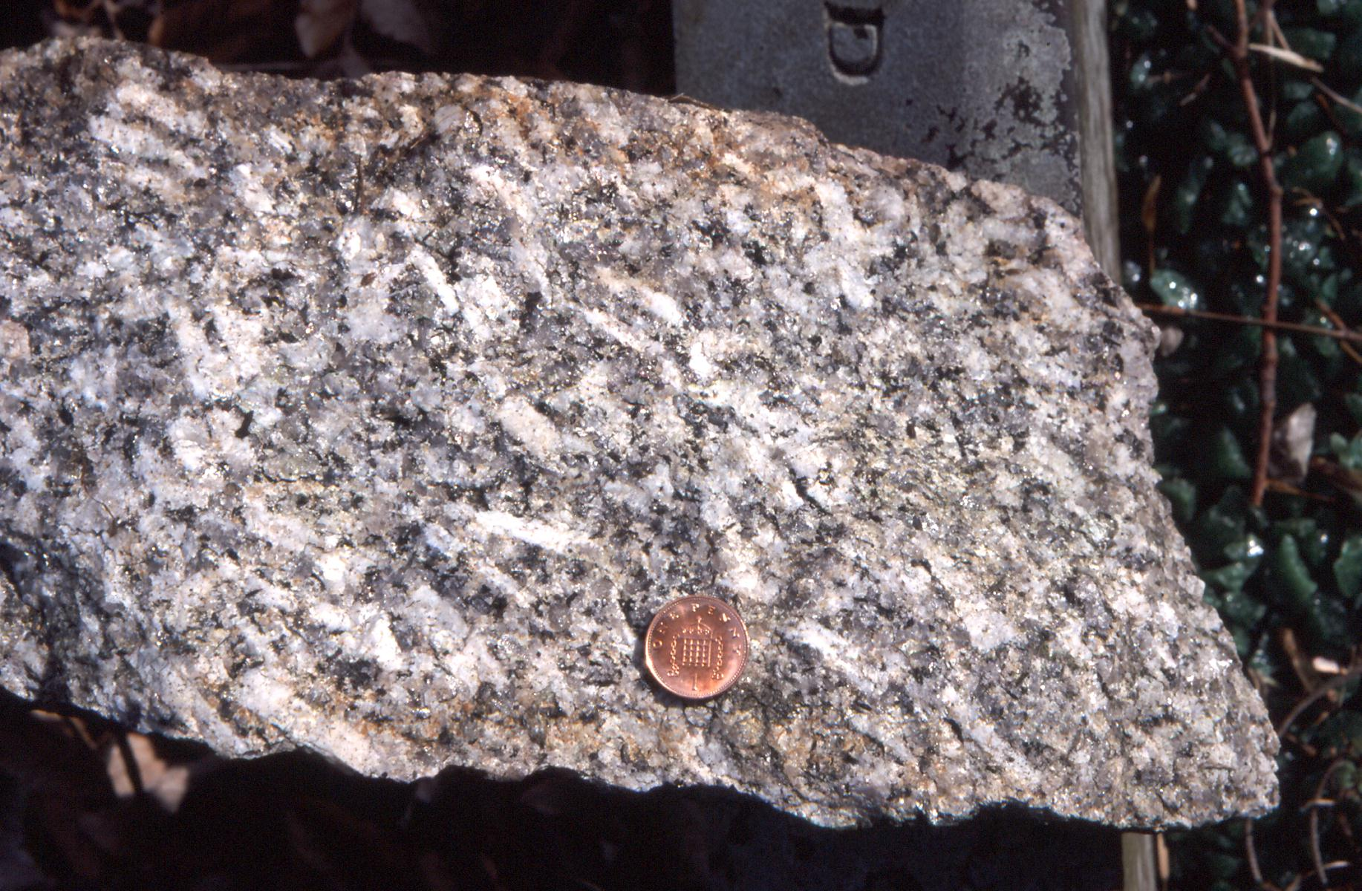
Any Quarry Guide
Focus 8: Crystals

Slide 19
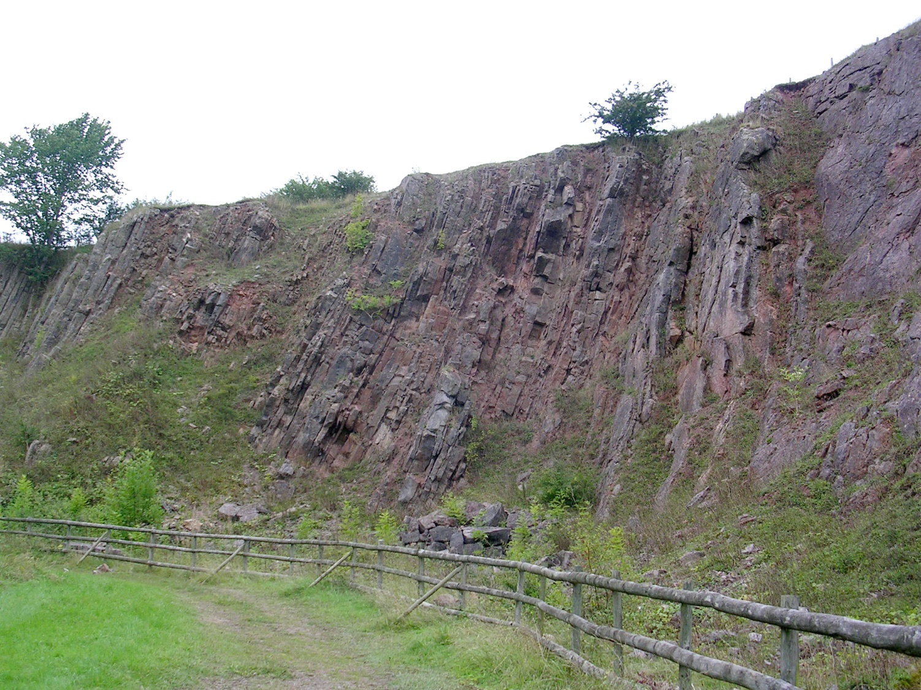
Any Quarry Guide
Focus 9: Tilted rocks
Video – Tilted rocks

Slide 20
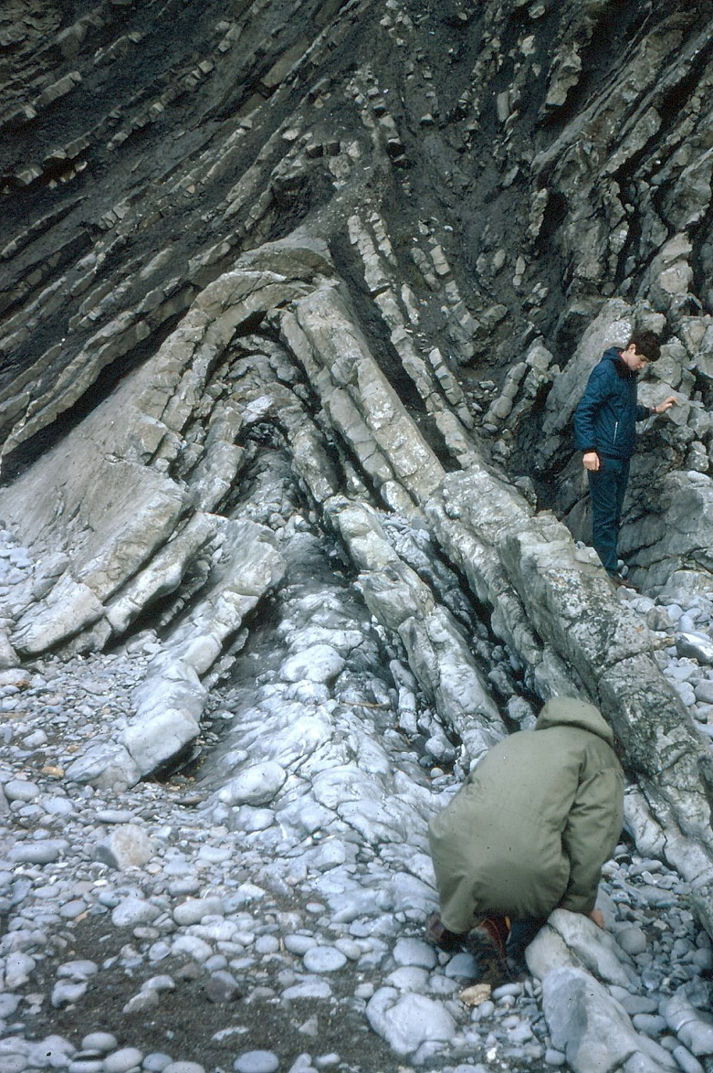
Any Quarry Guide
Focus 10: Folds

Slide 21
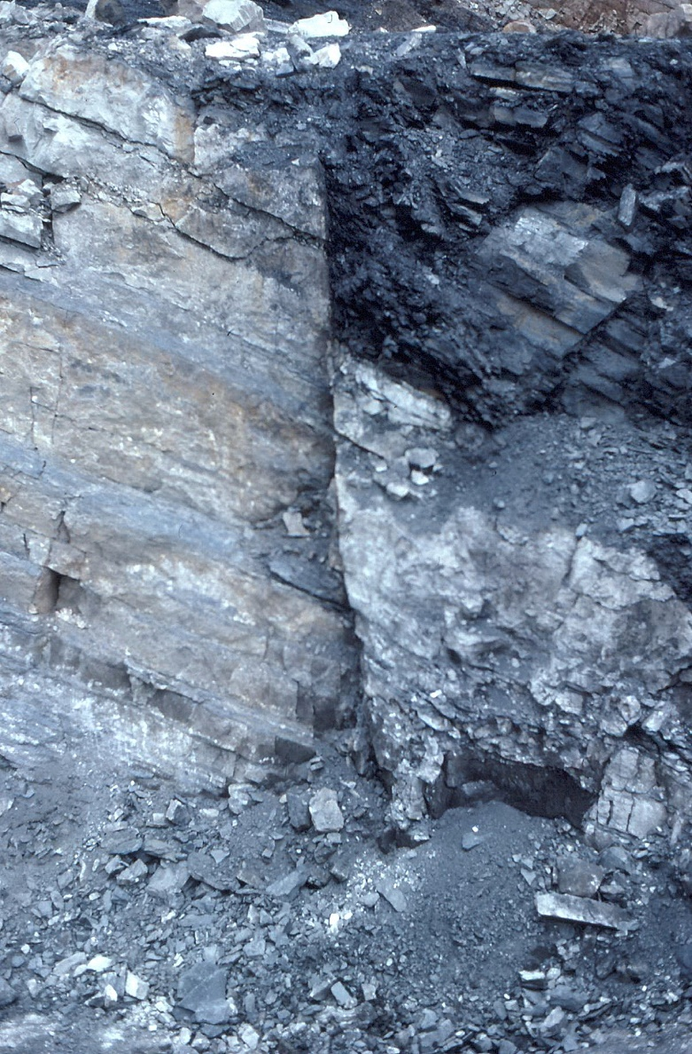
Any Quarry Guide
Focus 11: Faults

Slide 22
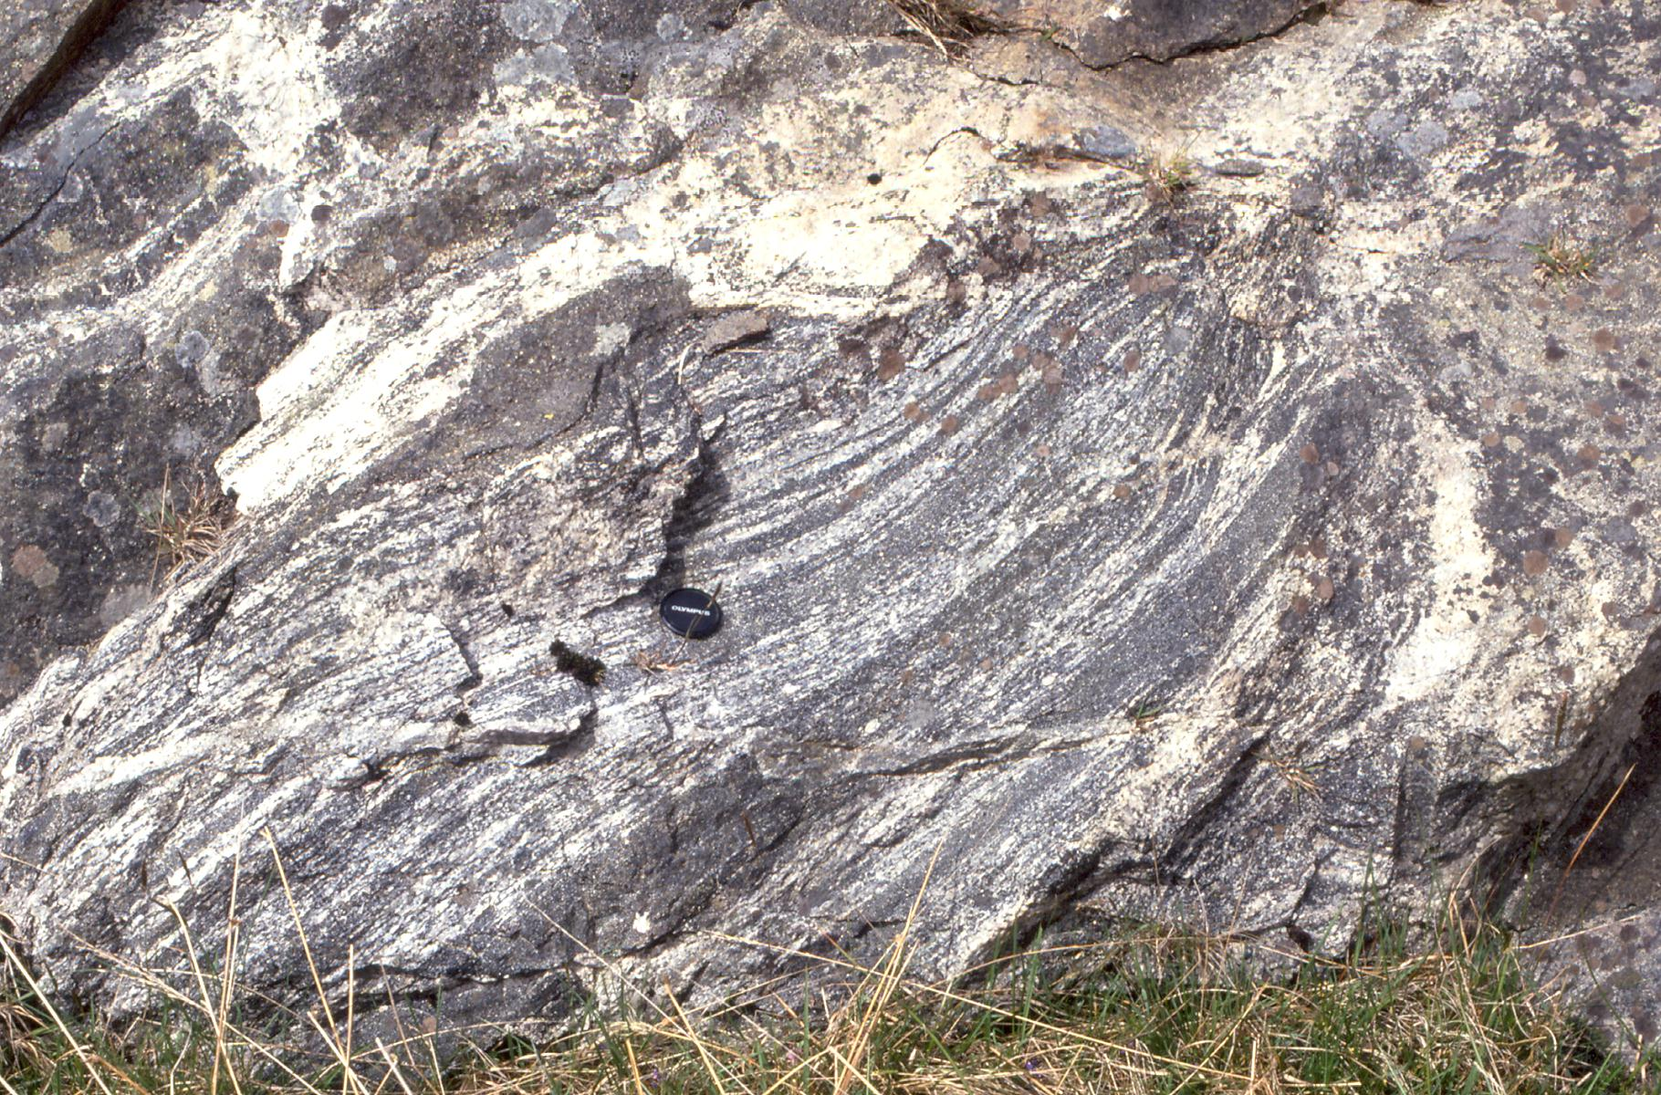
Any Quarry Guide
Focus 12: Metamorphism

Slide 23
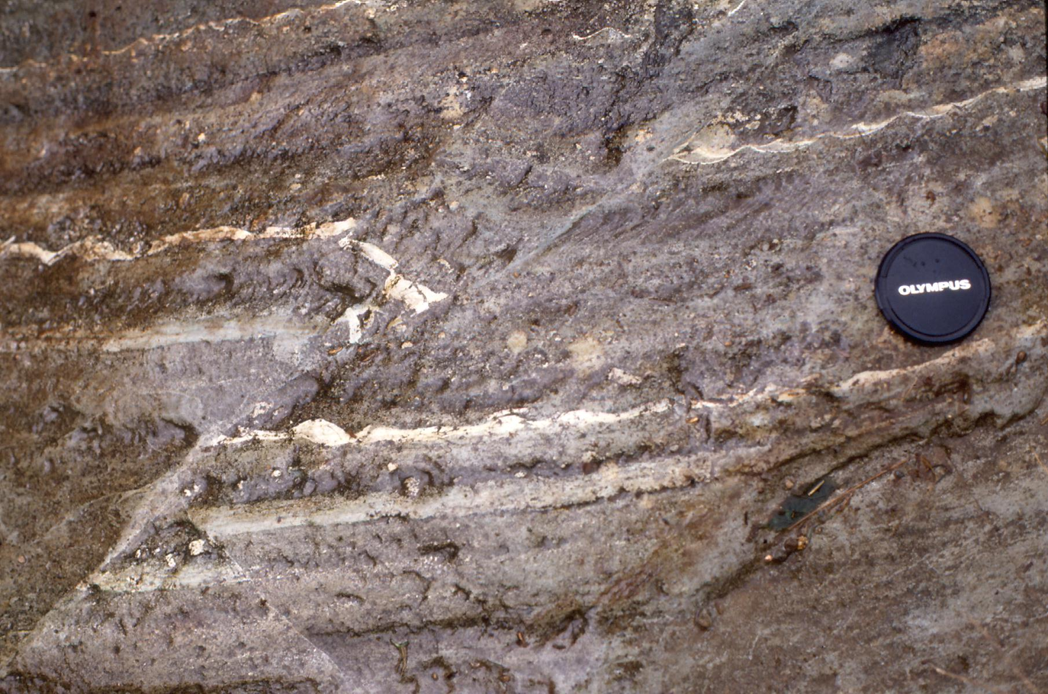
Any Quarry Guide
Focus 13: Sequencing
Video - Sequencing

Slide 24
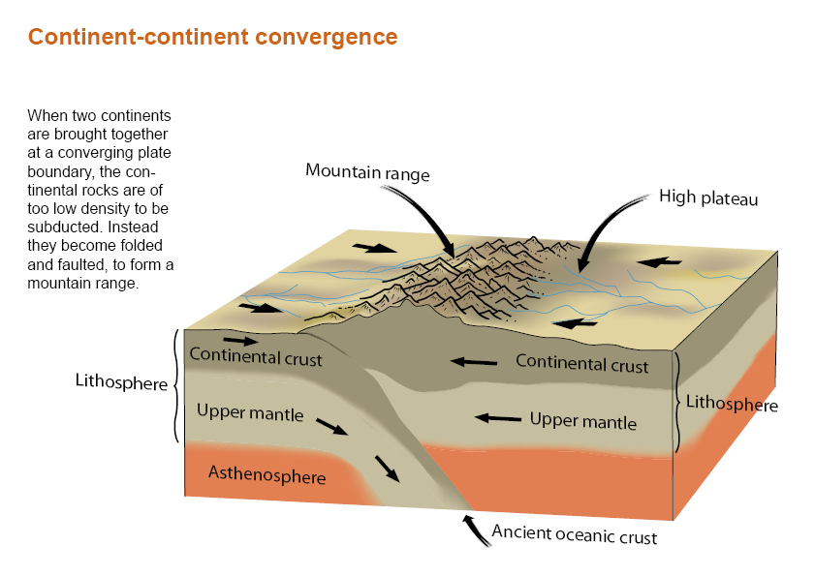
Any Quarry Guide
Focus 14: Tectonic plates (Diagram courtesy of ESEU)
Video – Tectonic plates

Slide 25
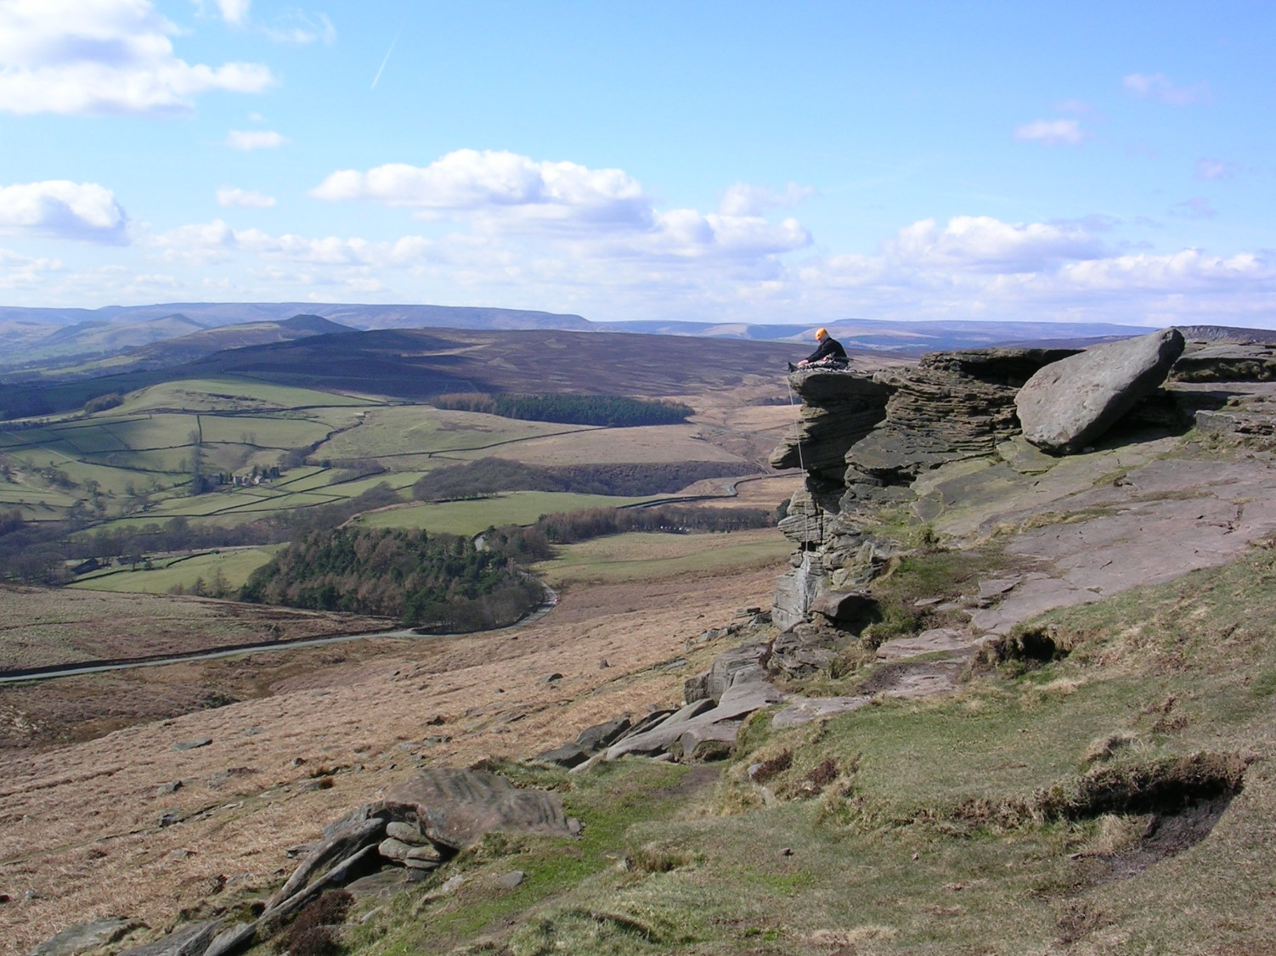
Any Quarry Guide
Focus 15: Landscape
Video - Landscape

Slide 26
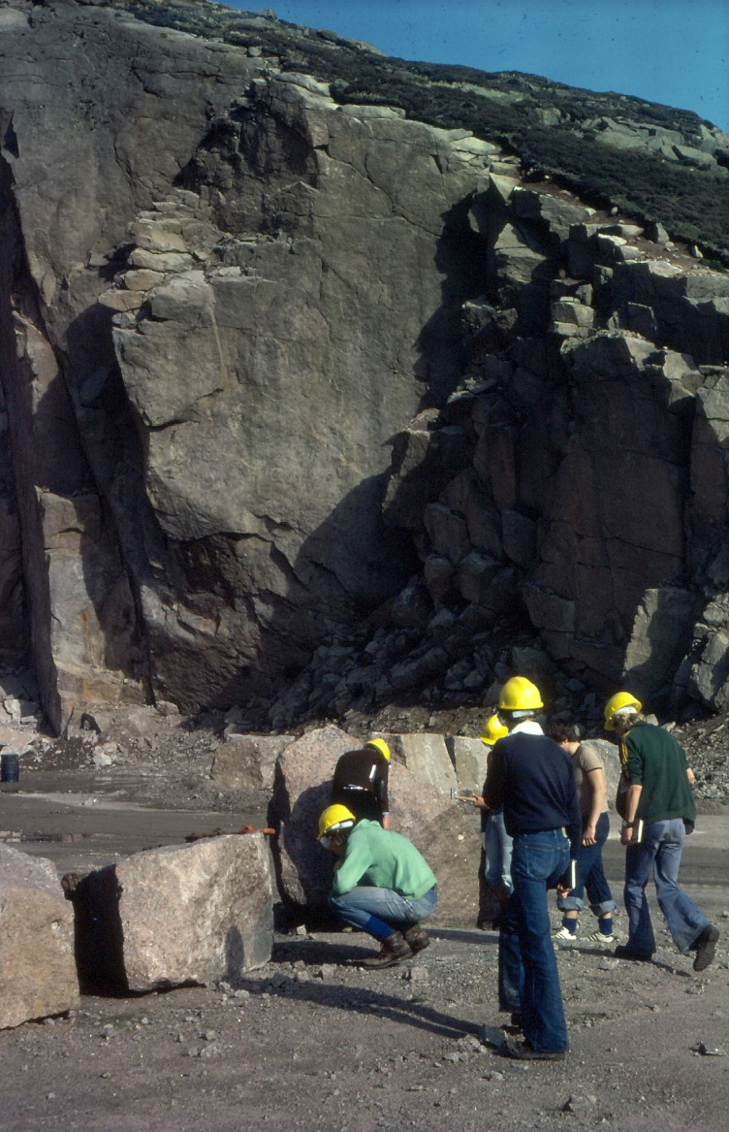
Any Quarry Guide
Focus 16: Quarry economics
Video – Quarry economics

Slide 27
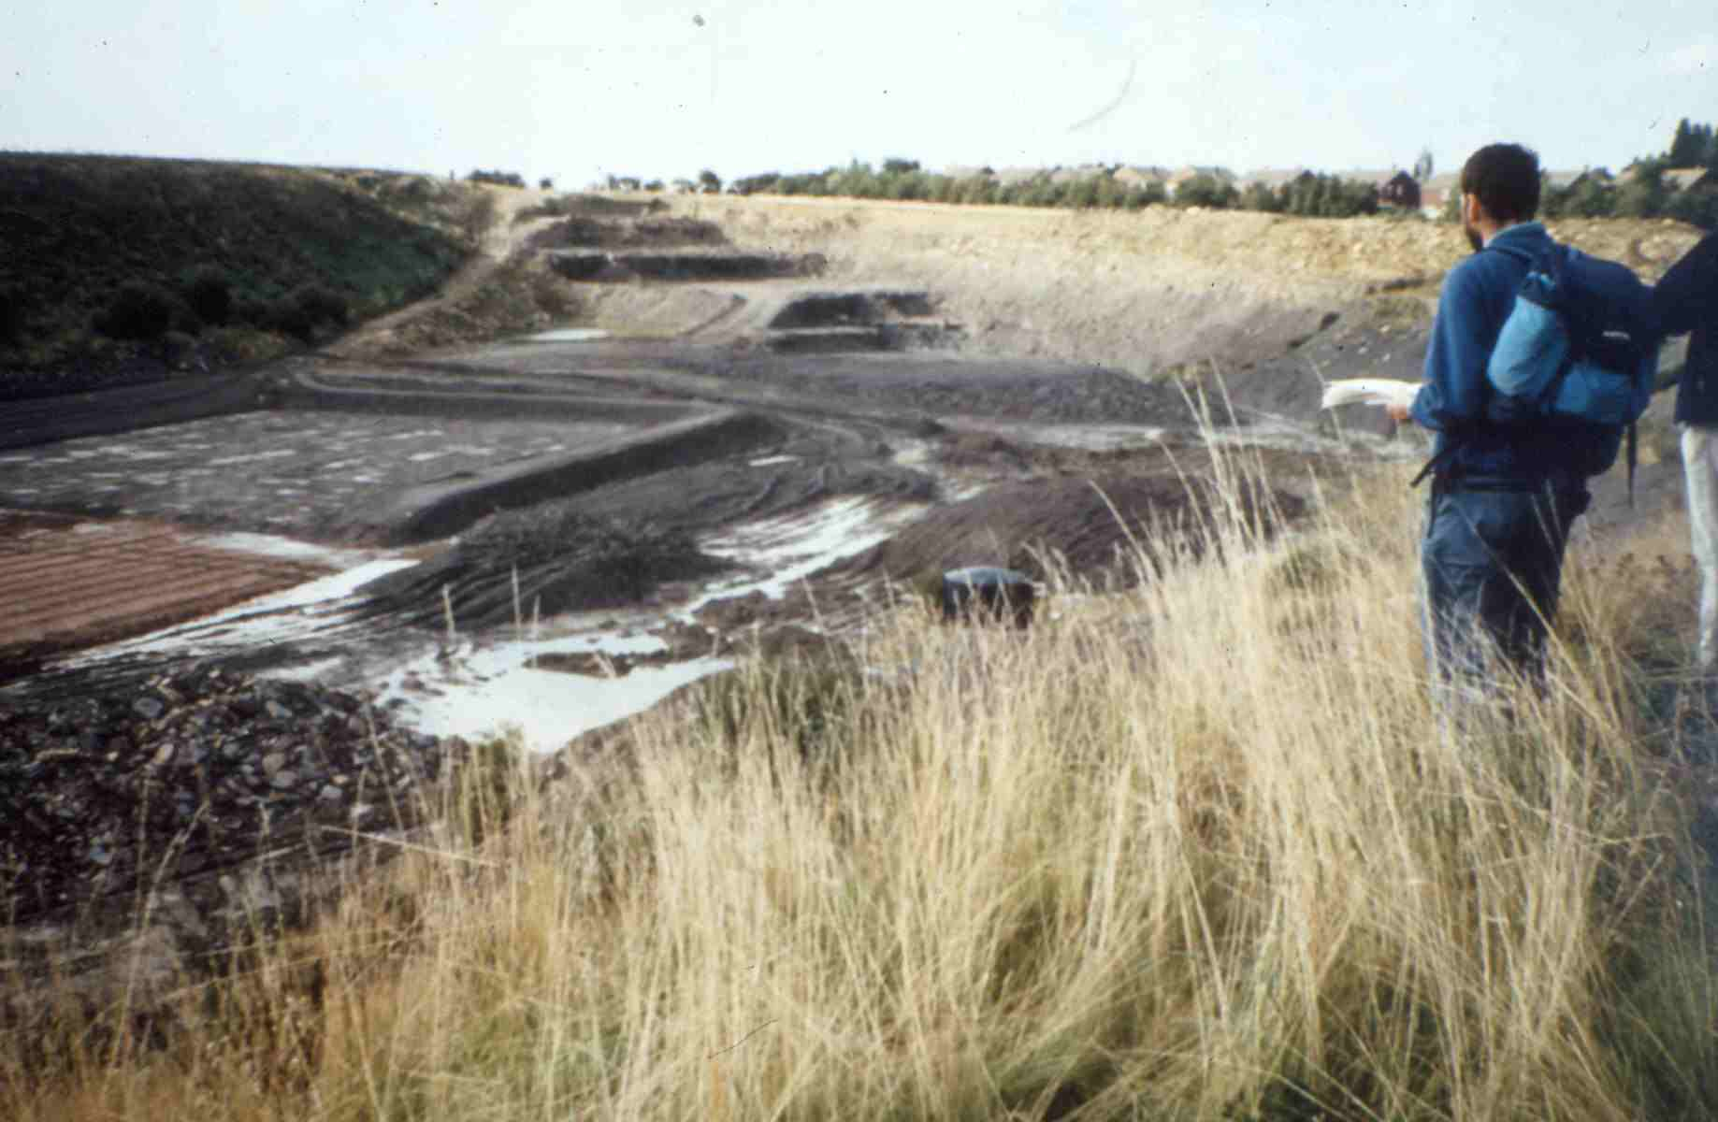
Any Quarry Guide
Focus 17: Quarry potential
Video – Quarry potential

Slide 28
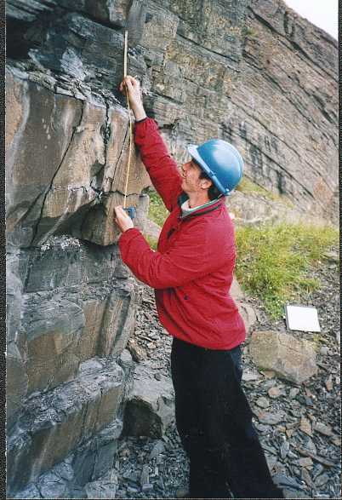
Any Quarry Guide
Focus 18: Recording

Slide 29
Any Quarry Guide
All photographs © Peter Kennett, Earthlearningidea

Slide 30
Any Quarry Guide
Workshop outcomes
The quarry visit provides the following outcomes:
identification of a range of rock types;
knowledge and understanding about processes of weathering, erosion and soil formation;
skills of thinking in three dimensions;
understanding how the geological history of an area can be elucidated;
experience of bridging school-based learning with the outside environment.
Notes:
<number>

Slide 31
Any Quarry Guide :
good questions to ask and answer
at a quarry, cliff face or rock face
Earth science out of doors
for KS3 science/geography
© Copyright is waived for original material contained in this workshop if it is required for use within the laboratory or classroom. Copyright material contained herein from other publishers rests with them. Any organisation wishing to use this material should contact the Earthlearningidea team.
Notes:
<number>

